Slide 1



Schizophrenia
Pharma Intelligence Disease Analysis
Publication Date: January 2024
www.datamonitorhealthcare.com

Slide 2
Key Takeaways
Datamonitor Healthcare estimates that in 2023, there were 25.4 million 12-month prevalent cases of schizophrenia in those aged 15 years and older worldwide, and forecasts that number to increase to 26.8 million cases by 2027.
The most recent high-impact events in the schizophrenia market include the FDA approvals of Lundbeck’s Abilify Asimtufii, Teva’s Uzedy, and Luye Pharma’s Rykindo, as well as an NDA filing for Minerva’s MIN-101. Additionally, topline Phase III data have been released for Uzedy, Karuna’s KarXT, Sumitomo’s SEP-363856, Reviva’s brilaroxazine, and BioXcel’s Igalmi. With the latest data release, Karuna now has three positive pivotal trials under its belt for KarXT in schizophrenia patients with psychosis.
The current dynamics of the antipsychotic market show domination by atypical antipsychotics, mainly oral agents, but there is also increasing uptake of long-acting injectable (LAI) neuroleptics, which will continue. Oral atypical antipsychotics that were historical blockbusters are now facing intense generic erosion. The best-selling oral antipsychotic Latuda lost exclusivity in February 2023. Generic atypical antipsychotics, such as olanzapine and risperidone, are widely used as first-line treatments.
Other newly marketed and pipeline antipsychotics look likely to maintain growth of the oral antipsychotic segment. Demand for both Rexulti and Vraylar, patent-protected until 2029 and 2028, respectively, looks set to continually increase over this decade. Rexulti and Vraylar are anticipated to take over as key branded products following the genericization of Latuda. Vraylar could even become an unprecedented treatment option for the negative symptoms of schizophrenia.
Johnson & Johnson’s Invega Sustenna and Invega Trinza remain highly competitive, leading the LAI market. In addition to succeeding oral Invega with a combined wealth of real-world data, these LAI formulations are highly appealing in the schizophrenia market since poor medication compliance rates are seen all too commonly. Furthermore, a longer, six-monthly formulation, Invega Hafyera, was approved by the FDA in August 2021. This is the first – and only – twice-yearly injectable for the treatment of schizophrenia, further tackling non-compliance for longer periods and reducing the burden of frequent healthcare visits for chronic schizophrenia patients.

Slide 3
Key Takeaways
In terms of aripiprazole LAIs, Otsuka/Lundbeck’s once-monthly Abilify Maintena (approved by the FDA in 2013) competes with Alkermes’ Aristada (aripiprazole lauroxil), which was first approved by the FDA in 2015 and is dosed once monthly, every six weeks, or every two months. Additionally, Lundbeck recently launched Abilify Asimtufii, which is a follow-on product from Maintena, with dosing every two months. Asimtufii was developed to offset the impending generic erosion of Maintena during 2024.
Risperidone LAI formulations have struggled to penetrate the market thus far due to a lack of differentiation. Johnson & Johnson’s Risperdal Consta, approved by the FDA in 2003, lost US market exclusivity in 2021, but no generics have been launched as the twice-monthly dosing schedule and oral supplementation required set it behind newer LAIs.
Although the current range of antipsychotics may provide some relief from positive symptoms in schizophrenia patients, there are still several large unmet needs that remain. Some of the greatest unmet needs include drugs targeting the negative and cognitive symptoms of schizophrenia, drugs with improved tolerability, therapies encouraging enhanced compliance rates, and more effective treatment options for refractory schizophrenia. All drugs studied for negative symptoms so far have failed to show clinically meaningful efficacy benefit. Newly approved and pipeline therapies are being positioned to target these unmet needs.
Hoping to make an impact on the crowded LAI market are Teva’s recently FDA-approved Uzedy and Laboratorios Farmacéuticos ROVI’s pipeline asset Risvan, which are both risperidone formulations. Uzedy is the first risperidone LAI offering an injection interval of two months. Already approved for schizophrenia treatment in Europe under the name Okedi, Risvan incorporates ROVI’s in situ microimplants technology with the aim of overcoming some of the drawbacks associated with risperidone LAIs such as the use of loading doses or the need for oral risperidone supplementation at the start of treatment. It lacks advantages over Uzedy in terms of dosing frequency, but is differentiated by its efficacy in acute schizophrenia.
Alkermes’ Lybalvi, a distinct formulation of olanzapine and the novel opioid receptor antagonist samidorphan, is a recently FDA-approved antipsychotic designed to provide the efficacy of olanzapine while mitigating olanzapine-associated weight gain. It is useful for patients who have responded well to olanzapine, but it is competing with antipsychotics that cause even less weight gain, such as Latuda, Caplyta, and Vraylar, particularly in the stable patient market.

Slide 4
Key Takeaways
SEP-363856, a novel schizophrenia pipeline candidate from Sumitomo Pharma, has the potential to be a first-in-class trace amine-associated receptor 1 (TAAR1) agonist. Phase II results were promising, demonstrating a statistically significant and clinically meaningful improvement in Positive and Negative Syndrome Scale (PANSS) total score compared to placebo at four weeks; however, the drug has since failed two Phase III trials.
Karuna Therapeutics’ KarXT combines xanomeline, a novel muscarinic agonist, with trospium, an approved (outside of schizophrenia) muscarinic antagonist, and is being primarily developed for the treatment of acute psychosis in adults with schizophrenia. Effect sizes so far compare well to widely prescribed antipsychotics such as Risperdal, but its differentiating factors include a strong tolerability profile and its potential to treat cognitive symptoms.
Reviva’s brilaroxazine produced strong efficacy and safety data in its Phase III trial but may struggle to compete on the market, if approved. Brilaroxazine belongs to a class of third-generation antipsychotics called dopamine-serotonin system stabilizers, although it has close structural similarity to aripiprazole. Reviva aims for brilaroxazine to achieve a mix of modulation to drive strong efficacy while reducing the side effects associated with many marketed atypical antipsychotics.
Minerva’s MIN-101 previously established efficacy in treating negative symptoms in a large, controlled Phase IIb trial. However, more recently, Minerva released Phase III trial results illustrating the pipeline drug’s failure to separate from placebo on the primary endpoint associated with schizophrenia negative symptoms. Minerva received a refuse to file letter in October 2022 after its NDA filing, but the company resubmitted an NDA in May 2023. The potential of MIN-101 in this indication remains uncertain. A potential competitor of MIN-101, Nuplazid, is a pipeline agent also targeting the 5-HT2A receptor. Comparably, it is being developed to treat the negative symptoms of schizophrenia while avoiding the long-term dopaminergic-related adverse effects that accompany many antipsychotics currently on the market.
A number of high-impact upcoming events for schizophrenia drugs are expected during 2024, including Phase III trial data for KarXT (evaluating efficacy and safety in acutely psychotic hospitalized adults with DSM-5 schizophrenia) and Nuplazid (evaluating efficacy and safety as an adjunctive treatment for the negative symptoms of schizophrenia), as well as US approval decisions for KarXT and MIN-101.

Slide 5
Table of Contents
Disease Background and Treatment
Epidemiology
Drug Landscape
  Marketed Drugs
  Pipeline Drugs
  Key Regulatory Events
  Probability of Success
  Licensing and Asset Acquisition Deals
Clinical Trial Landscape
Market Assessment and Disease Analysis
  Drug Assessment Model
  Market Dynamics
  Future Trends
  Consensus Forecasts
  Recent Events and Analyst Opinion
  Key Upcoming Events
  Key Opinion Leader Insights
  Unmet Needs

Slide 6
Disease Background and Treatment

Slide 7
Disease Background
Definition
Schizophrenia is a serious mental illness distinguished by incoherent thoughts, bizarre behavior, and delusions or hallucinations. The American Psychiatric Association (APA) defines schizophrenia as a chronic brain disorder which actively presents with delusions, hallucinations, lack of motivation, and issues with thinking and concentration. The World Health Organization (WHO) states that it is characterized by significant impairments in the way reality is perceived. Schizophrenia is a psychotic disorder that typically first presents in adolescence and young adulthood. The condition is associated with a prodromal period that can last for months or years, during which emotional, behavioral, and attenuated psychotic symptoms first appear. It is frequently associated with significant distress and impairment in personal, family, social, educational, occupational, and other important areas of life.
Schizophrenia is heterogeneous in its clinical presentation. The symptoms of schizophrenia can be broadly classified into three groups: positive symptoms, negative symptoms, and cognitive symptoms. Unlike bipolar disorder, there are few affective symptoms, although the negative symptoms of schizophrenia can be mistaken for depression. To qualify for a diagnosis of schizophrenia, patients must have at least one positive symptom, including delusions, hallucinations, or disorganized speech, while there can be considerable variability in the wider presentation. See the following figure for a more granular breakdown of disease symptoms and explanations.
Source: APA, 2020; NAMI, 2023; NHS, 2023; WHO, 2022

Slide 8
Disease Background
Symptoms
Positive symptoms
Negative symptoms
Cognitive deficits
Hallucination
Profoundly distorted reality perception occurring through any sensory experience
Delusion
A false personal belief, not subject to reason or a person’s usual cultural/religious concepts
Maintained despite contrary incontrovertible evidence
Thought disorder
Unusual/dysfunctional thought processes leading to abnormal organization and expression of thoughts
Movement disorder
Agitated body movements – repetition of motions
Catatonia – lack of movement/responsiveness to others
Flat affect
Severe reduction in emotional expressiveness
Anhedonia
Loss of capacity to experience pleasure
Inability to gain pleasure from normally pleasurable experiences
Avolition
General lack of drive/motivation for goals/work/socializing
Alogia
General lack of additional, unprompted content seen in normal speech
Asociality
Lack of a strong motivation to engage in social interaction and/or the preference for solitary activities
Executive function
Impaired ability to organize thoughts and activities, prioritize tasks, manage time, and make decisions
Attention
Lack of ability to focus selectively on a stimulus, sustaining that focus and shifting it at will
Working memory
Trouble executing complex cognitive tasks, such as learning, reasoning, and comprehension
Source: Dryden-Edwards, 2018; NAMI, 2023

Slide 9
Disease Background
Patient segmentation
Schizophrenia is widely accepted as a highly heterogenous disorder, and there is little evidence to support discrete subtypes. However, certain elements in patients and the disorder have been utilized in categorization attempts, including whether a patient is experiencing their first episode, or whether they have experienced multiple episodes. Other attempts at subtype classification have included whether patients are responsive to treatments or not, the disease phase (acute or stable), and also the persistence of certain symptom types, for example negative symptoms.
Risk factors
Genetic risk factors
The World Federation of Societies of Biological Psychiatry (WFSBP) has published a consensus paper regarding the genetics of schizophrenia. In the paper, it is found that the genetic component of schizophrenia has an up to 80% contribution to its etiology. Heritability of the disease is estimated to be around 64–81%, and mode of inheritance is complex, involving the interplay of large numbers of genetic variants. Thus far, only a small fraction of schizophrenia’s genetic architecture has been successfully identified.
Candidate gene studies have elucidated the role of genes participating in the modulation of dopamine (including COMT and DRD2–4), serotonin neurotransmission (e.g., HTR2A), neuronal development and function, glutamate, and the immune system (IL-1β). Notably, COMT and AKT1 gene polymorphisms predispose individuals to cannabinoid-related psychosis. Meta-analyses have identified 13 common gene variants across schizophrenia, bipolar disorder, major depressive disorder, attention deficit hyperactivity disorder, and anxiety disorders. This may be indicative of pleiotropy.
Source: Gatt et al., 2015; Giegling et al., 2017; Radhakrishnan et al., 2017; Rolls et al., 2017

Slide 10
Disease Background
Environmental risk factors
There is some evidence for gene-environment interactions in schizophrenia, whereby the presence of a gene influences individuals’ vulnerability to environmental factors. It has been highlighted that repetitive stress exacerbates psychopathological response to subsequent exposures. In particular, proxies for environmental stressors include:
migration
lack of social support
urbanicity
negatively expressed emotions.
The wider literature also suggests involvement of numerous other risk-associated exposures, including:
childhood maltreatment
drug abuse (particularly cannabis)
pregnancy complications
paternal age.
Prenatal environmental effects are likely mediated through direct central nervous system (CNS) injury and epigenetic genome misregulation. On the other hand, postnatal risk factors may have an influence through potentiation of key CNS pathways in schizophrenia. Furthermore, it has been hypothesized that the environmental modulation of immune mechanisms underlies the etiopathogenesis of psychosis spectrum disorders.
Source: Giegling et al., 2017; Pelayo-Terán et al., 2012; Radhakrishnan et al., 2017

Slide 11
Disease Background
Diagnosis
Diagnosis of schizophrenia is dependent upon assessment by a mental health specialist in line with the criteria stipulated in the fifth edition of the Diagnostic and Statistical Manual of Mental Disorders (DSM-V). Currently, there is a lack of radiological, laboratory, or psychometric tests to facilitate diagnosis of the condition.
To achieve diagnosis, mental health specialists monitor disease course over a six-month period, evaluating the presentation of diagnostic criteria summarized in the figure below. Differential diagnosis is crucial as schizophrenia is a heterogenous syndrome akin to several psychotic disorders. Importantly, cases of schizoaffective, depressive, or bipolar disorder with psychotic features must be excluded. Furthermore, it must be ensured that the disturbance is not a physiological effect of a substance or another medical condition.
DSM-V DIAGNOSTIC CRITERIA (A-C)
(Each criterion present for a significant proportion of at least a one-month period)
(A) ≥2 of the following criteria, including ≥1 bold criterion:
Delusions
Hallucinations
Disorganized speech (e.g., frequent derailment or incoherence)
Grossly disorganized/catatonic behavior
Negative symptoms (e.g., diminished emotional expression or avolition)
(B) Social/occupational dysfunction in ≥1 major area (e.g., work, interpersonal relations, or self-care)
(C) Continuous signs persist for ≥6 months (including criterion (A) and possibly periods of prodromal/residual symptoms)
Source: APA, 2013

Slide 12
Treatment
Pharmacological versus non-pharmacological therapy
Non-pharmacological and pharmacological approaches are utilized in schizophrenia treatment. The mainstay of treatment is drug therapy, while non-pharmacological psychotherapies are used in a complementary fashion to bridge treatment gaps and crucially improve compliance. An array of non-pharmacological therapies can be used to optimize treatment outcomes, including:
cognitive behavioral therapy
compliance therapy
social skills therapies
counseling
vocational sheltered employment rehabilitation therapies
interactive/social group therapy.
Drug approaches
High pharmacological treatment rates are to be expected given the severity of symptomatology and consequences of untreated schizophrenia. While the vast majority of schizophrenic patients will be recommended pharmacological treatment, evidence stresses the importance of immediate drug treatment in the acute phases of schizophrenia, whether that be a first episode or exacerbation, as it is desirable to optimize treatment outcomes and improve longer-term prognosis. Similarly, antipsychotics are a mainstay in the maintenance treatment of this chronic disorder, as they have consistently been shown to effectively reduce the number and severity of relapses and the need for hospitalization.
Source: Leucht et al., 2012; Patel et al., 2014

Slide 13
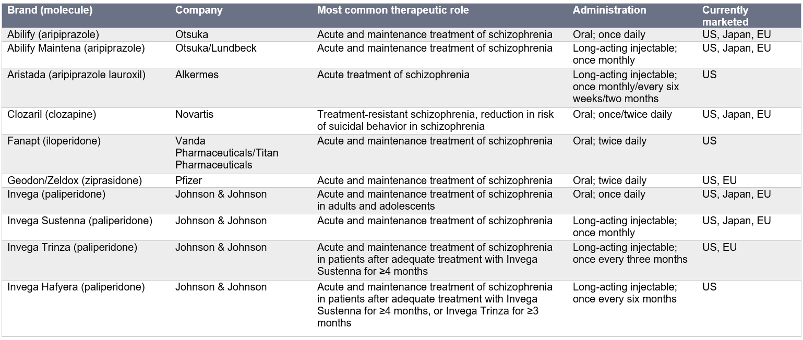
Treatment
Atypical antipsychotics are a staple for the pharmacological treatment of schizophrenia. The vast majority of leading therapies are approved for the acute and maintenance treatment of schizophrenia. The table below summarizes the leading products available for schizophrenia in the US, Japan, and five major European markets (France, Germany, Italy, Spain, and the UK).
[continued on next slide]
Source: Datamonitor Healthcare; Biomedtracker

Slide 14
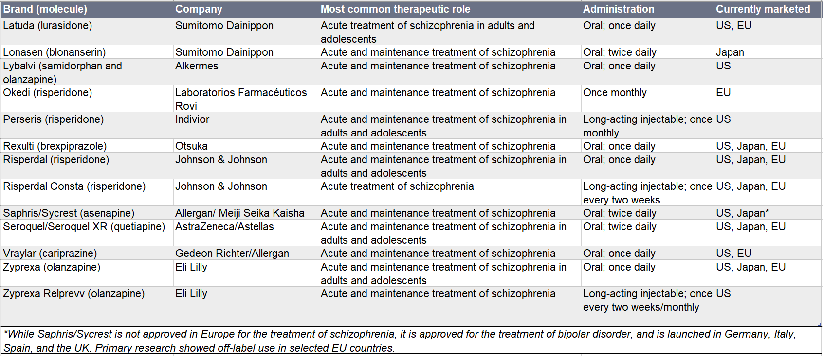
Treatment
Source: Datamonitor Healthcare; Biomedtracker

Slide 15
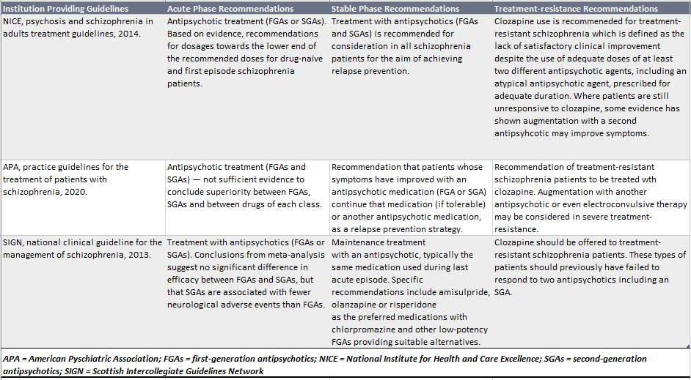
Treatment
Key treatment guideline recommendations
Source: APA, 2020; NICE, 2014; SIGN, 2013

Slide 16
Epidemiology

Slide 17
Epidemiology
Prevalence
Methodology
Datamonitor Healthcare used historical prevalence data to estimate and forecast the global 12-month prevalence of schizophrenia in those aged 15 years and older in the United Nations (UN) world regions (World, Africa, Asia, Europe, Latin America and the Caribbean, Northern America, and Oceania) between 2018 and 2027. Individuals below 15 years of age were excluded from this analysis because the diagnosis of schizophrenia is rare in this age group.
To calculate the number of 12-month prevalent cases of schizophrenia in the 2018–27 forecast period, Datamonitor Healthcare extracted region-specific 12-month prevalence proportions from Simeone et al. (2015) for Africa, Asia, Europe, Northern America, and Oceania. The overall 12-month prevalence proportion extracted from Simeone et al. was then also assumed for the Latin America and the Caribbean region. Region-specific prevalence proportions were multiplied by the corresponding region-specific population estimates from the UN World Population Prospects database. The UN database was chosen as a reliable population denominator; the data include standard sets of demographic indicators.
Included are estimated 12-month prevalent cases of schizophrenia during 2018–27.
Source: Datamonitor Healthcare; Simeone et al., 2015; United Nations, 2019

Slide 18
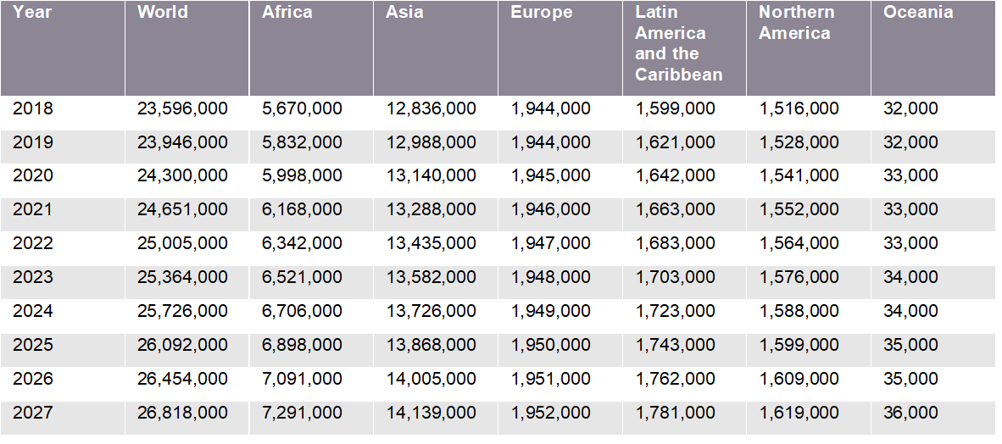
12-Month Prevalent Cases of Schizophrenia, 2018–27
Note: totals may not sum due to rounding.
Datamonitor Healthcare estimates that in 2023, there were 25.4 million 12-month prevalent cases of schizophrenia in those aged 15 years and older worldwide, and forecasts that number to increase to 26.8 million cases by 2027.
Asia is estimated to have had the largest number of 12-month prevalent cases in those aged 15 years and older in 2023 (13.6 million cases), while the Oceania region is estimated to have had the smallest number (34,000 cases).
Source: Datamonitor Healthcare; Li et al., 2018; Niu et al., 2017; Plassman et al., 2007; United Nations, 2019
Source: Datamonitor Healthcare; Simeone et al., 2015; United Nations, 2019

Slide 19
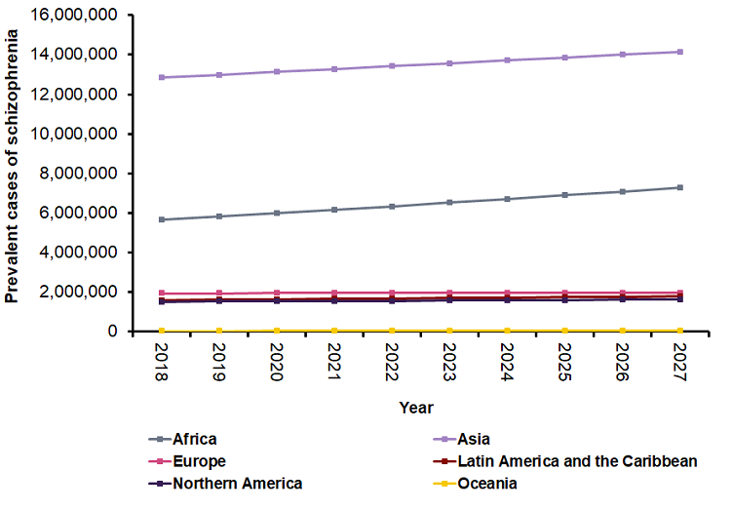
Trends in 12-Month Prevalent Cases of Schizophrenia, 2018–27
Datamonitor Healthcare forecasts the number of prevalent cases of schizophrenia to increase by 13.7% worldwide between 2018 and 2027.
This trend is driven by population demographics, as prevalence proportions were held constant throughout the forecast period.
Source: Datamonitor Healthcare; Simeone et al., 2015; United Nations, 2019

Slide 20
Drug Landscape

Slide 21
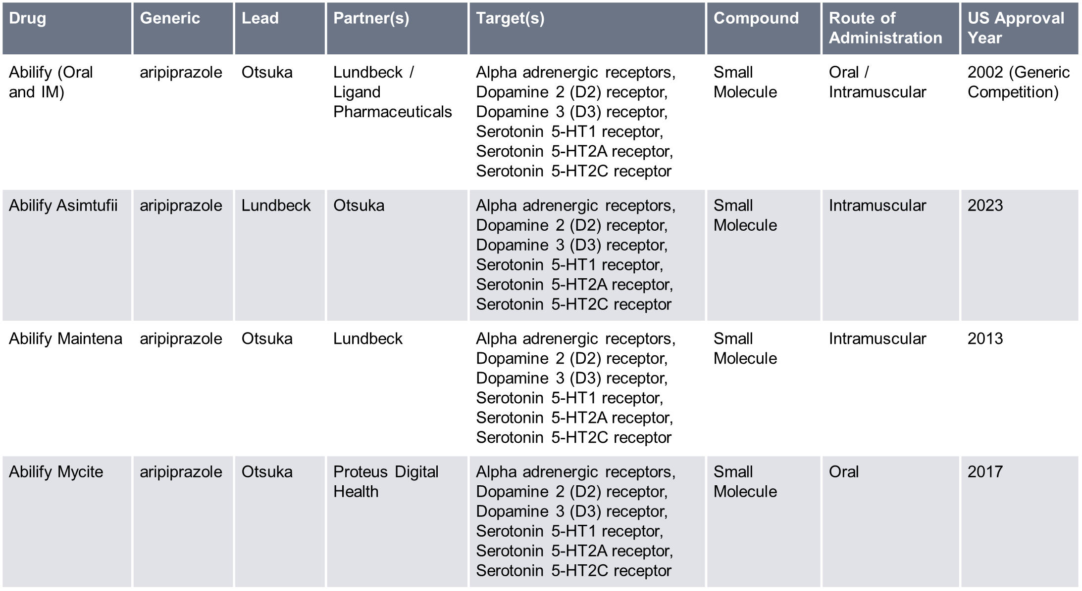
Marketed Drugs
This is a snapshot of approved drugs in the schizophrenia space in the curated Biomedtracker database. The vast majority of drugs on the market for schizophrenia mediate their effects through the dopaminergic and/or serotonergic pathways, with newer entrants tending to be reformulations or long-acting injectables (LAIs).
Source: Biomedtracker 16 January 2024; Pharmaprojects

Slide 22
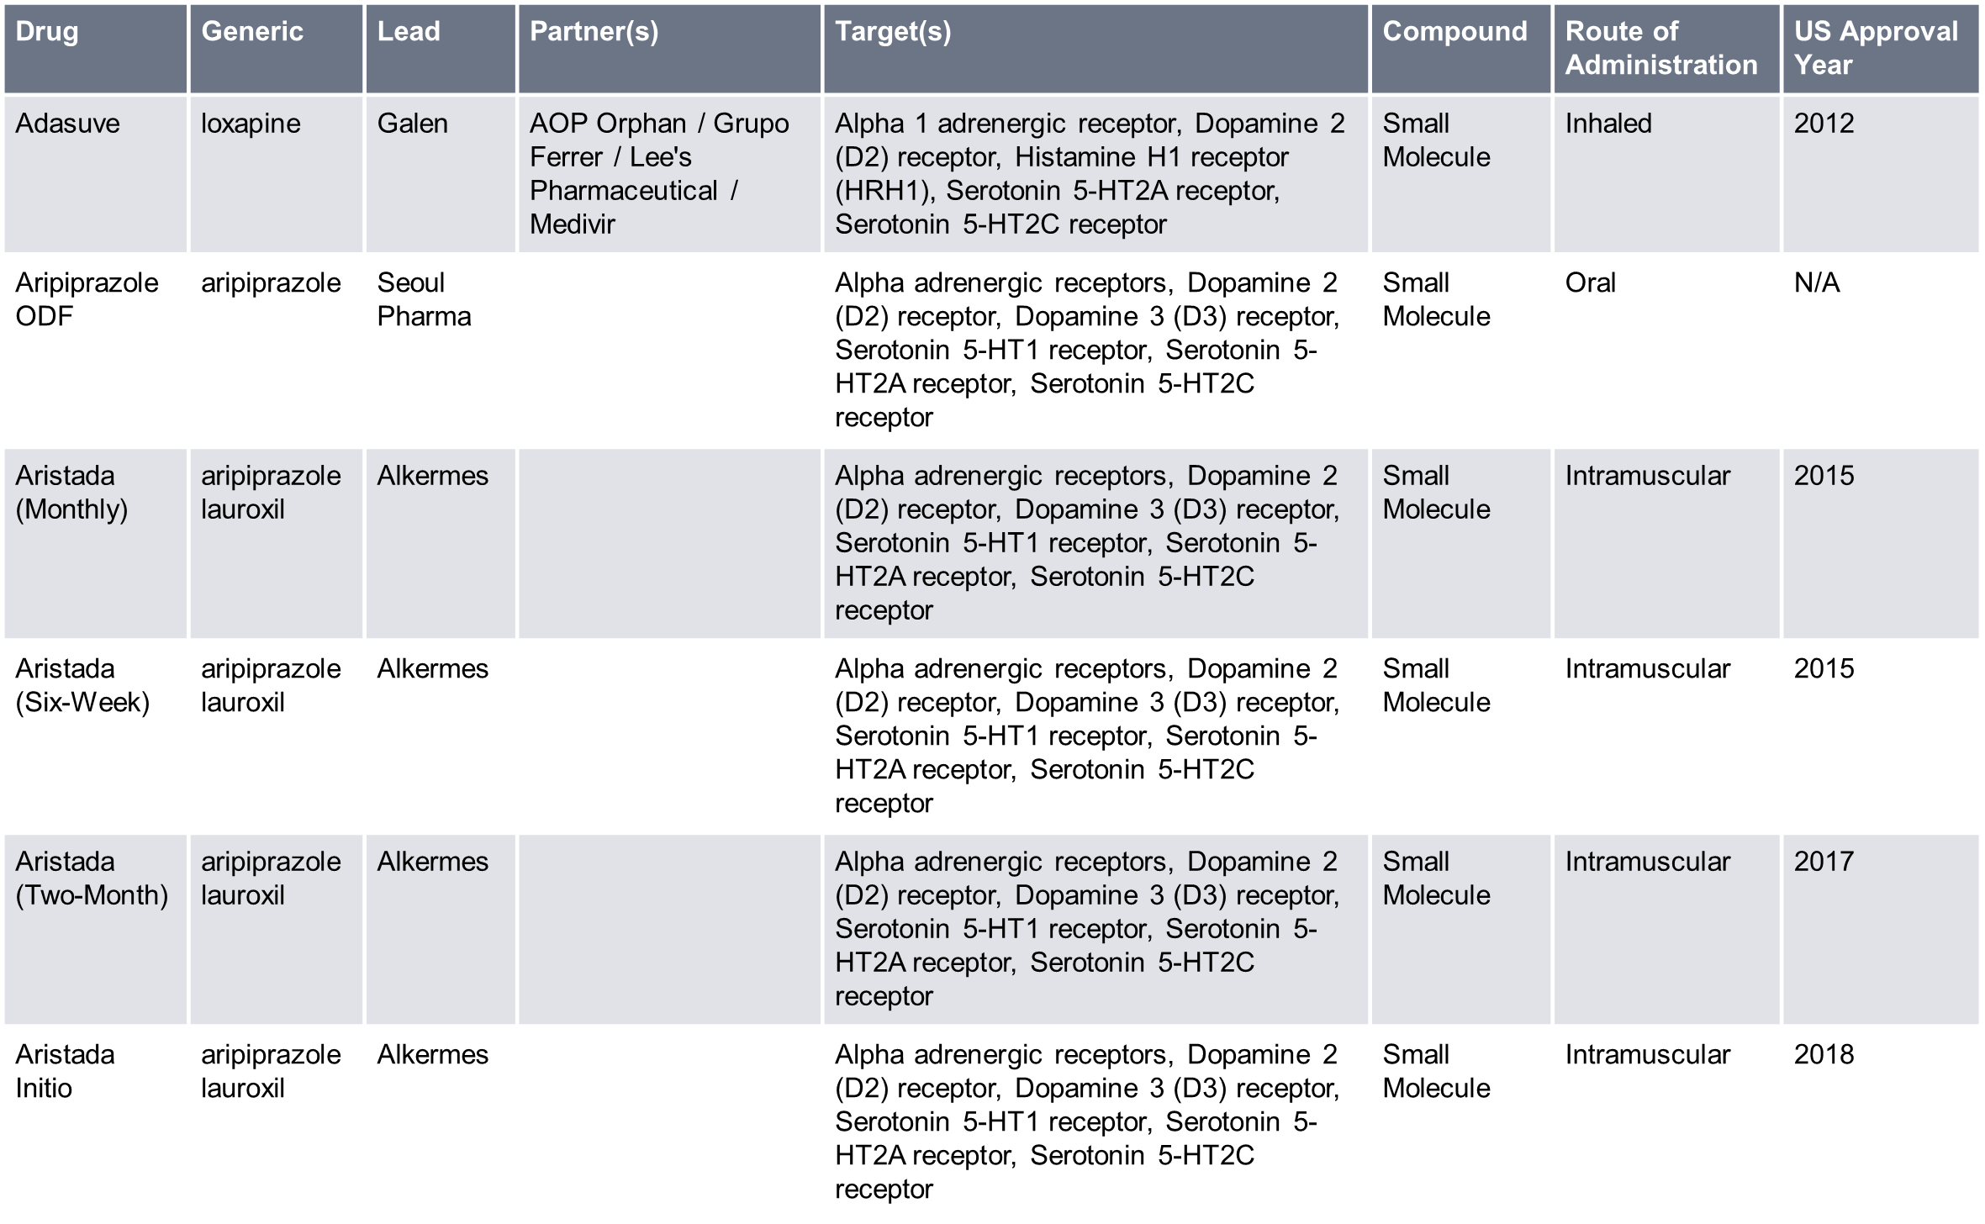
Marketed Drugs
Source: Biomedtracker 16 January 2024; Pharmaprojects

Slide 23
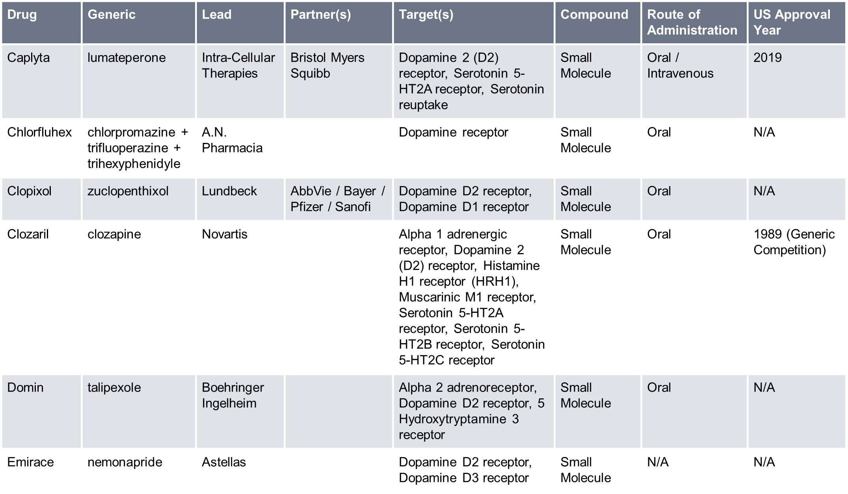
Marketed Drugs
Source: Biomedtracker 16 January 2024; Pharmaprojects

Slide 24
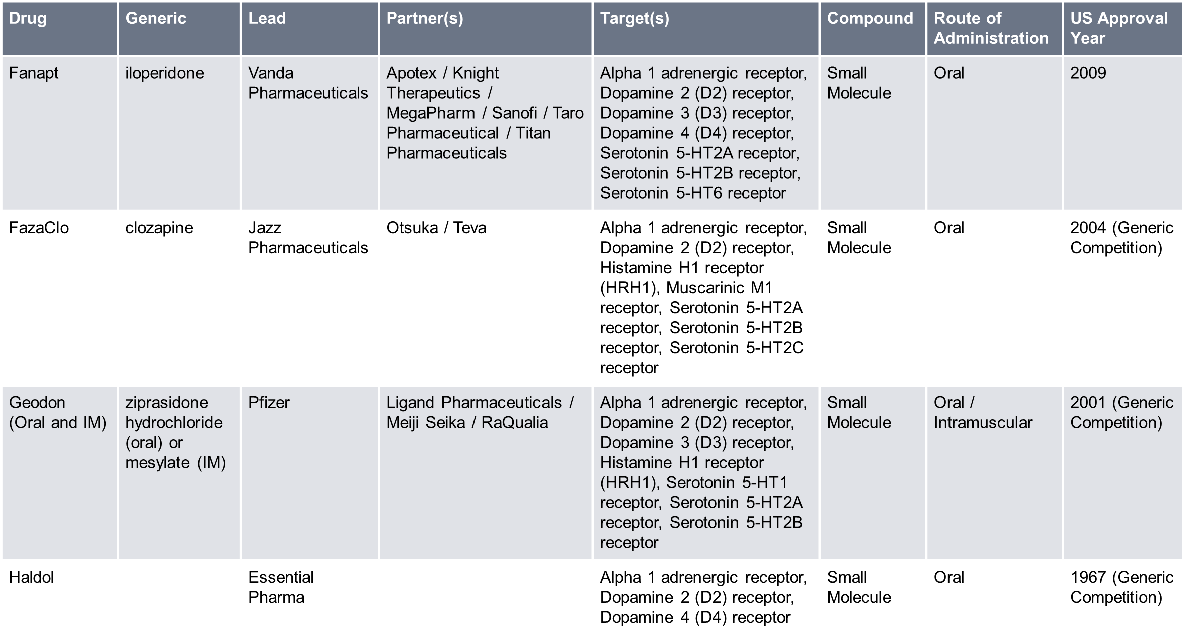
Marketed Drugs
Source: Biomedtracker 16 January 2024; Pharmaprojects

Slide 25
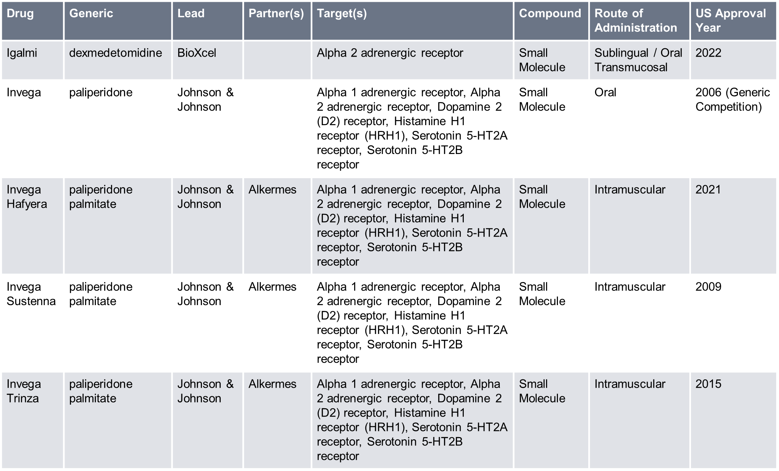
Marketed Drugs
Source: Biomedtracker 16 January 2024; Pharmaprojects

Slide 26
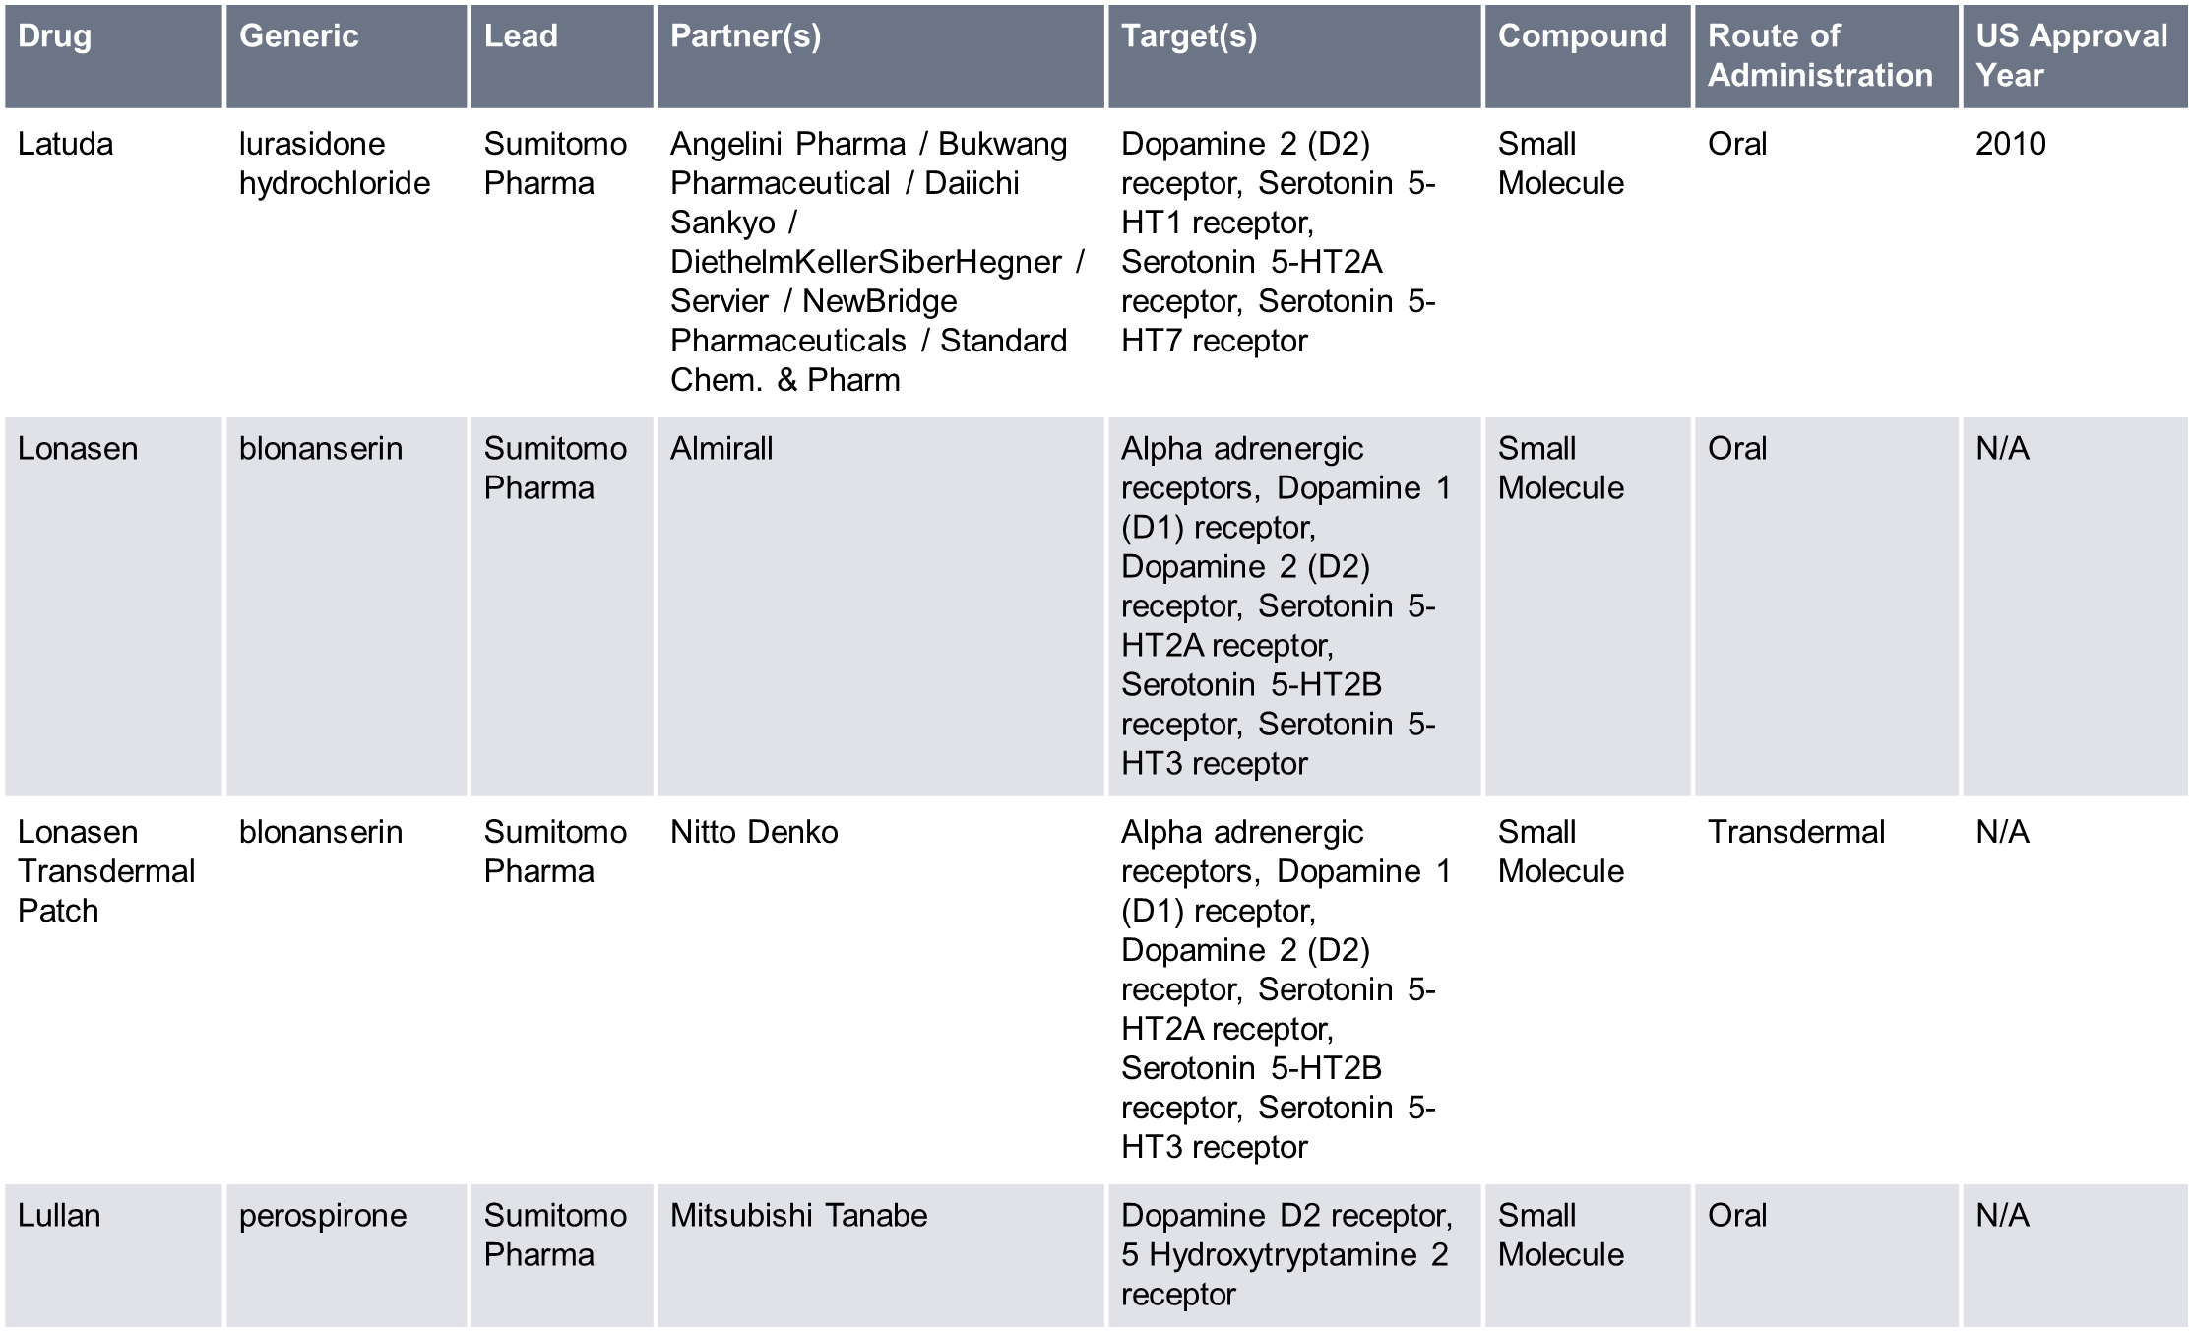
Marketed Drugs
Source: Biomedtracker 16 January 2024; Pharmaprojects

Slide 27
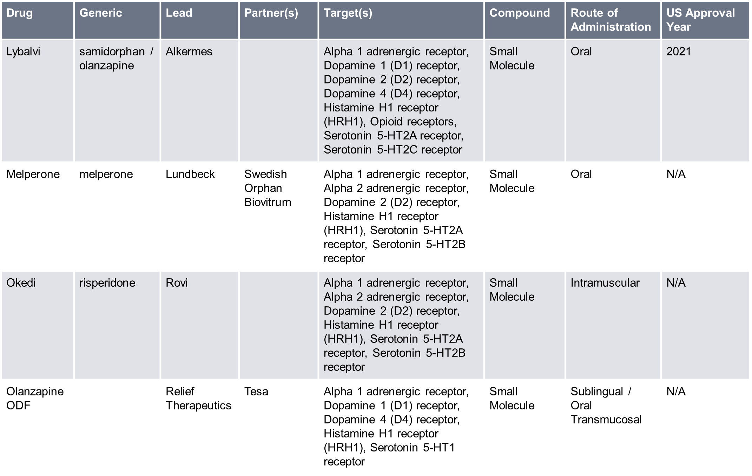
Marketed Drugs
Source: Biomedtracker 16 January 2024; Pharmaprojects

Slide 28
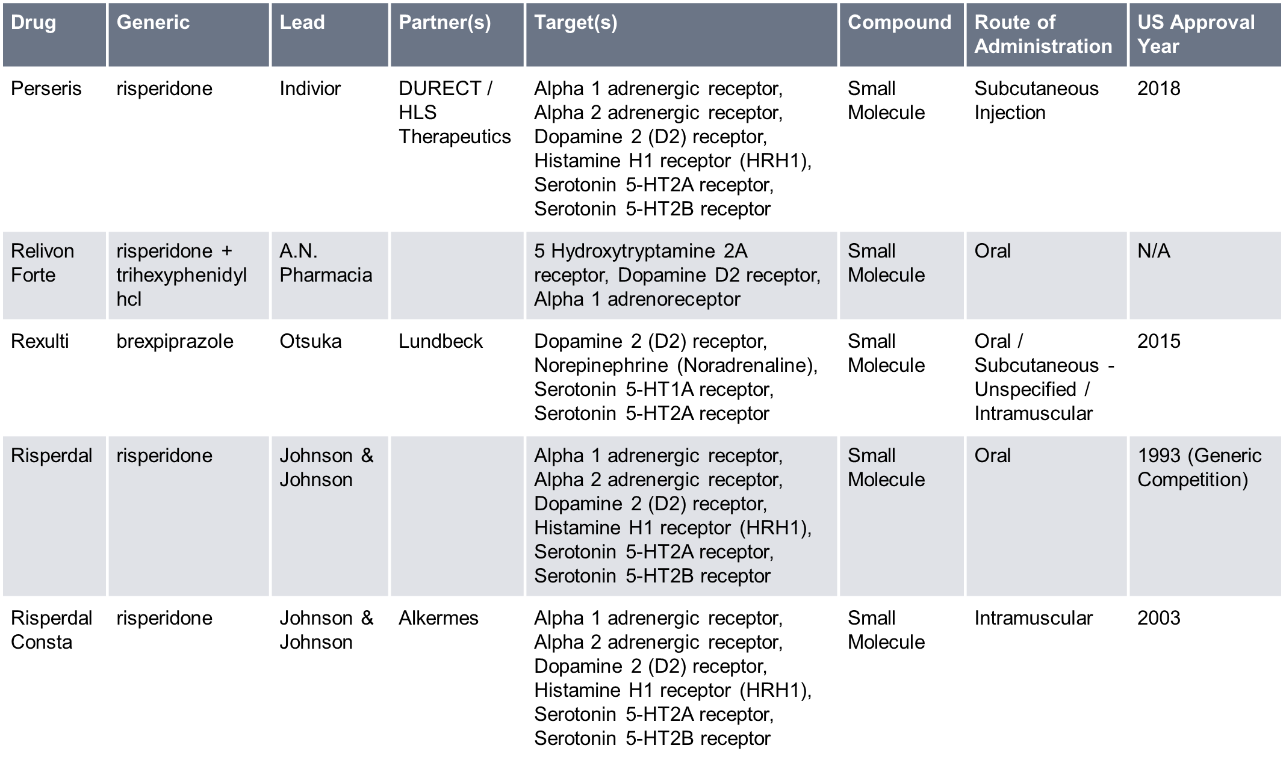
Marketed Drugs
Source: Biomedtracker 16 January 2024; Pharmaprojects

Slide 29
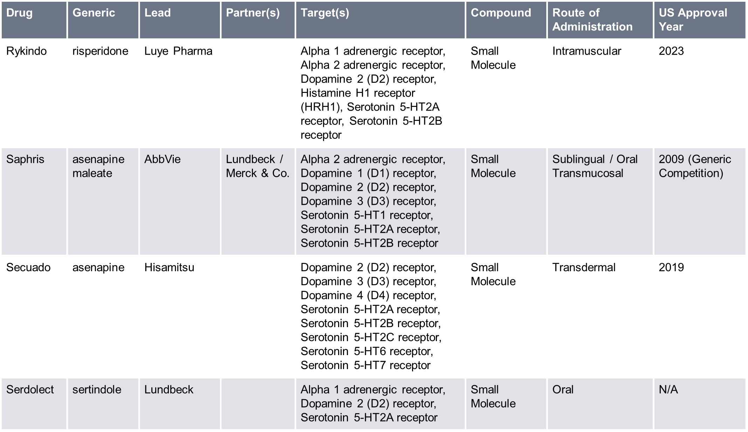
Marketed Drugs
Source: Biomedtracker 16 January 2024; Pharmaprojects

Slide 30
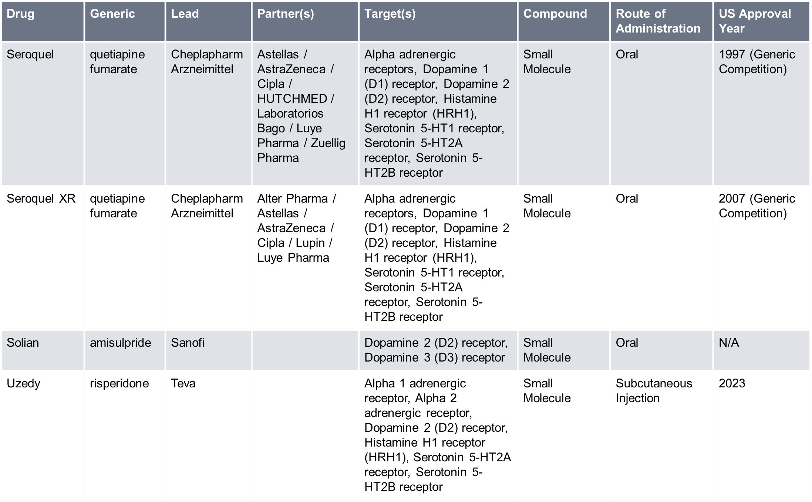
Marketed Drugs
Source: Biomedtracker 16 January 2024; Pharmaprojects

Slide 31
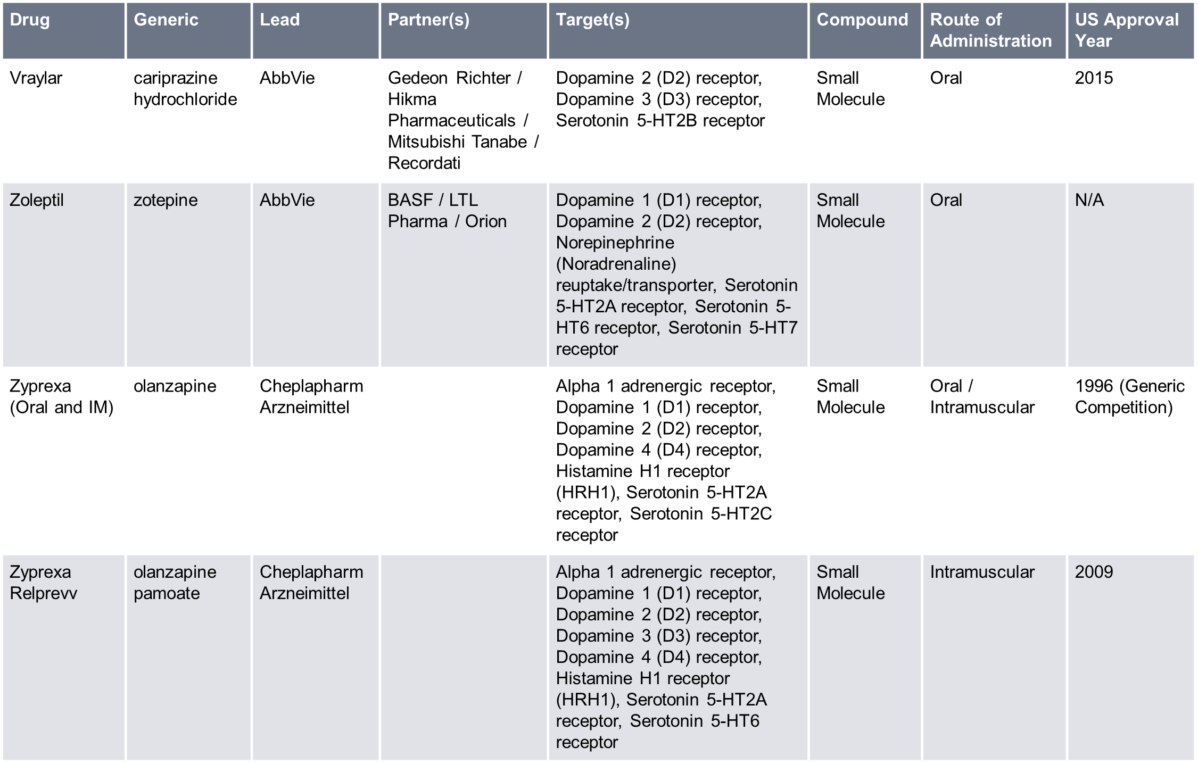
Marketed Drugs
Source: Biomedtracker 16 January 2024; Pharmaprojects

Slide 32
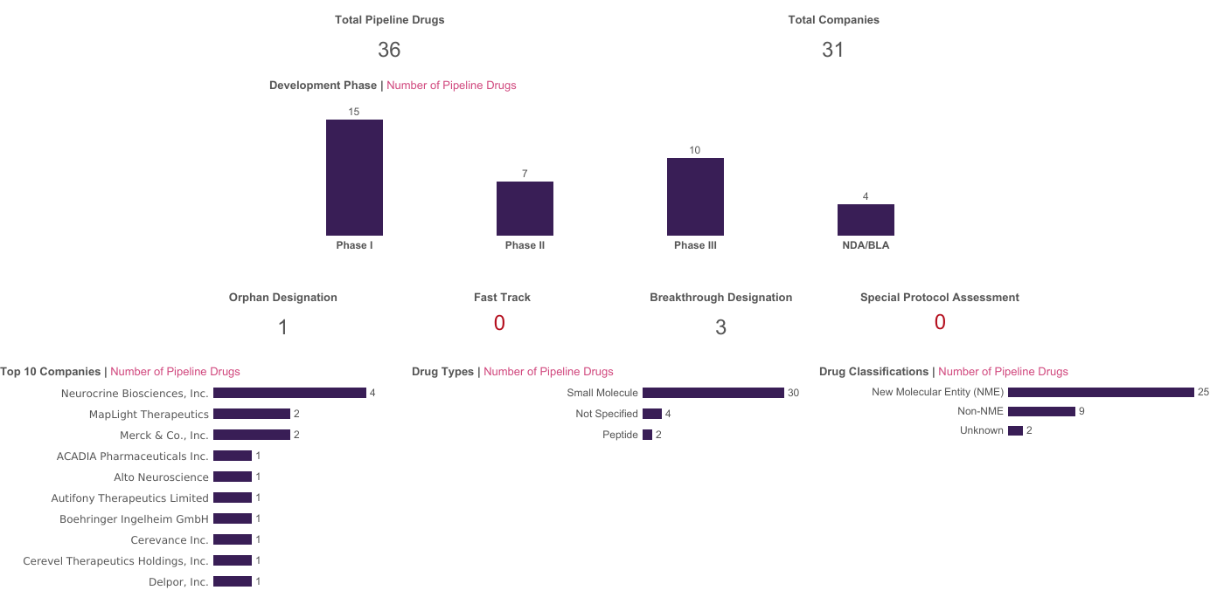
Pipeline Drugs in the US
This is a snapshot of Phase I–III and New Drug Application (NDA) or Biologics License Application (BLA) candidate drugs in the schizophrenia space in the curated Biomedtracker database. A number of new therapies are expected to enter the market in the near term, with four pipeline candidates currently at the NDA/BLA stage, and 10 in Phase III. Preclinical, Investigator Initiated, and Investigational New Drug (IND) candidates are not included here. Phase I/II and Phase II/III are counted as Phase II and Phase III, respectively.
Source: Biomedtracker 16 January 2024

Slide 33
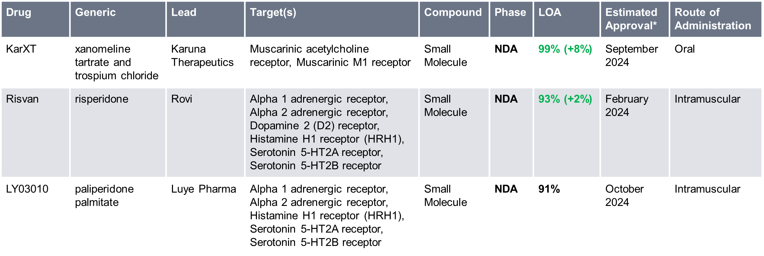
Pipeline Drugs in the US
This is a snapshot of Phase I–III and NDA or BLA candidate drugs in the schizophrenia space in the curated Biomedtracker database. Pipeline compounds seem to be most commonly directed at dopamine and serotonin receptors, but there are some drugs in development against novel schizophrenia targets, including the NMDA receptor and D-amino-acid oxidase.
Likelihood of Approval (LOA) refers to the chance of FDA approval of an NDA or BLA. The average chance of FDA approval for marketing in the US for the specified disease was based on the historical performance of drugs in the same development phase as per a 2003–13 analysis of the Biomedtracker database published in the peer-reviewed journal, Nature Biotechnology. These numbers have since been updated to reflect the years 2011–20. Biomedtracker analysts view the average approval chance as a starting point for analyzing specific data on the drug to arrive at the LOA. The difference from the average approval chance is indicated here in parentheses.
Source: Biomedtracker 16 January 2024; Datamonitor Healthcare

Slide 34
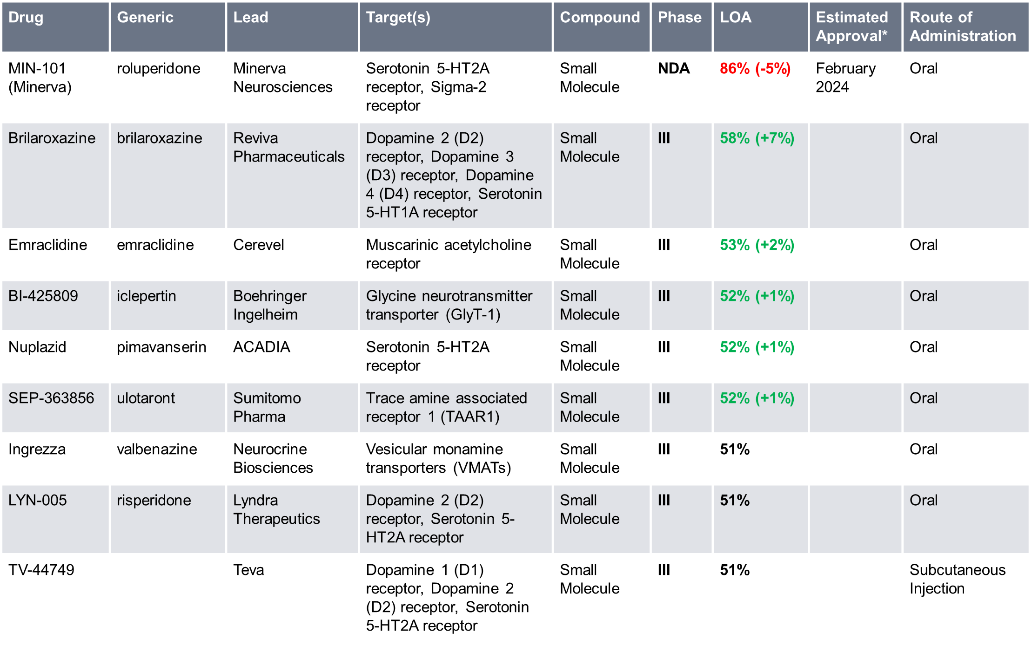
Pipeline Drugs in the US
Source: Biomedtracker 16 January 2024; Datamonitor Healthcare

Slide 35
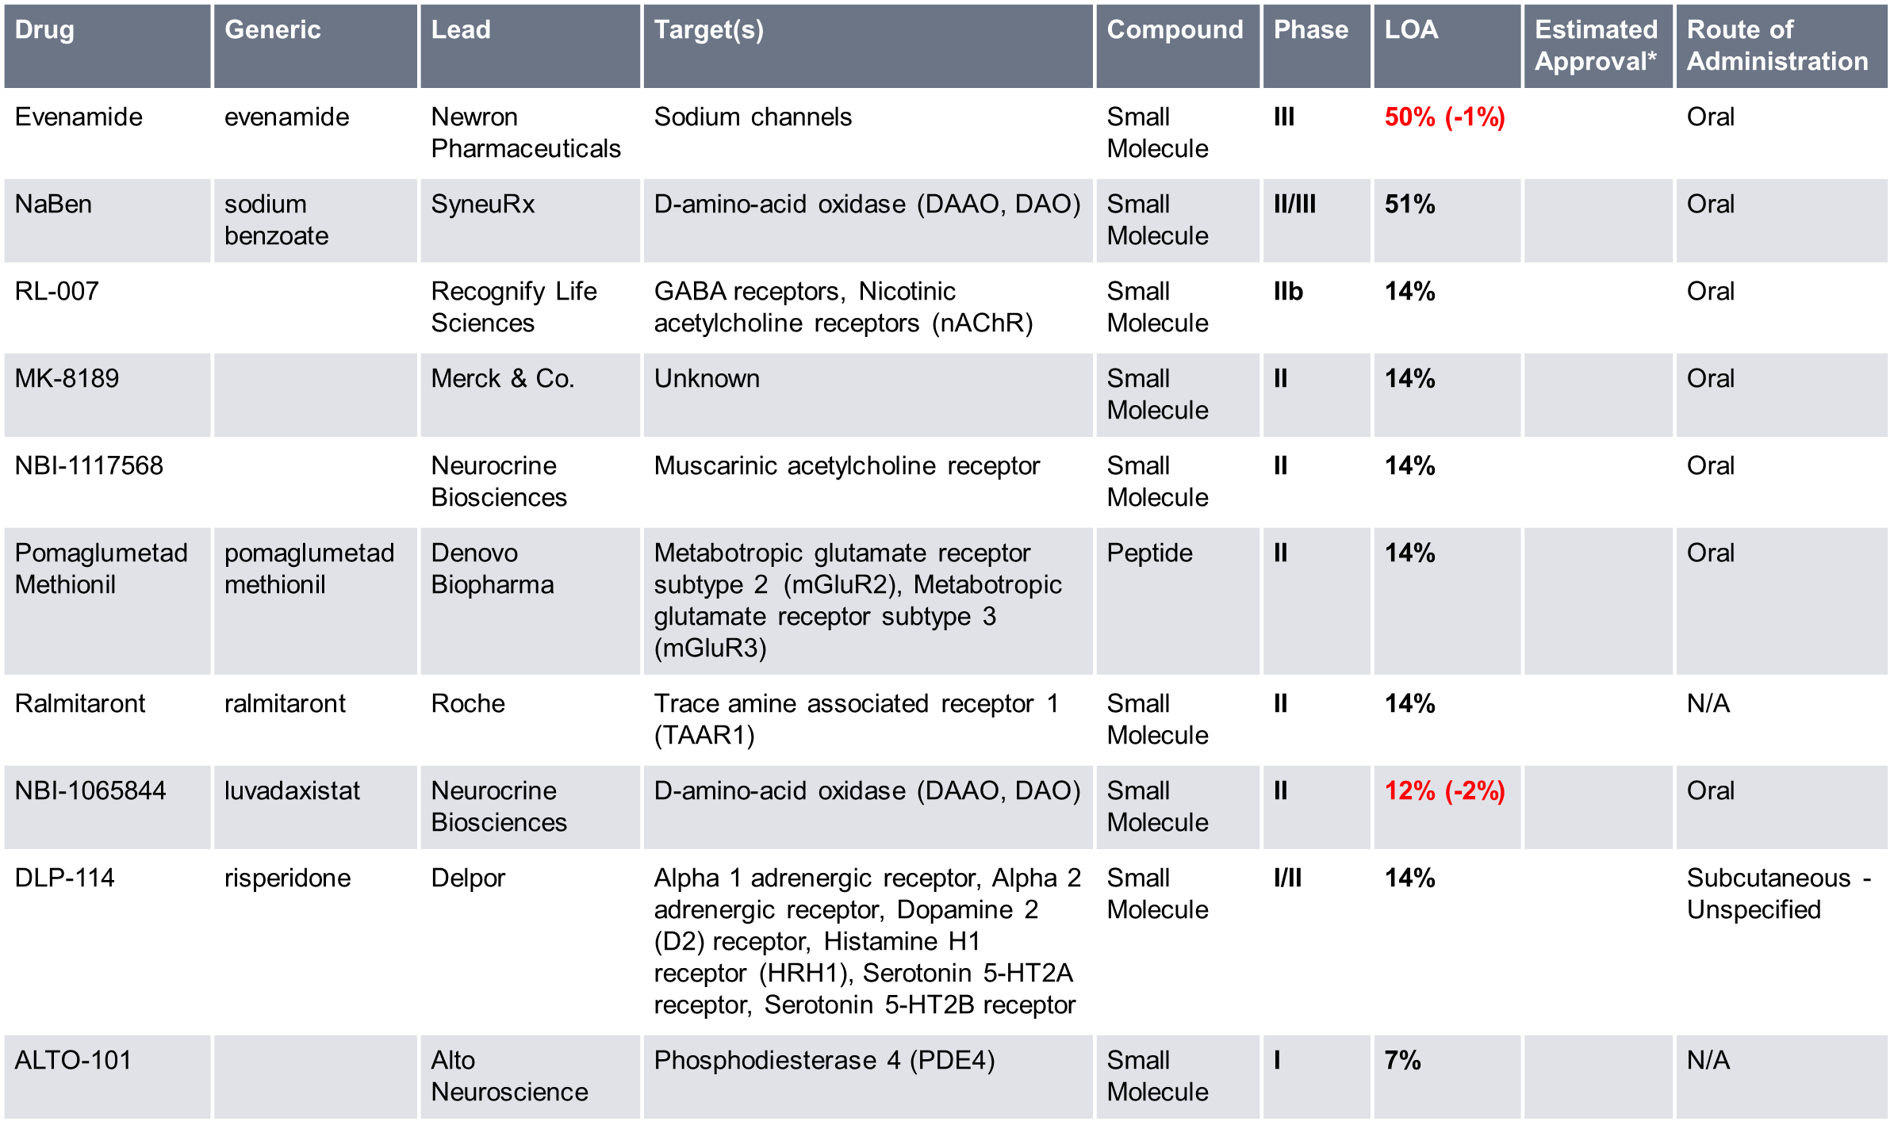
Pipeline Drugs in the US
Source: Biomedtracker 16 January 2024; Datamonitor Healthcare

Slide 36
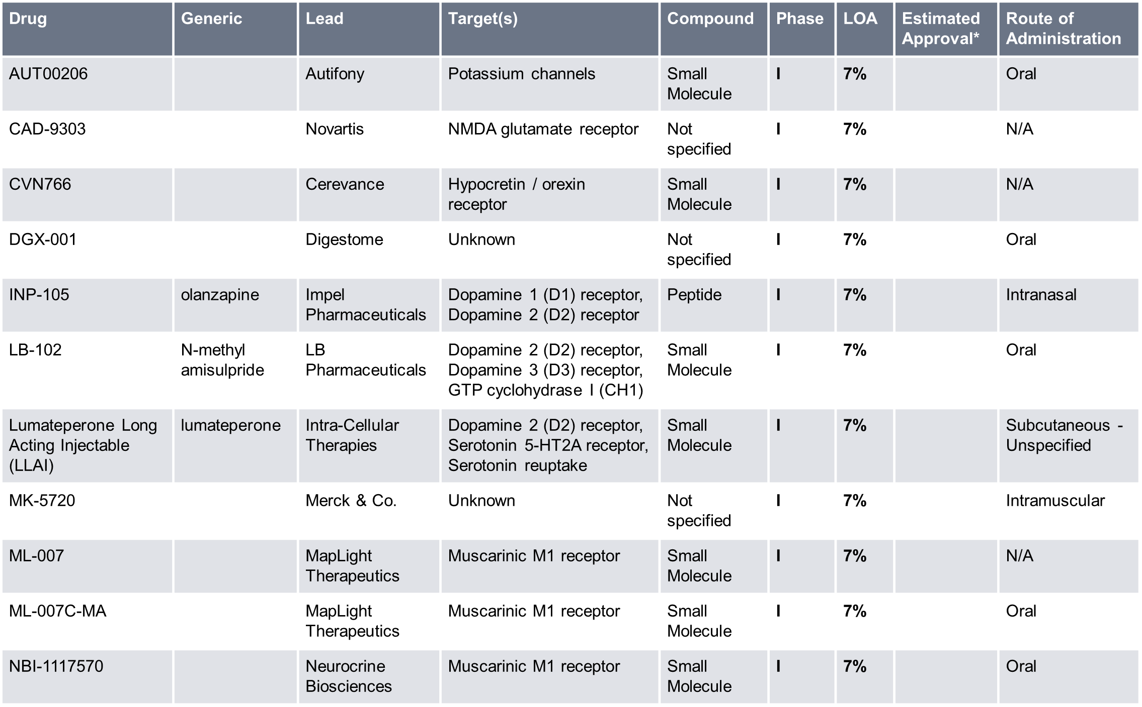
Pipeline Drugs in the US
Source: Biomedtracker 16 January 2024; Datamonitor Healthcare

Slide 37
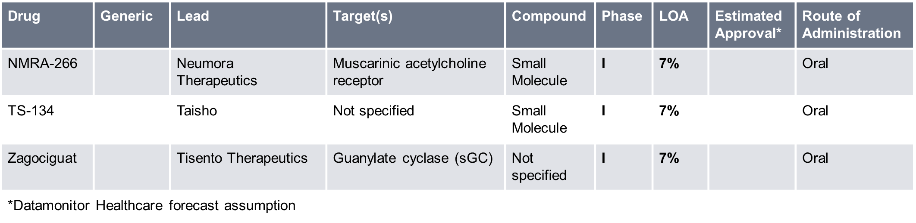
Pipeline Drugs in the US
For additional details on all pipeline candidates, from preclinical to preregistration, as well as suspended candidates, click here to view pipeline information on Biomedtracker.
Source: Biomedtracker 16 January 2024; Datamonitor Healthcare

Slide 38
Key Regulatory Events
Karuna Therapeutics Submits NDA For KarXT The psychiatry pipeline keeps producing new drug candidates based on well-known mechanisms, but Karuna Therapeutics, Inc. touts its newly submitted dual M1/M4 muscarinic acetylcholine receptor agonist KarXT (xanomeline/trospium) as “first novel pharmacological approach to treating schizophrenia in several decades.” The product combines a novel muscarinic agonist, xanomeline, and with the muscarinic antagonist trospium, which was approved for overactive bladder as Allergan’s Sanctura and is now available generically. Muscarinic agonists have been studied as antipsychotics since the 1990s, but most ran aground on the high rates of procholinergic adverse events like nausea and hypotension. Trospium mitigates the stimulation of peripheral muscarinic receptors while leaving xanomeline’s effect on the CNS unaffected. The NDA submission is based on three placebo-controlled Phase III trials in the EMERGENT program. In all three trials, KarXT showed a statistically significant and clinically meaningful reduction in Positive and Negative Syndrome Scale (PANSS) total score compared to placebo. “Notably, KarXT was not associated with common side effects of currently available antipsychotics, including changes in metabolic function, weight gain, somnolence, and extrapyramidal symptoms,” Karuna said. Pink Sheet October 2023
Source: Pink Sheet

Slide 39
Key Regulatory Events
BioXcel Ends Marketing Of Igalmi To Hospitals And Other Facilities New Haven, CT-based BioXcel Therapeutics, Inc. is shifting its focus for Igalmi (dexmedetomidine), approved in the US in April 2022 for agitation related to schizophrenia and bipolar disorder. Igalmi is approved for patients treated in an institutional setting, but BioXcel plans to largely end its marketing of the drug to hospitals and other facilities to cut its commercial costs as part of its plans to reduce overall expenses as the company pursues further development and commercialization of the drug for agitation associated with Alzheimer’s disease, schizophrenia and bipolar disorder as an at-home treatment. The company reported positive Phase III results in Alzheimer’s agitation in June, with some trouble with data reported from one trial site, and is discussing a supplemental filing with the FDA. A Phase III trial for at-home administration to patients with schizophrenia and bipolar disorder also is under way. In the interim, BioXcel plans to make its $127.5m in cash as of 30 June last through mid-2024 by changing its commercial strategy and cutting its workforce by more than 50% from 190 to 80 employees. Scrip August 2023
Source: Scrip

Slide 40
Key Regulatory Events
Otsuka Withdraws EU Filing For Asimtufii At the CHMP meeting, the committee recommended revoking the conditional marketing authorization for Novartis’ sickle cell disease drug, Adakveo (crizanlizumab), after the results of a Phase III trial failed to meet one of the specific obligations of the conditional approval. In addition, it noted that two marketing authorization applications had been withdrawn. These relate to Otsuka Pharmaceutical/Lundbeck’s Asimtufii (aripiprazole), for maintenance treatment of schizophrenia, and Roche's eye implant Susvimo (ranibizumab), for treating neovascular age-related macular degeneration (AMD) in adults. Otsuka said it was withdrawing its marketing application for Asimtufii based on a change in the company’s strategy. The product was developed as a hybrid medicine, meaning that it contained the same active substance as an authorized reference medicine, in this case Otsuka's Abilify Maintena, but it was to be available in a different pharmaceutical form and strength. Pink Sheet May 2023
Source: Pink Sheet

Slide 41
Key Regulatory Events
FDA Issues 46 Fresh Product-Specific Guidances An ophthalmic implant, nasal sprays and powders for inhalation are among the 46 products covered by new or revised product-specific guidances that have just been published by the US Food and Drug Administration for the purpose of aiding and streamlining generic drug development. The latest batch of PSGs listed by the FDA comprises 25 new and 21 revised PSGs, which provide recommendations for developing generics and generating evidence to support abbreviated new drug applications. As it published the latest PSGs, the FDA pointed out that the 46 guidances included 34 PSGs for products with no approved ANDAs, including 19 complex products. Overall, 24 PSGs were published for complex products. “When finalized, the guidances in today’s batch posting will describe the agency’s current thinking and recommendations on how to develop generic drug products that are therapeutically equivalent to specific reference listed drugs,” the agency noted. “FDA considers all comments to the public docket before finalizing PSGs.” Noteworthy PSGs highlighted by the FDA included a new PSG for loxapine inhalation powder, a generic version of Adasuve. “FDA published a new PSG for a systemically acting inhalation drug product using a novel thermally assisted aerosolization process during administration, indicated for acute treatment of agitation associated with schizophrenia or bipolar I disorder in adults,” the agency pointed out. “This is the first PSG for this type of product.” As it published the latest PSGs, the FDA also updated its page on upcoming PSGs that provides information about the agency’s plans for issuing new or revised PSGs in the coming year. Generics Bulletin May 2023
Source: Generics Bulletin

Slide 42
Key Regulatory Events
Teva Prepares To Launch LAI Risperidone After US Approval Teva expects to launch its Uzedy long-acting injectable risperidone product within weeks after receiving a long-awaited US Food and Drug Administration approval for the 505(b)(2) hybrid schizophrenia treatment. Uzedy was developed in partnership with French LAI specialist MedinCell. Teva has previously described the firms’ risperidone product as a potential “gamechanger” for patients. Late last year, Teva indicated that it was optimistic of launching the 505(b)(2) long-acting injectable product in the US by 1 July 2023, despite having earlier in 2022 received a complete response letter from the FDA denying approval. And now, having received FDA approval after addressing the CRL, the Israeli firm has stated that Uzedy will be available “in the coming weeks” in the US. The approval was based on data from two Phase III trials evaluating Uzedy in patients with schizophrenia. Teva has announced a wholesale acquisition cost ranging from $1,232 to $3,080 per month depending on dosage strength for Uzedy, with the company insisting that it is “committed to helping patients who have been prescribed Uzedy access their medication and [will] provide patient support specialists to help with access and reimbursement, prescription pull-through and patient assistance.” “Uzedy is the first subcutaneous, long-acting formulation of risperidone that utilizes SteadyTeq, a copolymer technology proprietary to MedinCell that controls the steady release of risperidone,” Teva underlined, with therapeutic blood concentrations reached within 6-24 hours of a single dose. Generics Bulletin May 2023
Source: Generics Bulletin

Slide 43
Key Regulatory Events
Rovi’s Value-Added US Risperidone Gets New Goal Date, Teva Ruled Out As Partner Laboratorios Farmaceuticos Rovi’s Risvan (risperidone) once-monthly injectable, a proposed 505(b)(2) hybrid version of Janssen-Cilag’s Risperdal tablets, has been handed a new US Food and Drug Administration user fee goal date after the Spanish player submitted final responses to a second complete response letter denying its approval. But as it continues to push through Risvan, Rovi has confirmed that Teva is not in consideration to be its US marketing partner. The Israeli firm’s subsidiary in Spain has launched recently another of Rovi’s long-acting injectable treatments for schizophrenia, its Baceq (paliperidone) generic version of Janssen’s Xeplion, under a ten-year promotion and distribution agreement. As it weighs Rovi’s latest responses, the FDA has issued the firm a new user fee goal date of 27 July 2023. Both Rovi and a manufacturing partner have provided answers to the FDA. Meanwhile, Rovi has also filed proposed corrections with the FDA after a pre-approval inspection of Rovi’s manufacturing facility in Madrid, Spain, unearthed deficiencies. FDA approval for Risvan is subject to the closure of the observations, noted Rovi, which is awaiting confirmation on whether a second inspection is required to close out the process. Rovi’s risperidone product, developed using its proprietary ISM sustained release injectables platform technology, was approved by the European Commission in February last year, under the name Okedi. It is indicated for the treatment of schizophrenia in adults for whom tolerability and effectiveness has been established with oral risperidone. Generics Bulletin March 2023
Source: Generics Bulletin

Slide 44
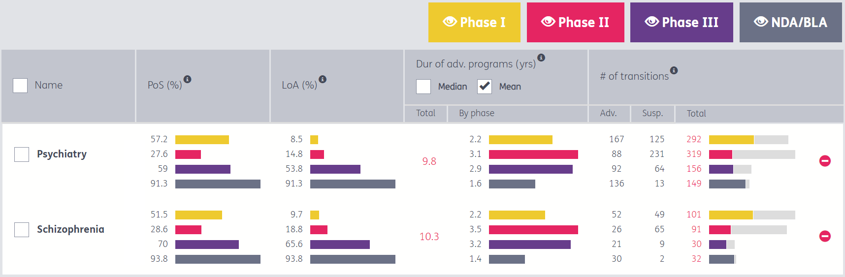
Probability of Success
This is a snapshot of probability of success and likelihood of approval, by trial phase, in the schizophrenia space in the curated Pharmapremia database. The overall likelihood of approval of a Phase I schizophrenia asset is 9.7%, and the average probability that a schizophrenia drug advances from Phase III is 70.0%. Schizophrenia therapies, on average, take 10.3 years from Phase I to approval, compared to 9.8 years in the overall psychiatry space.
To view more details in Pharmapremia to help you identify opportunities and manage portfolio risk, click here.
PoS = Probability of Success a drug advances from the current phase; LoA = Likelihood of Approval from current phase; Dur. of adv. programs (yrs) = average cycle time a drug is in this phase, in years; # of transitions = # of drug programs that advanced or were suspended in this phase
Source: Pharmapremia 16 January 2024

Slide 45
Licensing and Asset Acquisition Deals
BMS Speeds Expansion Into Neuroscience With $14bn Karuna Buy Bristol Myers Squibb Company is paying $14bn to rapidly ramp up its neuroscience portfolio through the acquisition of Karuna Therapeutics, Inc. and its M1/M4 receptor agonist KarXT (xanomeline-trospium), which is filed with the US Food and Drug Administration for the treatment of schizophrenia with a 26 September 2024 action date. The deal announced on 22 December gives BMS a product with blockbuster potential across multiple indications plus much-needed diversification of its portfolio. KarXT, which has shown impressive efficacy and differentiation from standard-of-care generic antipsychotic medications, will double Bristol’s commercial neuroscience portfolio, which today consists of one drug – the S1P receptor modulator Zeposia (ozanimod), approved for multiple sclerosis in 2020. The Karuna drug also is in Phase III for two additional indications and BMS has further expansion plans for the asset, including a possible long-acting injectable formulation. With the Karuna deal, which is expected to close during the first half of next year, BMS is placing a big bet that KarXT and earlier-stage assets will go a long way to offsetting the impact of current and future generics for its biggest sellers. The company is paying $330 per share for Karuna – a 53% premium to the firm’s 21 December closing price of $215.19. The transaction will be financed with newly issued debt, but Bristol said it will continue to have financial flexibility for future dealmaking. "Business development continues to be a top priority to further strengthen the long-term growth profile of the company through bolt-on transactions,” BMS chief financial officer David Elkins said during a same-day conference call to discuss the Karuna transaction. Cantor Fitzgerald analyst Olivia Brayer pointed out in a 22 December note that the $14bn deal valuation – or $12.7bn net of Karuna’s cash – is almost entirely driven by KarXT. “It’s not a cheap deal at $14bn (at a 53% premium), but consensus … puts peak sales for the drug at $3.9bn – and so a 3x peak sales multiple looks justified to us,” Brayer said. “[Bristol] hasn’t shied away from M&A this year, and today’s Karuna deal is quite the splash to make at year-end,” Brayer said. “Shareholders have been pushing the company to make more impactful M&A, and we’d definitely put Karuna in that camp.” “After [the AbbVie-Cerevel] deal, we considered Karuna the key takeout candidate, being two years ahead [of Cerevel in schizophrenia],” Wells Fargo analyst Mohit Bansal said in a 22 December note. “Also, Karuna does not have any major development risks and schizophrenia trials have already read out positively. Alzheimer’s disease psychosis Phase III is ongoing, but there is a strong proof-of-concept from prior trials, making this relatively de-risked from a development point.” “Our two takeaways from today’s announcement are: 1) Bristol Myers was serious when it mentioned reestablishing a neuroscience pipeline as a focus on the 2023 R&D event and 2) management is aggressively trying to replace upcoming loss of exclusivities, paying meaningful premiums for de-risked assets,” William Blair analyst Matt Phipps said in a 22 December note. “While we can debate whether the acquisition is overpaying for KarXT, the drug has shown strong efficacy across trials to date and should receive regulatory approval in the second half of 2024, adding another drug to the important new product portfolio.” Scrip December 2023
Source: Scrip

Slide 46
Licensing and Asset Acquisition Deals
AbbVie Strikes Again By Teeing Up $8.7bn Offer For Cerevel AbbVie Inc. made a big splash in mergers and acquisitions for the second time in a week on 6 December, announcing an $8.7bn offer to acquire Cerevel Therapeutics Holdings, Inc. on the strength of its Phase II emraclidine for schizophrenia and potentially other neuropsychiatric indications. Together, the Cerevel buyout and the ImmunoGen, Inc. deal announced 30 November are two of the year’s four biggest biopharmaceutical M&A transactions and make the Chicago-area pharma the year’s second-biggest spender. With two bolt-on deals designed to strengthen its portfolio diversification efforts, AbbVie comes in second to Pfizer Inc. with its pending $43bn purchase of Seagen Inc. AbbVie itself had the second-largest M&A deal of 2019 with its $63bn acquisition of Allergan plc, which laid the groundwork for the neuroscience expansion AbbVie is undertaking with Cerevel. AbbVie unveiled its bid for Cerevel, structured as a $45-per-share offer for the Cambridge, MA-based biotech, on 6 December. Both companies’ boards of directors have approved the deal, which is expected to close in mid-2024, AbbVie said. The deal helps AbbVie build on its neurology portfolio, currently led by Vraylar (cariprazine), the blockbuster antipsychotic it obtained in its buyout of Allergan. In addition, the aesthetic giant Botox (onabotulinumtoxinA), another Allergan-developed blockbuster, derives most of its therapeutic product revenue from its use in migraine prevention. Emraclidine, a positive allosteric modulator of the muscarinic M4 receptor, has potential in multiple diseases, AbbVie said, noting it is in two Phase II studies that are meant to be registration-enabling. The drug demonstrated efficacy and safety in schizophrenia in a Phase Ib study and is also being investigated as a treatment for dementia-related psychosis in Alzheimer’s disease as well in Parkinson’s disease. The deal also will bring to AbbVie’s pipeline clinical candidates for Parkinson’s (tavapadon, a first-in-class dopamine D1/D5 selective partial agonist), major depressive disorder (CVL-354, a kappa opioid receptor antagonist) and treatment-resistant epilepsy and panic disorder (darigabat, a Phase II alpha 2/3/5 selective GABA receptor modulator). Scrip December 2023
Source: Scrip

Slide 47
Licensing and Asset Acquisition Deals
Teva Gets Investment From Royalty On Olanzapine LAI Teva has announced a collaboration deal with Royalty Pharma that will see the firm “provide R&D and funding support of up to $125m” for the development of Teva’s olanzapine long-acting injectable, known by the development codename TEV-‘749. The collaboration to “further accelerate the clinical research program for Teva’s olanzapine” will “offset program costs,” Teva explained, as the project heads towards a Phase III readout at the end of this year. The firm believes TEV-‘749 “has the potential to be the first long-acting olanzapine with a favorable safety profile.” Under the terms of the agreement, Royalty will provide Teva up to $100m fund ongoing development costs TEV-‘749, with the two firms enjoying “a mutual option to increase the total funding amount to $125m.” Assuming US Food and Drug Administration approval, “Teva will pay Royalty Pharma the total amount funded over five years, as well as low- to mid-single digit royalties upon commercialization.” However, if Teva chooses not to file a new drug application with the FDA following positive Phase III study results, then Teva “will pay an amount equal to 125% of the total amount funded.” Teva will continue to lead the development and commercialization of TEV-‘749 globally. Teva’s development partner MedinCell – which uses its proprietary technology, licensed to Teva under the name SteadyTeq, to develop long-acting injectable versions of existing products – had announced early this year that the schizophrenia treatment had entered Phase III trials, with MedinCell referring to the product by the mdc-TJK designation. “We are excited to collaborate with Royalty Pharma, a leading funder of innovation with a strong track record, experience, and reputation. This funding agreement enables us to continue to accelerate the development of olanzapine LAI, a critical program for us, without impacting resources dedicated to our innovative and generic medicines.” Meanwhile, Royalty Pharma founder and CEO Pablo Legorreta said the firm was “delighted to partner with Teva, to realize the potential of olanzapine LAI and support them as their innovative pipeline continues to come to fruition.” Long-acting injectable antipsychotics “improve compliance and can help prevent hospitalizations,” Legoretta pointed out. “Teva’s olanzapine LAI could be an important new treatment option for patients with schizophrenia.” Generics Bulletin November 2023
Source: Generics Bulletin

Slide 48
Licensing and Asset Acquisition Deals
Pharmanovia Acquires 11 CNS Brands From Sanofi On 18 September, the UK’s Pharmanovia acquired 11 central nervous system (CNS) brands from Sanofi that span four therapy areas: psycholeptic, anxiolytic, anti-epileptic and anti-psychotic. The brands are specific to where they are sold and not all indications are approved in every market. Deal terms were not disclosed. Sanofi will divest seven clobazam brands (Frisium, Urbanyl, Urbanol, Urbadan, Urbanil, Castilium and Noiafren) under the agreement. The four additional divested brands are Tercian (cyamemazine), an antipsychotic available only in France, to treat certain acute and chronic psychotic conditions, anxiety in patients where other treatments have failed, and some types of depression in combination with another anti-depressant; Gardenal (phenobarbital), an anti-convulsant sold in India and Tunisia and various EU and Latin American regions to treat all forms of epilepsy, except absence seizures; Stemetil (prochlorperazine) an antipsychotic sold in the UK and other markets for vertigo, nausea and vomiting, schizophrenia, acute mania, and as an adjunct to the short-term management of anxiety; and Sentil, for an undisclosed indication. Pharmanovia said acquisition of this portfolio, sold in more than 60 markets worldwide, will grow its CNS footprint in Brazil, South Africa, France and Italy while complementing its existing neurology portfolio (of mainly pain indications) and commercial capabilities. Scrip September 2023
Terran Biosciences Announces Licensing Deal With Pierre Fabre For Idazoxan New York-headquartered Terran Biosciences, Inc. licensed global development and commercial rights on 2 June to Pierre Fabre’s idazoxan for schizophrenia, along with a pipeline of assets with a similar mechanism of action, to treat neuropsychiatric illnesses. Idazoxan, a selective alpha 2 receptor antagonist, has been tested in multiple clinical studies across a variety of neuropsychiatric indications. Despite a promising safety and efficacy profile as seen in Phase II proof-of-concept trials in schizophrenia patients, idazoxan has a short half-life that requires dosing three-times daily to achieve the desired plasma levels and pharmacological effects, thus restricting its development. The collaboration aims to develop a novel extended-release formulation to enable daily oral dosing and GMP manufacturing to meet Phase III standards. Scrip June 2023
Source: Scrip

Slide 49
Licensing and Asset Acquisition Deals
Neuraxpharm Brings In Greek Olanzapine Brand European central nervous system specialist Neuraxpharm has struck a deal to acquire the Lazap olanzapine brand in Greece from local player Lyofin, enabling Neuraxpharm to further expand in the Greek market. In March last year, Neuraxpharm gained a significant foothold in Greece through the acquisition of Athens-based Brain Therapeutics. At the time, Neuraxpharm said the deal meant it was “now able to bring new products to the Greek market, since the platform offers a unique level of local market access,” allowing the firm to “expand its offering rapidly and build on its position as a CNS specialist in Southeast Europe.” And now, with the acquisition of Lazap – a “well-established local prescription brand” that is primarily used to treat schizophrenia and bipolar disorder – Neuraxpharm said it would “further expand [our] presence in Greece and will leverage [our] CNS expertise to provide CNS patients, physicians, pharmacists and hospitals throughout Greece with access to suitable products from our extensive portfolio.” The agreement between Neuraxpharm’s Brain Therapeutics and Lyofin covers rights to commercialize Lazap’s two marketed presentations – 5mg and 20mg film-coated tablets – in Greece, with Neuraxpharm pledging to “ensure the continuity of the supply of Lazap to the Greek patients.” Financial terms of the deal were not disclosed. The brand was described by Neuraxpharm as an “atypical antipsychotic prescription drug” that is “well-known and mostly prescribed by psychiatrists and CNS specialists for the management of schizophrenia and bipolar disorder, two of the most common mental health disorders affecting 100,000 and 330,000 people in Greece respectively.” Commenting on the deal, Neuraxpharm CEO Jörg-Thomas Dierks said the acquisition “represents an excellent opportunity to further consolidate our Greek presence and expand our product portfolio in Greece,” noting that “the established brand with its large geographic presence in Greece is well aligned with Neuraxpharm’s strategy to offer a broad range of therapeutic options and to become the truly leading CNS pharmaceutical player in Europe.” “Lazap’s acquisition will strengthen our portfolio to psychiatrists and will perfectly fit with our future introductions in order to become a leading CNS player in Greece” added Brain Therapeutics/Neuraxpharm Greece’s country manager, George Pavlakis. Generics Bulletin June 2023
Source: Generics Bulletin

Slide 50
Licensing and Asset Acquisition Deals
PureTech Cashes In On Promise Of Karuna Schizophrenia Drug PureTech Health plc is reaping the benefits of the excitement surrounding the schizophrenia candidate KarXT from Karuna Therapeutics, Inc., one of the companies it founded, with the sale of royalty rights that could bring in up to $500m to advance its own pipeline. It has been a very busy week for Karuna which kicked off with a second set of positive Phase III results for KarXT (xanomeline-trospium) in schizophrenia. In the EMERGENT-3 trial, the first-in-class M1/M4-preferring muscarinic receptor agonist met its primary endpoint of showing a meaningful reduction in the Positive and Negative Syndrome Scale (PANSS) score and analysts have been queueing up to trumpet an efficacy comparable to prior antipsychotics but with a differentiated side-effect profile. Karuna plans to file KarXT with the US Food and Drug Administration in the middle of 2023 and, assuming approval, launch the drug in the second half of 2024. The day after the EMERGENT-3 data were disclosed, 21 March, Karuna announced a follow-on public offering that grossed $400m from the sale of 2.48 million shares at $161.33 each. Now, PureTech has decided to monetize its interests in KarXT. Through a deal with Royalty Pharma plc, PureTech will receive up to $500m for a share of its royalties, with $100m of that being paid upfront in cash. If sales of KarXT surpass $2 billion annually, and analysts are saying that is a very reachable target, Royalty will receive 33% of the royalties and PureTech will retain the rest of the payments. Additionally, under its license agreement with Karuna, PureTech has the right to receive milestone payments upon the achievement of certain regulatory approvals and 20% of sublicense income. Scrip March 2023
Source: Scrip

Slide 51
Clinical Trial Landscape

Slide 52
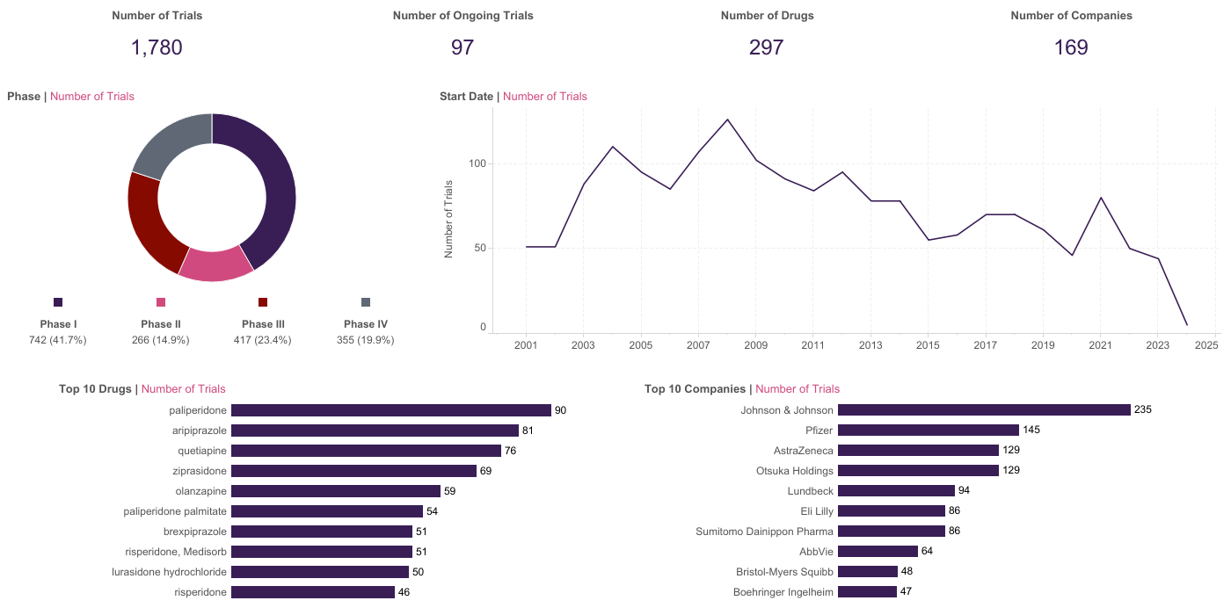
Clinical Trials
This is a snapshot of Phase I–IV clinical trials for primary investigational drugs with at least one industry sponsor in the schizophrenia space in the curated Trialtrove database. Johnson & Johnson leads drug development in schizophrenia, with 235 trials. Pfizer is in second place, with 145 trials. Phase I/II and Phase II/III trials are counted as Phase II and Phase III, respectively.
Source: Trialtrove 16 January 2024

Slide 53
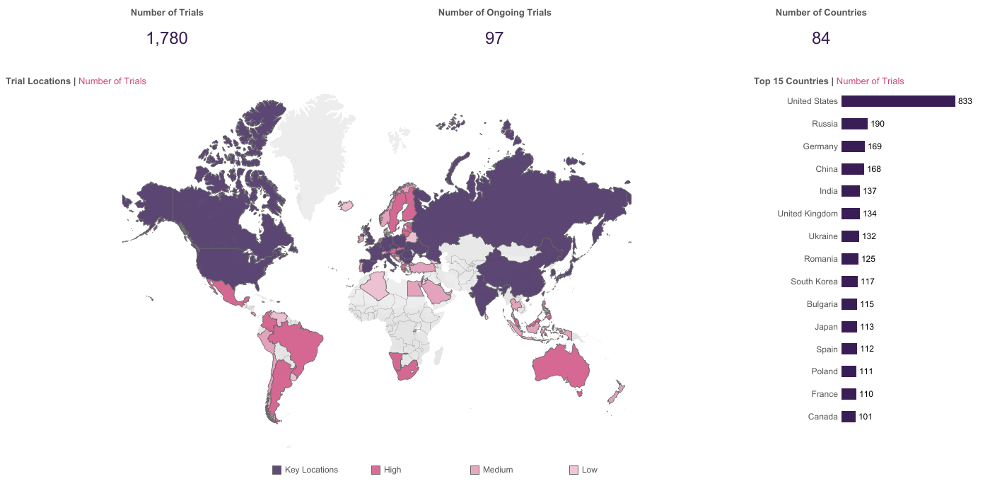
Clinical Trials
This is a snapshot of Phase I–IV clinical trials for primary investigational drugs with at least one industry sponsor in the schizophrenia space in the curated Trialtrove database. Globally, the largest proportion of schizophrenia trials have been conducted in the US, with Russia and Germany as the next most prominent locations.
Source: Trialtrove 16 January 2024

Slide 54
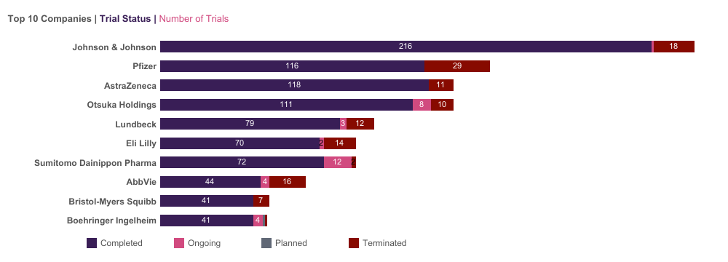
Clinical Trials – Sponsors by Status
This is a snapshot of Phase I–IV clinical trials for primary investigational drugs with at least one industry sponsor in the schizophrenia space in the curated Trialtrove database. Clinical trial activity in the schizophrenia space is dominated by completed trials. Johnson & Johnson has the highest number of completed schizophrenia trials (216).
Source: Trialtrove 16 January 2024

Slide 55
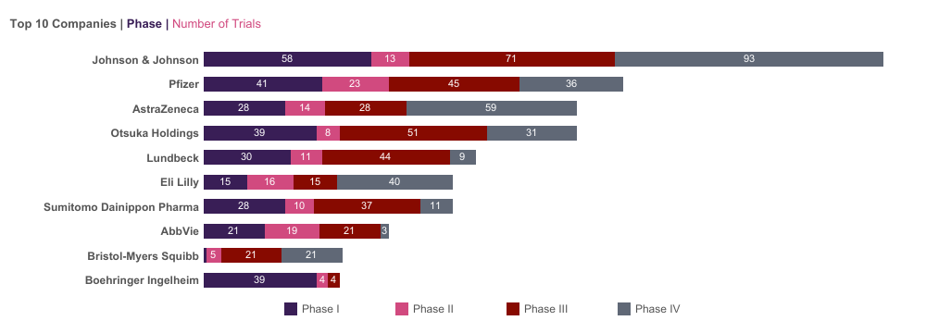
Clinical Trials – Sponsors by Phase
This is a snapshot of Phase I–IV clinical trials for primary investigational drugs with at least one industry sponsor in the schizophrenia space in the curated Trialtrove database. Johnson & Johnson has a clear lead in industry sponsorship with the highest overall number of Phase I, III, and IV trials, though Pfizer leads in terms of Phase II schizophrenia trials (23).
Source: Trialtrove 16 January 2024

Slide 56
Clinical Trials
Newron Enters New Year With High Hopes For Evenamide For Newron Pharmaceuticals SpA, 2024 is looking like a transformational year as the Italian biotech moves closer to presenting data from a potentially pivotal study evaluating evenamide in patients suffering from schizophrenia. The Milan-based group has just announced the completion of patient enrolment in study 008A, a four-week randomized, double-blind and placebo-controlled trial assessing evenamide in patients already being treated with a second-generation antipsychotic who are not classed as having treatment-resistant schizophrenia (TRS) but who demonstrate an inadequate response to that treatment. Some 290 patients were enrolled at centers in Europe, Asia and Latin America and the results from the study, which is testing a 30mg dose taken twice a day, are expected in March. If positive, Newron stated that 008A would be "the first well-controlled study to demonstrate the utility of evenamide in schizophrenia patients who show an inadequate response to atypical antipsychotics." Evenamide blocks voltage-gated sodium channels and normalizes glutamate release induced by aberrant sodium channel activity without affecting basal glutamate levels; it is the only drug with this target in active clinical development for schizophrenia. Evenamide is also progressing well through the clinic as a potential treatment for TRS. In October, Newron presented positive new data from study 014/015 at the European Clinical Neuropsychopharmacology congress in Barcelona which further demonstrated that evenamide was associated with an increasing, sustained and significant improvement of TRS symptoms. All efficacy scales used in the trial - the Positive and Negative Syndrome Scale (PANSS), the Clinical Global Impression of Severity (CGI-S) and the Strauss Carpenter Levels of Functioning - showed gradual and sustained improvement and "in contrast to common clinical experience, no patients experienced worsening of their psychoses," Newron noted, "and consequently, no patients relapsed." A large proportion of the responders (defined as a reduction of at least 20% from baseline on PANSS) at week six maintained their response at six months, while a review of the efficacy data indicated that treatment with evenamide resulted in around 40% of patients, at six months, no longer meeting the protocol severity criteria used to diagnose TRS. Chief medical officer Ravi Anand said that "what is remarkable about the effect of evenamide in this study is that treatment benefits continue to accrue over time and many patients who do not respond early achieve clinically important benefits later." A Phase III trial evaluating 15mg and 30mg doses in patients with TRS is expected to begin soon. Scrip January 2024
Source: Scrip

Slide 57
Clinical Trials
Reviva’s First Phase III Schizophrenia Readout Rivals Karuna’s Stellar KarXT Reviva Pharmaceuticals Holdings, Inc. saw its stock price jump nearly 50% on 30 October after the small-cap company reported that brilaroxazine succeeded in its first Phase III clinical trial in schizophrenia with results that look just as good and potentially slightly better than data for KarXT, which caused Karuna Therapeutics, Inc.’s valuation to double last year. Reviva closed up 46.4% at $5.49 per share on 30 October based on the results of its Phase III RECOVER study of brilaroxazine in schizophrenia, which showed statistical significance on all of the trial’s primary and secondary endpoints, including significant impacts on negative symptoms of schizophrenia where KarXT has shown mixed results across its trials. Karuna closed down 1.3% at $161.90 per share, falling around the same time of day when Reviva’s share price began its ascent. Nevertheless, Reviva’s drug, engineered to offer efficacy in schizophrenia and other neuropsychiatric diseases with fewer side effects known to impact compliance with antipsychotic therapies, seems to have delivered on those goals in its first Phase III trial. RECOVER enrolled 412 patients with acute schizophrenia who received once-daily treatment with 15mg of brilaroxazine, 50mg of brilaroxazine or placebo once-daily for 28 days, or four weeks. The primary endpoint was the decrease in Positive and Negative Symptoms Assessment (PANSS) total score compared to placebo from baseline to day 28. Key secondary endpoints included changes in positive symptoms, negative symptoms, social cognition, excitement/agitation and clinical global impression-severity (CGI-S). The 50mg dose met all of the endpoints with statistical significance, with a 10.1-point difference between brilaroxazine 50mg and placebo on PANSS scores reductions at four weeks (-23.9 for drug versus -13.8 for placebo, p<0.001). Karuna’s KarXT showed a 9.6% difference versus placebo at five weeks in its initial Phase III clinical trial, EMERGENT-1. Differences between brilaroxazine and placebo at four weeks were 2.8 points for positive symptoms of schizophrenia (p<0.001), 2 points for PANSS negative symptoms (p=0.003), 2.1 points for PANSS negative symptoms Marder factor (p=0.002), 1.6 points for PANSS social cognition factors (p<0.001), 2.1 points for PANSS excitement/agitation scores (p<0.001) and 1 point for CGI-S (p<0.001). There were no brilaroxazine-related serious adverse events in RECOVER after four weeks of treatment. Overall treatment-emergent adverse event (TEAE) rates were 35.5% for brilaroxazine 50mg, 34.5% for brilaroxazine 15mg and 30% for placebo; one serious TEAE in the high-dose group and two serious TEAEs in the low-dose group were determined not to be associated with the drug. The most common TEAEs associated with brilaroxazine were headache (8%) and somnolence (<7.5%), which were described as generally transient in nature. Treatment discontinuation rates in RECOVER were 16% for brilaroxazine 50mg (none for adverse events), 19% for the 15mg dose (1% for adverse events) and 22% for placebo (4% for adverse events). Scrip October 2023
Source: Scrip

Slide 58
Clinical Trials
Ulotaront Phase III Schizophrenia Setback For Sumitomo, Otsuka Alliance Sumitomo Pharma Co., Ltd. and Otsuka Pharmaceutical Co. Ltd.’s ulotaront (SEP-363856) has failed in two Phase III trials for severe schizophrenia, posing a setback for the multi-product CNS alliance between the two Japanese firms in which it is one of the lead assets. The DIAMOND 1 and 2 studies with the first-in-class, once-daily oral trace amine-associated receptor 1 (TAAR1) agonist were conducted in acutely psychotic adults living with schizophrenia, but both did not meet their primary efficacy endpoint. The partners said they would now “analyze the data to determine our next steps and plan to discuss with the US FDA how to proceed based on these results." At present, a timescale for any further decision is not clear. DIAMOND 1 evaluated ulotaront 50 mg/day and 75 mg/day versus placebo over six weeks in 435 acutely psychotic adults with schizophrenia. However, neither drug dose was superior to placebo against the primary endpoint of change from baseline in Positive and Negative Syndrome Scale (PANSS) total score at Week 6 (least squares (LS) mean: -16.9 and -19.6 for ulotaront 50 mg/day and 75 mg/day, respectively, versus -19.3 for placebo). DIAMOND 2 assessed ulotaront 75 mg/day and 100 mg/day versus placebo over six weeks in 464 acutely psychotic adults with schizophrenia. But again, neither dose demonstrated a statistically significant improvement compared to placebo against the same primary endpoint, although the reductions were numerically larger. At Week 6, both ulotaront treatment groups showed a mean reduction in PANSS total score from baseline (LS mean: -16.4 and -18.1 for 75 mg/day and 100 mg/day, respectively), versus -14.3 for placebo. In both studies, but particularly DIAMOND 1, “a large placebo effect was observed which may have masked the molecule's therapeutic effect,” the companies said, noting this is an effect sometimes observed in psychiatric studies. Furthermore, “these studies were conducted throughout the COVID-19 pandemic and initial analyses of these data suggest an impact of COVID-19 on the placebo responses that were seen,” they added, without specifying how that might be so. Ulotaront was generally safe and well-tolerated in both studies. Scrip July 2023
Source: Scrip

Slide 59
Clinical Trials
Part One Disappointment For BioXcel’s Igalmi In Pivotal Agitation Trial BioXcel Therapeutics, Inc.’s Igalmi has missed the primary endpoint in the first part of a pivotal trial in psychiatric patients with agitation, but an adaptive part two design plus a clean safety profile mean potential for expansion to the at-home treatment setting remains. The Phase III SERENITY compared Igalmi with placebo in bipolar disorder or schizophrenia patients with acute agitation. The trial is split into two parts – the first investigated the drug when administered for one day in a monitored medical setting and the second will investigate it pro re nata in the home setting for 12 weeks. Patients in part 1 were treated with 60µg of BXCL501 – half the approved dose of the branded product (120µg). The primary endpoint measured change in PANSS Excited Component (PEC) total score at two hours after treatment. PEC assesses symptoms such as excitement, tension, hostility, uncooperativeness and poor impulse control. Igalmi missed significance versus placebo two hours after treatment (p=0.077) but hit the mark four hours after treatment (p=0.049). Treatment safety was comparable with placebo and BioXcel noted that patients enrolled in part two would have relatively lower levels of agitation than those in part one. Notably, the second part will also measure a different endpoint – change in Clinical Global Impression Improvement (CGI-I) scale score, a clinician assessment of how much the patient's illness has improved or worsened from baseline. Despite the firm’s attempts at reassurance, its stock price plummeted by 33% to $17.68 on the NASDAQ in response to the data release. The adaptive design for SERENEITY part two allows for the testing of both 60µg and 80µg doses to help address a wider agitation spectrum for at-home patients. Canaccord Genuity analyst Sumant Kulkarni remarked in a same-day day note that although he would have preferred that Igalmi reached significance at the two hour mark, there were some redeeming features to the data including “a very clean safety profile.” Kulkarni further highlighted that the miss at two hours was “narrow” and “still delivered a clinically meaningful result.” The latter comment referred to the fact that, at two hours, Igalmi had attained a 52% response rate – defined as at least a 40% reduction in PEC total score – versus a 36% response rate for placebo. BioXcel management said it could shift the SERENITY part two timepoint from two hours to four hours, Truist Securities analyst Robyn Karnauskas revealed. She added that the SERENITY part one results did not necessarily provide a read through to the ongoing pivotal TRANQUILITY II trial of 40µg and 60µg BXCL501 in Alzheimer’s-related agitation as the two trials are in different age groups and patient populations. Scrip May 2023
Source: Scrip

Slide 60
Clinical Trials
Karuna Three-For-Three As Another KarXT Schizophrenia Trial Hits Primary Endpoint Karuna Therapeutics, Inc. has posted positive results from a third clinical trial of KarXT (xanomeline-trospium) in adults with schizophrenia with the announcement that the Phase III EMERGENT-3 trial met its primary endpoint of showing a meaningful reduction in the Positive and Negative Syndrome Scale (PANSS) score. The data indicate the drug should see commercial success, with analysts deeming its efficacy comparable to prior antipsychotics but with a differentiated side effect profile. Karuna announced the results on 20 March, making EMERGENT-3 the third trial in the EMERGENT program and the second in Phase III to produce positive results, following the Phase II EMERGENT-1 study and the Phase III EMERGENT-2 trial. The company plans to file a new drug application with the US Food and Drug Administration in the middle of 2023 and, assuming approval, launch the drug in the second half of 2024, with a pre-NDA meeting with the FDA scheduled for early in the second quarter. “These results marked our third positive trial of KarXT in schizophrenia, further reinforcing the clear, consistent efficacy, safety and tolerability results seen in our prior trials,” CEO Bill Meury told a same-day call with analysts. The 256-patient trial met its primary endpoint, with a statistically significant and clinically meaningful reduction in the PANSS score compared with placebo: the KarXT group experienced a 20.6-point reduction versus a 12.2 reduction for the placebo arm at week 5 (p<0.0001). Karuna added that, consistent with prior trials, there was an early and sustained statistically significant reduction in symptoms from week 2 through the end of the trial (p<0.05). However, on the secondary endpoint of PANSS negative subscale and PANNS negative Marder factor subscale – which measure the negative symptoms of schizophrenia, like withdrawal from others and difficulty enjoying life – the study showed a statistically significant result at week 4 (p<0.05) but not at week 5. Overall, Karuna described KarXT as well-tolerated in the study, with a side effect profile consistent with previous trials, as well as similar discontinuation rates due to treatment-emergent adverse events between the treatment and placebo arms of 6% and 5%, respectively. The most common treatment-emergent adverse events, occurring in at least 5% of participants receiving KarXT, were nausea, dyspepsia, vomiting, constipation, headache, hypertension, diarrhea and insomnia, with no discontinuations due to hypertension. “And when you look across the entire EMERGENT program, we had, I think, seven out of 340 patients roughly discontinue due to either nausea or vomiting,” Meury said. “That’s one out of 50, and so I think that this is going to be not a problem as we commercialize the product.” Scrip March 2023
Source: Scrip

Slide 61
Clinical Trials
Newron Points ‘Future Value-Driver’ Evenamide At Drug-Resistant Schizophrenia Newron Pharmaceuticals S.p.A.’s evenamide has shown signs of long-term safety and efficacy as an add-on therapy in a Phase II treatment-resistant schizophrenia (TRS) trial, sparking the advancement of pivotal development for the key value driver. Evenamide blocks voltage-gated sodium channels (VGSCs), which is theorized to normalize glutamate release induced by aberrant sodium channel activity without affecting basal glutamate levels. It is the only drug with this target in active clinical development for schizophrenia, according to the Citeline database Pharmaprojects. The Phase II trial enrolled 161 people with TRS on a stable dose of an antipsychotic other than standard-of-care clozapine across sites in Italy, India and Sri Lanka. Of the first 100 patients recruited, 77 completed one-year-long treatment with either 7.5mg, 15mg or 30mg evenamide. Another 16 patients discontinued the trial either due to adverse events (two patients) or withdrawal of consent or loss of follow-up mostly related to the COVID-19 pandemic (14 patients). Newron CEO Stefan Weber told analysts on a 16 February conference call, “We’re showing you an unexpectedly high number of patients who completed the one year of study duration,” adding that this suggested evenamide had an “almost flawless” safety profile. The Italian firm had previously reported data from the study’s six-week and six-month marks but interim one-year data showed more than a 50% increase over the previous significant benefit attained at six weeks (p<0.001) in the primary endpoint of change from baseline in the Positive and Negative Syndrome Scale (PANSS). Furthermore, the proportion of patients with a clinically meaningful PANSS improvement at one year almost tripled from the 16% who had attained this milestone at six weeks. Meanwhile, the percentage of patients who saw a highly meaningful improvement in disease severity as measured by change in the Clinical Global Impression of Severity (CGI-S) at one year more than doubled from the 10% at six weeks. Change in the proportion of patients who saw a clinically meaningful improvement on the CGI-C – those rated as at least “much improved” – was up by 10% at one year from the 27% who attained this milestone at six weeks. Full data from the trial’s six-month endpoint will be presented at the 31st European Congress of Psychiatry from 25-28 March. Newron is planning to start a ten-week, placebo-controlled pivotal trial of evenamide in TRS later this year. The one-year data “should help us to expedite the start of our placebo-controlled Phase III study,” chief medical officer Ravi Anand said. Scrip February 2023
Source: Scrip

Slide 62
Clinical Trials
Teva-MedinCell Alliance Heats Up With Second Phase III Trial Underway Teva is betting big on its partnership with MedinCell for long-acting injectables, recently describing the firms’ proposed 505(b)(2) hybrid risperidone LAI as a “gamechanger” for patients – while, as it awaits near-term regulatory action, also being a potential fillip for Teva’s spluttering margins. Now MedinCell has announced that the pair’s second product candidate, the proposed first subcutaneous LAI formulation of olanzapine also for the treatment schizophrenia, has entered Phase III clinical trials. Teva, which under its agreement with MedinCell finances and pilots the regulatory development of the product, TEV-44749, expects patients to begin enrolling in the SOLARIS Phase III study in the coming days. Set to involve 640 adult patients with schizophrenia, the open-label, long-term safety phase study aims to evaluate the efficacy and safety of TV-44749 over as many as 61 weeks. The Israeli firm anticipates primary completion in September next year. No guidance on a potential launch date for TV-44749 was disclosed by either party at this stage. Deciding to take the candidate to Phase III studies triggered a $3m payment from Teva to MedinCell, with the French firm eligible potentially for further milestones and royalties on sales in the future. With a second candidate in the clinic, Teva and MedinCell continue to guide for US Food and Drug Administration approval and launch of their risperidone product, under the name Uzedy, in the first half of 2023. Generics Bulletin January 2023
Source: Generics Bulletin

Slide 63
Market Assessment and Disease Analysis

Slide 64
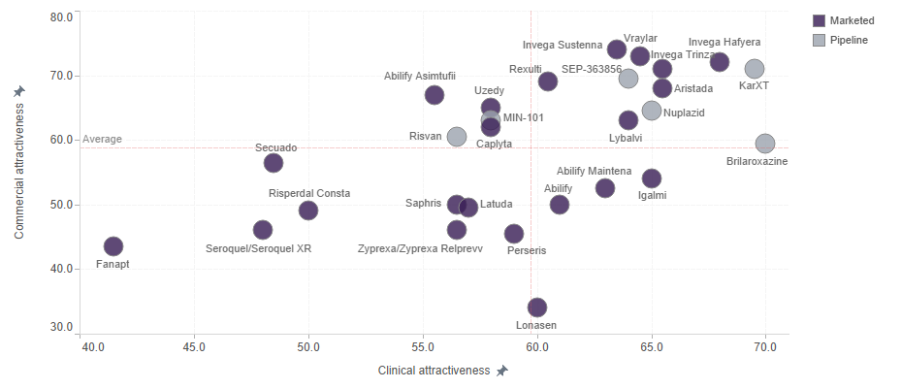
Drug Assessment Model
Our drug assessment model for schizophrenia compares select marketed and pipeline drugs based on clinical and commercial attributes. Each attribute score is assigned by our analysts, factoring in primary and secondary research. The figure below shows the positioning of each drug based on its aggregated clinical and commercial scores. To view further detail by drug or attribute, including the disease-specific weightings assigned to each attribute, please view our interactive Schizophrenia Drug Comparator Dashboard.
Source: Datamonitor Healthcare

Slide 65
Drug Assessment Model
Marketed oral treatments
Vraylar and Rexulti are likely to dominate the oral antipsychotic market in the coming years as key oral brands’ sales diminish through generic erosion. The once market-leading oral brand Latuda lost exclusivity in February 2023, and Vraylar and Rexulti could overtake Latuda’s returns in this segment. Each drug has demonstrated comparable efficacy with some of the most efficacious antipsychotics on the market. Allergan’s Vraylar demonstrated enhanced efficacy over risperidone in the treatment of schizophrenia negative symptoms; however, this trial was not enough to support a label expansion for negative symptoms, although it still may encourage off-label prescribing for this severely underserved need in schizophrenia. Vraylar provided similar results to placebo with regard to weight gain, and, furthermore, could have market exclusivity maintained until around 2028. Otsuka/Lundbeck’s Rexulti is set to lose its market exclusivity in 2029 and has recently been approved for the treatment of pediatric patients.
Aripiprazole has been the most widely prescribed antipsychotic for all segments and lines of therapy in schizophrenia. While our drug assessment model maintains a strong clinical profile for Abilify, accommodating its strong efficacy, safety, and tolerability profiles, the commercial potential of the drug has been somewhat diminished by loss of exclusivity in 2015. Since this patent cliff, aripiprazole generics have entered the schizophrenia market, undercutting Abilify on price and increasingly snatching market share.
It has remained difficult for Vanda Pharmaceuticals to distinguish Fanapt from other key therapies available in the neuroleptic market. Other than being a new molecular entity at its time of approval, its mechanistic approach is neither novel nor refined/enhanced. The drug is not particularly well tolerated, and its efficacy in clinical trials was modest at best. Coupling all this with its higher-than-average price tag and limited label, it is clear to see why this therapy is not classified as one of the key drugs in the market. The silver lining for Vanda Pharmaceuticals is that it has been able to uphold further patents, extending US market exclusivity until at least 2027.
Alkermes’ Lybalvi (previously ALKS 3831), a distinct formulation of olanzapine and the novel opioid receptor antagonist samidorphan, is an antipsychotic drug candidate designed to provide the efficacy of olanzapine while mitigating olanzapine-associated weight gain. It is useful for patients who have responded well to olanzapine, but is competing with antipsychotics that cause even less weight gain, such as Latuda, Caplyta, and Vraylar, particularly in the stable patient market. In trials, Lybalvi has demonstrated similar efficacy to olanzapine and less weight gain, and an FDA advisory committee panel largely agreed with the metabolic benefits of the drug, though deemed preventive measures necessary to circumvent the risk associated with the opioid antagonist action of samidorphan to opioid users. The drug was approved by the FDA in May 2021.
Source: Datamonitor Healthcare

Slide 66
Drug Assessment Model
“So, Lybalvi has been shown to reduce the weight gain from olanzapine by 50%, but if we’re still talking about a patient who puts on 40–50 pounds, even 50% less you’re talking about 20–25 pounds, which numerically is still higher than what other antipsychotics can induce in terms of weight gain. Latuda does not cause 20–25 pounds’ increase in weight.” – US key opinion leader
While our assessment model maintains a reasonable clinical profile for Sumitomo Pharma’s Lonasen, it lacks in commercial viability. The main reasoning behind this is the drug’s limited availability for schizophrenia patients, which is restricted to just Japan, China, and South Korea. The strategic reasons why the company has abstained from pursuing the drug in the US and five major European markets are unclear, but it is likely the drug may have struggled due to its lack of novelty in schizophrenia and the widespread genericization of these markets. Furthermore, following Lonasen’s loss of exclusivity in Japan, the first blonanserin generics entered the Japanese schizophrenia market in 2019 and will likely continue to deplete the drug’s market share over the coming years. Sumitomo has worked to offset this decline in revenue from the Japanese schizophrenia market with the approvals of the blonanserin transdermal patch formulation and Latuda.
BioXcel’s Igalmi, a sublingually administered dexmedetomidine formulation, was approved by the FDA in April 2022 for the acute treatment of agitation associated with schizophrenia. The drug lacks feasibility, despite positive efficacy and safety data, mainly because its route of administration means it will struggle to compete with the standard of care for acute agitation. In the pivotal Phase III trial, both treatment doses (120mcg and 180mcg) resulted in rapid and durable agitation improvements with statistically significant separation from placebo, with improvements observed as early as 20 minutes after dosing. In general, the treatment of severe agitation in acute psychiatric facilities is currently achieved through invasive intramuscular administration of antipsychotics or benzodiazepines. This raises ethical dilemmas due to the tranquilizing effects, but the injections are cheap and work very quickly to calm patients, which is important when an individual is aggressive to the point of needing restraint. While Igalmi is fast-acting and not over-sedating, its administration route is not applicable to real-life settings where patients are severely agitated and will not allow a film to be placed under their tongue. Additionally, individual films are very expensive compared to generic injectable alternatives. Beginning in January 2024, Igalmi will be separately reimbursed under a direct and predictable J-Code (to simplify claims submissions) for the outpatient setting, which could help to reduce economic barriers and improve market access. Igalmi is currently being investigated in the Phase III SERENITY III trial for at-home use. The drug failed the primary endpoint in Part 1 of the study, but a different primary endpoint in Part 2 (ongoing) may save the outlook of the overall trial. Based on FDA feedback from a Type C meeting held in November 2023, the 120mcg dose will be studied in Part 2. While administration at home could be feasible for those who are mildly agitated, most patients will not be able to recognize themselves as agitated, and many caregivers will be lacking expertise to recognize if a patient is agitated enough for medication. Also, many severely agitated patients will need to be hospitalized.
Source: Datamonitor Healthcare

Slide 67
Drug Assessment Model
Marketed LAIs
The LAI market is very crowded, with Johnson & Johnson’s Invega franchise (paliperidone) currently coming out top in terms of revenue. In addition to succeeding oral Invega with a combined wealth of real-world data, these three LAI formulations are highly appealing in the schizophrenia market, where poor medication compliance rates are seen all too commonly. After its FDA approval in 2009, Invega Sustenna (Xeplion in Europe) became the first treatment in the schizophrenia market with once-monthly dosing, and is the most dominant of the three Invega LAIs in terms of US market share. Xeplion lost exclusivity in Europe at the beginning of 2023, and generic versions are now available. Invega Hafyera (dosing once every six months) was approved in August 2021 in the US and three months later in Europe (as Byannli). Results showed non-inferiority of Hafyera compared to Invega Trinza (dosing once every three months) on the primary endpoint of time to first relapse at the end of the 12-month period. This six-month formulation is the first of its kind in schizophrenia, further tackling non-compliance for longer periods and reducing the burden of frequent healthcare visits for patients. Before transitioning to Hafyera, patients must be adequately treated with Sustenna for at least four months or Trinza for at least one three-month injection cycle. Treatment initiation of these LAIs does not require oral supplementation.
In terms of aripiprazole LAIs, Otsuka/Lundbeck’s once-monthly Abilify Maintena (approved by the FDA in 2013) competes with Alkermes’ Aristada (aripiprazole lauroxil), which was first approved by the FDA in 2015 and is dosed once monthly, every six weeks, or every two months. Additionally, Lundbeck has launched Abilify Asimtufii in the US, which is a follow-on product from Maintena, with dosing every two months. Asimtufii was developed to offset the impending generic erosion of Maintena from 2024. The annual patient cost of Asimtufii in the US (approximately $11,000) works out as less than half that of Maintena, likely so that it can compete with Maintena generics when they arise. Aristada also has an annual patient cost of approximately $11,000 in the US, as well as a first-to-market advantage over Asimtufii. Alkermes further strengthened its position in the LAI market by attaining approval for Aristada Initio, a one-off introductory dose of the drug, mitigating the prior need for three weeks of concomitant oral aripiprazole. Treatment initiation of both Maintena and Asimtufii requires oral supplementation with aripiprazole. However, Lundbeck benefits from Maintena and Asimtufii also being indicated for bipolar disorder, which is not the case for Aristada or the Invega products.
Source: Datamonitor Healthcare

Slide 68
Drug Assessment Model
Risperidone LAI formulations have struggled to penetrate the market thus far due to a lack of differentiation. The efficacy of risperidone is comparable to aripiprazole and paliperidone, but paliperidone has a better safety (metabolic) profile, especially for patients who have kidney or liver impairment. Johnson & Johnson’s Risperdal Consta, which was approved by the FDA in 2003, lost US market exclusivity in 2021, but no generics have been launched as the twice-monthly dosing schedule and oral supplementation required set it behind newer LAIs. Indivior launched Perseris in the US in 2018, which is administered once monthly and does not require oral supplementation for initiation, but it has still struggled to gain US market share. In 2023, two more risperidone LAI formulations were approved by the FDA: Teva’s Uzedy (formerly TV-46000) and Luye Pharma’s Rykindo. Uzedy has the highest potential for success as the first risperidone LAI offering an injection interval of two months (as well as once-monthly dosing), although it may struggle to compete with aripiprazole and paliperidone LAIs. In the 362-patient Phase III RISE trial, patients treated with Uzedy either monthly or once every two months experienced a statistically significant delay in time to relapse versus placebo, with 80% and 62.5% reductions in the risk of relapse, respectively. The initiation of treatment requires no loading dose or oral supplementation. It is also one of the few LAI products for schizophrenia that is administered subcutaneously, with the majority being intramuscular products. Rykindo is aiming to gain market share from Risperdal Consta with a simpler dosing regimen and discounted price, but we have not included it in our assessment model as limited clinical data are available and its twice-monthly dosing means it will struggle to compete with less frequently dosed LAIs.
“I think these new formulations of risperidone are really going to have a tough time, because in the end paliperidone and risperidone are nearly the same. Paliperidone is nothing more than the 9-hydroxirisperidone, which is the metabolite of risperidone. So, I doubt there will be any clinical superiority of risperidone over paliperidone.” – US key opinion leader
Source: Datamonitor Healthcare

Slide 69
Drug Assessment Model
The majority of schizophrenia patients are still being treated with oral antipsychotics, partly because physicians can have difficulty with patients agreeing to LAI treatment. Physicians tend to concur that the higher rates of compliance make up for the increased upfront cost of LAIs.
“LAIs are now recommended by the APA as well as others as a first-line treatment for patients with severe and persistent mental illness. About five years ago, I adopted earlier utilization, particularly in younger patients. Adherence to oral meds is often overestimated, and studies have shown missing just one out of four days’ meds was enough to increase relapse rates. We shouldn't think of these agents [LAIs] as a last-ditch effort, but rather a way to preserve brain volumes and patient functioning.” – US physician
“The financial burden may be felt upfront but not when compared to cost that could ensue with non-compliance. State programs usually will cover LAI... at least in Pennsylvania. Prior authorization may be required, but not usually.” – US physician
“Despite increased cost of LAIs, they have shown to significantly reduce frequency of relapse, and with that ED visits and hospitalizations; this reduction in admissions more than makes up for the increased cost of the medication. I am hopeful for their ongoing increased usage and potential discharge from inpatient units on the LAI to help maintain compliance and continuity with medications.” – US physician
“I primarily work in the Emergency Department, so I can't initiate LAIs (unable to do the oral trial for long enough and can't ensure that the patient can follow-up), but I see many patients who I think would benefit from them.” – US physician
“In general, the long-acting injectable versions of Invega and Abilify [Aristada and Maintena] offer very good efficacy and tolerance, and best form of compliance.” – US physician
“Oral antipsychotics account for the majority of medication used in the schizophrenia population, approximately 80%. 20% are on IM [intramuscular] formulations, so having an injectable to go to from an oral formulation such as Haldol or Prolixin or Invega or Abilify is helpful.” – US physician
“My preference is for LAI formulations of atypical antipsychotics both for schizophrenia and mood disorders, both for efficacy and tolerability. I have 30–35% on this treatment; the number would be larger if they would agree.” – US physician
Source: Datamonitor Healthcare; Skipta

Slide 70
Drug Assessment Model
Pipeline LAIs
Laboratorios Farmacéuticos ROVI’s once-monthly Risvan, an intramuscular LAI risperidone formulation which incorporates ROVI’s in situ microimplants (ISM) technology, lacks advantages over Uzedy and Perseris in terms of dosing frequency, but is differentiated by its efficacy in acute schizophrenia. Marketed LAIs are primarily used in stable patients. ISM technology applied to risperidone allows therapeutic levels of the active moiety to be achieved within two hours of intramuscular administration without the need for loading doses or oral supplementation. In the Phase III PRISMA-3 study, which assessed 438 patients with acutely exacerbated schizophrenia, the primary efficacy endpoint, PANSS total score, improved significantly with Risvan (75mg and 100mg) from the beginning until day 85, with adjusted differences of -13.0 (17.3 to -8.8; p<0.0001) and -13.3 (-17.6 to -8.9; p<0.0001), respectively. At the end of treatment, the difference versus placebo in the overall response rate was 39.2% with Risvan 75mg and 33.8% with the 100mg dose (p<0.0001). Furthermore, the long-term efficacy and tolerability of Risvan has recently been confirmed by the open-label extension of the PRISMA-3 trial. ROVI received a second complete response letter (CRL) from the FDA in July 2023, after initially receiving one in September 2021. The most recent letter states that the FDA considers the responses to the evaluation of the Risvan dossier complete and makes no additional observations, but that ROVI must close the observations made by the FDA during its inspection in May 2023. Consequently, the drug’s Prescription Drug User Fee Act (PDUFA) goal date was pushed from July 2023 to February 2024. In Europe, where Risvan was approved under the name Okedi in 2022, there is less competition as Risperdal Consta is the only other risperidone LAI on the market. Okedi has now been approved in all five major European markets (France, Germany, Italy, Spain, and the UK), and physician feedback has been positive.
“I mostly use LAIs for stable patients, but in Germany we also now have the risperidone variant, ROVI’s Okedi, and this is also used in the acute phase. It’s quite interesting, or quite helpful.” – EU key opinion leader
Source: Datamonitor Healthcare

Slide 71
Drug Assessment Model
Pipeline oral treatments
MIN-101 previously established efficacy in treating negative symptoms in a large, controlled Phase IIb trial. However, more recently, Minerva released Phase III trial results illustrating the drug’s failure to separate from placebo (placebo response was noted as particularly high) on the primary endpoint associated with schizophrenia negative symptoms. MIN-101 is a potential first-in-class sigma-2 receptor modulator, with research linking the antagonism of this receptor with antipsychotic properties. Moreover, the drug only further targets the 5-HT2A receptor, thus avoiding the direct binding of dopamine receptors which is linked to the troublesome extrapyramidal symptoms associated with the long-term use of dopaminergic antipsychotics. Minerva submitted an NDA to the FDA in August 2022, but the company received a refuse to file letter two months later. In two Type C meetings with the FDA, the regulatory body expressed dissatisfaction with the proposed data. Concerns involved the potential impact of MIN-101 on the efficacy and safety of antipsychotic drugs, the applicability of non-US patients in the Phase IIb study (conducted in Europe) to the US population, whether the subgroup analysis undertaken is sufficient evidence of efficacy, and the ability of clinicians to identify patients who might benefit from MIN-101. As the drug would likely be used as an adjunctive therapy initially while clinicians gain greater experience, the lack of data regarding MIN-101’s interactions with other antipsychotics is of particular concern.
In May 2023, Minerva announced that its NDA for MIN-101 for the treatment of negative symptoms in schizophrenia had been filed by the FDA (in accordance with its appeal of the refuse to file letter) and assigned a standard review classification. The FDA has set a PDUFA goal date of 26 February 2024.
“In my opinion, they [Minerva] need another trial, but it’s up to them. The data is not strong enough. In my opinion, on prior trials, their outcomes, and their experiences with other drugs that were approved, they had much stronger applications, more convincing, and well-defined outcomes in their clinical trials than this one. Yes, I think more data. At this stage, the data that they have is not sufficient to justify coverage or approval and use, but it is up to the FDA to make this decision. Definitely having more data will be more convincing for clinicians to use it afterwards.” – US key opinion leader
Source: Datamonitor Healthcare

Slide 72
Drug Assessment Model
A potential competitor of MIN-101, Nuplazid, is a pipeline agent also targeting the 5-HT2A receptor. Comparably, it is being developed to treat the negative symptoms of schizophrenia while avoiding the long-term dopaminergic-related adverse effects that accompany many antipsychotics currently on the market. Following failure of a pivotal schizophrenia trial, Acadia strategically reverted and refined the program back to the Phase II development stage, focusing on negative symptoms. Topline results from this trial have indicated that Nuplazid produced a similar improvement in negative symptoms over placebo to that seen in the MIN-101 Phase IIb trial. Acadia recently completed enrollment for ADVANCE-2, a Phase III study evaluating Nuplazid for negative symptoms, with topline data expected during Q1 2024. Nuplazid has already been approved for Parkinson’s disease, which would help to support an sNDA for schizophrenia, but in that instance careful pricing deliberations would have to be made by Acadia in order for the drug to be competitive if it enters the schizophrenia market.
“Well, we know that about between 40% and 60% of people with schizophrenia have negative symptoms. We have nothing for negative symptoms, and we have no competition for any combination treatment. I would use it [Nuplazid] off the bat in 50–60% of my patients that I’m trying to improve the outcome. Also squinting at the data that were positive for positive symptoms, and if that’s showing then 70–80% of patients might be eligible. So, this will be used left and right, and if it actually sticks out clinically, it will be a multi-billion-dollar drug because we have such need and there’s nothing available.” – EU key opinion leader
“[Nuplazid is] quite expensive. If it’s going to get an indication for negative symptoms, this will differentiate it from other drugs, because other drugs are not approved for negative symptoms, what we call resistant negative symptoms, and maybe this, after trying other drugs, and failing to adequately manage the negative symptoms, it could be an argument to use a drug that is approved for negative symptoms.” – US key opinion leader
Source: Datamonitor Healthcare

Slide 73
Drug Assessment Model
SEP-363856 (ulotaront) is a novel schizophrenia pipeline candidate from Sumitomo Pharma which has the potential to be a first-in-class TAAR1 agonist. Compared to existing schizophrenia drugs, SEP-363856 has serotonin 1A (5-HT1A) agonist activity but does not bind dopamine D2 or 5-HT2A receptors, which are associated with unwanted adverse metabolic side effects and weight gain. Due to this novel mechanism of action, the FDA granted the drug a breakthrough therapy designation in May 2019. SEP-363856’s potential commercial outlook could be broad even though Sumitomo has indicated that the treatment of negative symptoms in schizophrenia is a priority. Phase II results (for patients with acute exacerbation of schizophrenia) were promising, demonstrating a statistically significant and clinically meaningful improvement in PANSS total score compared to placebo at four weeks (-17.2 vs. -9.7; 95% CI: -11.9 to -3.0; p=0.001) from a once-daily dose of 50mg or 75mg. Unfortunately, SEP-363856 did not meet the primary endpoint in either of the Phase III trials, despite strong PANSS score improvements in the treatment arms, which will undoubtably impact the drug’s development timeline. DIAMOND 1 showed decreases of 16.9 points and 19.6 points at 50mg/day and 75mg/day, respectively, and DIAMOND 2 had reductions of 16.4 points and 18.1 points in the 75mg/day and 100mg/day groups, respectively. However, the placebo groups experienced surprisingly high PANSS score reductions (-19.3 in DIAMOND 1, and -14.3 in DIAMOND 2), rendering the treatment group results statistically insignificant. Sumitomo has announced that SEP-363856 was generally safe and well tolerated throughout the studies, and that it will be analyzing the data to determine next steps and plans to discuss these steps with the FDA. Four Phase III studies assessing SEP-363856 for schizophrenia are currently recruiting patients.
“I think the TAAR1 mechanism is very interesting. We’ve seen ulotaront presented alongside clozapine with some small but meaningful data, so that one at least already has wind in its sails for use as an adjunct agent for the most ill patients. Again, the mechanism is not as different in some regards as the muscarinic drugs. I mean, all these compounds still mess around with all the same brain chemicals as all the other ones, but in notably different ways and different percentages and whatnot, and ways that, again, make them seem like they may be able to do things totally differently. But at least the TAAR1 drugs, they have this nice modifying effect.” – US key opinion leader
Source: Datamonitor Healthcare

Slide 74
Drug Assessment Model
Karuna Therapeutics’ KarXT combines the first-in-class M1/M4-preferring muscarinic receptor agonist xanomeline, which was previously discontinued due to side effects, with a pan-muscarinic receptor antagonist, trospium (approved outside of schizophrenia), which does not cross the blood-brain barrier and enables safe usage. The drug is being primarily developed for the treatment of acute psychosis in adults with schizophrenia. Effect sizes so far compare well to widely prescribed antipsychotics such as Risperdal, and its differentiating factors include a strong tolerability profile and potential to treat cognitive symptoms. While two Phase III trials are yet to release results, positive data have been gathered from the Phase III EMERGENT-2 and EMERGENT-3 trials, as well as the Phase II EMERGENT-1 trial. KarXT demonstrated a statistically significant 9.6-point reduction in PANSS scores compared to placebo (p<0.0001) at week five in EMERGENT-2, within the range of other atypical antipsychotics. Additionally, all secondary endpoints were met with statistical significance. These data were consistent with those from the Phase II trial, where KarXT met the primary endpoint with a statistically significant 11.6-point mean reduction in PANSS scores over placebo at week five. New analysis of the EMERGENT program data showed a statistically significant benefit on cognitive function, via the Cambridge Neuropsychological Test Automated Battery (CANTAB) score, in a subgroup of patients who demonstrated cognitive impairment at baseline (p<0.01; Cohen’s d=0.52). Importantly, this was not correlated with the robust degree of total PANSS improvement demonstrated across the EMERGENT program, which could suggest that cognitive benefit with KarXT is independent of pseudo-improvements associated with the lessening of positive symptoms. In the EMERGENT trials, patients treated with KarXT largely avoided the problematic side effects associated with current therapies such as weight gain and sedation, although some mild-to-moderate gastrointestinal side effects were observed. Rates of discontinuation and treatment-emergent adverse events were similar between the placebo and treatment arms.
Karuna’s NDA for KarXT for schizophrenia psychosis was submitted to the FDA in September 2023 and was accepted two months later. A US approval decision is expected in September 2024. Data from the long-term safety and tolerability trials EMERGENT-4 and EMERGENT-5 are expected during 2024, but will not delay approval timelines. Additionally, a fifth Phase III trial, ARISE, will evaluate the safety and efficacy of KarXT as an adjunctive treatment in adults who have an inadequate response to their current antipsychotic therapy, which is likely to be more reflective of how the drug would be used in the real world, if approved. Although KarXT and SEP-363856 would not directly compete on the market, KarXT’s lead in the race to FDA approval gives it a commercial advantage. In December 2023, it was announced that Karuna will be acquired by Bristol Myers Squibb, which will help substantially with commercial resources if KarXT is approved, considering the Big Pharma’s prior experience in multiple neuropsychiatric indications.
“It [KarXT] has a new mechanism of action, it has significant efficacy, it has a fast onset of action, all these are valuable things. But will it become first line? No, we will always go with generics first, knowing that the cost is a big barrier for many insurance companies, Medicaid, or Medicare to cover. But it will be an option to consider.” – US key opinion leader
Source: Datamonitor Healthcare

Slide 75
Drug Assessment Model
Reviva’s brilaroxazine has a strong efficacy and safety profile but may struggle to compete with KarXT if both are approved. Brilaroxazine belongs to a class of third-generation antipsychotics called dopamine-serotonin system stabilizers, although it has close structural similarity to aripiprazole. Reviva is aiming for brilaroxazine to achieve a mix of modulation to drive strong efficacy while reducing the side effects associated with many marketed atypical antipsychotics.
In the pivotal Phase III RECOVER trial for acute schizophrenia, treatment with 50mg brilaroxazine demonstrated a statistically significant 10.1-point PANSS score reduction (-23.9 for brilaroxazine vs. -13.8 for placebo) at week four, with a corresponding Cohen's d effect size of 0.6. These PANSS data are at the upper end of what has been reported for atypical antipsychotics historically, and are comparable to the Phase III data for KarXT, which also demonstrated an effect size of 0.6. In terms of safety, discontinuation rates in RECOVER were lower for the treatment arms than for placebo, with no incidence of suicidal ideation. Weight gain was slightly higher in the 50mg arm compared to placebo, with an increase of 5.9% compared to baseline vs. a 2.9% increase for placebo.
One drug that may take the edge in terms of safety is Intra-Cellular’s Caplyta, which has a very strong tolerability profile as it does not cause weight gain or akathisia and has a first-to-market advantage over brilaroxazine. Caplyta did, however, produce less impressive efficacy data in clinical trials compared to brilaroxazine, with reductions of 4.2–5.8 points on the PANSS scale compared to placebo.
Another pivotal Phase III trial of brilaroxazine, RECOVER-2, is due for initiation during Q1 2024, and completion of the one-year open-label extension study for RECOVER, which includes patients with stable schizophrenia, is expected in Q3 2024. Reviva plans to file an NDA to the FDA for brilaroxazine for the treatment of schizophrenia in 2025. Brilaroxazine also has potential as an LAI, although this may be a difficult market to penetrate considering the range of treatments available.
Source: Datamonitor Healthcare

Slide 76
Drug Assessment Model
Other promising treatments
The following drugs are promising assets within the schizophrenia pipeline but are not yet included in our assessment model due to limited clinical data.
Teva is developing a new once-monthly LAI formulation, TV-44749, which the company is positioning to become the first olanzapine LAI with minimal safety risk. This is an attractive asset as olanzapine is widely considered the most potent antipsychotic for schizophrenia, but only Phase I data are available currently. Eli Lilly’s has been the key marketed olanzapine LAI formulation, but its uptake has been negatively affected by safety issues. In its label, Zyprexa Relprevv carries a black box warning for post-injection delirium/sedation syndrome (PDSS), meaning patients must be closely monitored for at least three hours after administration. Additionally, Zyprexa Relprevv requires deep intramuscular administration, which risks the penetration of large blood vessels, leading to high concentration of the drug and, consequently, sedation. TV-44749 potentially avoids the risk of penetrating a large vessel, as well as the risk of PDSS, through its subcutaneous administration and Teva’s SteadyTeq technology for controlled drug release. Phase III data for TV-44749 in schizophrenia are expected in the second half of 2024.
Cerevel’s orally administered emraclidine activates the M4 muscarinic receptor while sparing the M1 subtype and is differentiated from competitor KarXT by its dosing frequency (once daily versus twice daily), its lack of titration needs, and, potentially, its stronger gastrointestinal side-effect profile. Unlike atypical antipsychotics, Cerevel does not expect emraclidine to cause cholinergic or anti-cholinergic effects, sedation, metabolic issues, weight gain, or motor symptom side effects. Emraclidine’s efficacy in its Phase Ib trial was comparable to KarXT’s Phase II and Phase III trials, with a total PANSS reduction of 11.9 points. Cerevel is running two Phase II trials, which are potentially registrational, with topline data expected in the second half of 2024. In these studies, emraclidine needs to show a placebo-adjusted difference of ~8–10 points on the PANSS to be in line with KarXT’s efficacy. With a US approval decision expected in 2026, emraclidine falls significantly behind KarXT in the race to approval; however, it was recently announced that Cerevel will be acquired by AbbVie, which will substantially help to increase commercial resources if emraclidine is approved.
BI 425809 (iclepertin) is a novel glycine-transporter-1 (GlyT1) inhibitor which is being developed by Boehringer Ingelheim for the severely underserved area of cognitive impairment associated with schizophrenia. In its Phase II trial, BI 425809 facilitated statistically significant improvements in cognitive function compared to placebo, as measured by the composite Measurement and Treatment Research to Improve Cognition in Schizophrenia (MATRICS) Consensus Cognitive Battery (MCCB) score. The company is currently recruiting for three double-blind Phase III trials, CONNEX-1, CONNEX-2, and CONNEX-3, in which ~1,750 patients will receive the drug once daily for 26 weeks. These studies have estimated primary completion dates of January 2025.
Source: Datamonitor Healthcare

Slide 77
Market Dynamics
Current dynamics
Market opportunity
Atypical antipsychotics dominate a market saturated with oral formulations, although LAI market entrants are rising, increasing convenience and aiding adherence
Drugs possess similar labels, with approvals for schizophrenia but without addressing specific symptom domains
Olanzapine and risperidone are widely used as first-line treatments
Invega Sustenna/Trinza is the most lucrative brand on the market as the first monthly and three-monthly dosed LAI. Additionally, the more recently approved Invega Hafyera is the first – and only – six-monthly dosed LAI
Some newer LAIs aim to decrease reliance on oral supplementation at the start of treatment as well as the need for loading doses
Critical unmet need exists in the schizophrenia market, notably for treatments targeting negative and cognitive symptoms
While atypical antipsychotics have begun to address tolerability issues compared to typical antipsychotics, the need for further improvement persists, particularly in the form of reduced weight gain and EPS
There are very few therapy options for treatment-resistant schizophrenia
A transition towards precision psychiatry, whereby patients are treated based upon their neurobiology as opposed to their symptoms, which will allow for more targeted treatments and less reliance on trial and error
Pediatric patients are largely underserved, with few drugs approved for this segment
Defining biomarkers for certain subgroups, such as agitation
Threat of substitution
Payer pressure / Buyer power
The market is already heavily led by generic oral antipsychotics, and genericization will continue
Physicians will likely shift patients from daily oral antipsychotics to LAI formulations to facilitate compliance
Despite having various patents, branded LAIs can face competition ahead of LOE from LAIs with longer dosing schedules
Oral atypical antipsychotics that were historical blockbusters, such as Latuda, are now facing intense generic erosion
Newer oral therapies have entered with a price premium over conventional oral antipsychotics
Intensifying generic competition is ramping up pricing pressure for branded products
Formulary restrictions are being placed on costly LAI therapies
There is a high evidence requirement for favorable pricing assessments among certain EU bodies
Payers require patients to try at least two generics before branded drugs are reimbursed
EPS = extrapyramidal symptoms; LAI = long-acting injectable; LOE = loss of exclusivity
Source: Datamonitor Healthcare

Slide 78
Future Trends
Growth drivers
Growth resistors
More tolerable atypical antipsychotics are entering the market with reduced adverse effects, such as weight gain, compared to their predecessors
Drugs targeting patient segments for which there are great unmet needs, including predominantly negative and cognitive symptom presentation, treatment-resistant schizophrenia, and pediatric schizophrenia patients
Newer and better-tolerated oral antipsychotics with remaining market exclusivity will prosper
The LAI market will grow as physicians swap patients to these brands to ensure compliance and reduce relapse rates
Expansions into Europe and Japan, where antipsychotic brand competition is less fierce than in the US
A growing patient population in the US and EU
Widespread genericization of numerous oral antipsychotics
Due to higher costs of LAIs, formulary restrictions may slow uptake of these drugs, particularly in the EU and Japan
Newer brands with limited distinguishing attributes from the rest of the market may struggle as increasing numbers of cheaper generics enter the market
There is generally less investment in chronic conditions with large populations as firms need a broad commercial strategy and must be prepared to engage with many healthcare providers
A lack of validated biomarkers is hindering the transition towards precision psychiatry
A diminishing patient population in Japan
Source: Datamonitor Healthcare

Slide 79
Future Trends
Uptake of LAIs will flourish
As physicians and patients become more familiar with the dosing schedules of LAIs while working together to facilitate compliance, we expect the antipsychotic LAI market to increase over the next decade. The Invega franchise should see the greatest return, already having the largest share in this market and the longest dosing schedules. In addition, Invega Sustenna was the first approved once-monthly LAI antipsychotic and therefore has the longest-standing reputation and familiarity in this space.
The potential approval of a generic version of Abilify Maintena from 2024 could change the dynamics within the LAI aripiprazole market significantly, depending on how it is priced. If it is priced considerably lower than Otsuka’s two-monthly Abilify Asimtufii and Alkermes’ one-to-two-monthly Aristada, the prescriptions of these branded products could be impacted. Meanwhile, Aristada and Asimtufii will compete to provide more convenient dosing over Maintena and its potential generics. Risperdal Consta and Perseris will continue to struggle to make an impact on the market, although Teva and ROVI could potentially impede on the LAI risperidone market share with their own LAI risperidone versions. These drugs will be explored as alternatives to the popular Invega franchise or further down the treatment algorithm.
Fresh uptake of atypicals will return the oral market to growth
Following on from Latuda’s dominance among the branded oral antipsychotics and its recent loss of exclusivity, other newly marketed and pipeline orally administered antipsychotics will take over and expand this market further. Demand for both Rexulti and Vraylar, patent-protected until 2029 and 2028, respectively, looks set to continually increase over this decade, and Vraylar could potentially become an unprecedented treatment option for the negative symptoms of schizophrenia.
Some of the most promising mid-to-late-stage neuroleptics – KarXT, Nuplazid, and SEP-363856 – are orally administered therapies; however, their respective drug developers will differentiate them from the highly genericized oral antipsychotic market by positioning them as drugs directed at the unmet needs of the indication, namely increased tolerability and negative and cognitive symptom domain targeting.
Source: Datamonitor Healthcare

Slide 80
Future Trends
Widespread genericization will erode numerous key brands’ market shares
The once blockbuster atypical antipsychotic brands – Otsuka’s Abilify, AstraZeneca’s Seroquel/Seroquel XR, and Eli Lilly’s Zyprexa – will see their sales continue to decline with each competing generic launch. Otsuka will be hoping transitions to its aripiprazole LAIs will accommodate for some of these losses in market share as LAIs become increasingly popular, and the company will also be looking to the orally administered Rexulti as a worthy successor to lessen the impact of Abilify’s widespread genericization. In line with this, Otsuka achieved expansions for Rexulti into the Japanese and European schizophrenia markets in 2018 and 2019, respectively.
Sumitomo’s Latuda has recently become genericized, and the same could also happen to its less lucrative Lonasen (marketed in Japan), which has already seen a generic rival approved in 2019. Sumitomo’s lifecycle management strategy could help to slow this decline, as approval was received for the blonanserin transdermal formulation in late 2019. In addition, Allergan’s (now AbbVie’s) Saphris has also seen its exclusivity expire, with asenapine generic rivals entering the market in late 2020.
A migration towards precision psychiatry
While diagnosis and treatment strategies are currently reliant on symptom presentation, there is hope among psychiatrists for a transition towards treating and diagnosing patients based upon their neurobiology, which would allow for more personalized treatment. In order for this to happen, further research needs to be undertaken on the pathogenesis of schizophrenia, including the identification of biomarkers. Given the heterogeneity of symptoms within the disorder, biomarkers may assist in stratifying patients based on subtype, which ultimately may have significant treatment implications.
Source: Datamonitor Healthcare

Slide 81
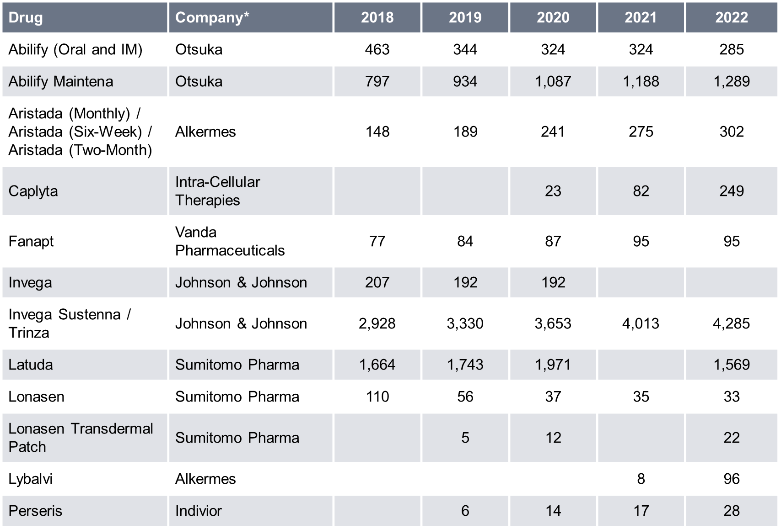
Consensus Forecasts
This is a snapshot of historical and forecasted sales of drugs in the schizophrenia space in the curated Biomedtracker database. The sales included here are total brand sales and not necessarily disease-specific. The forecasted sales are based on a consensus of a minimum of three analyst reports from major investment banks. For disease-specific sales, please view our Patient-Based Forecast for Schizophrenia.
Historical
Global Sales
($m)
Source: Datamonitor Healthcare; Biomedtracker 15 January 2024

Slide 82
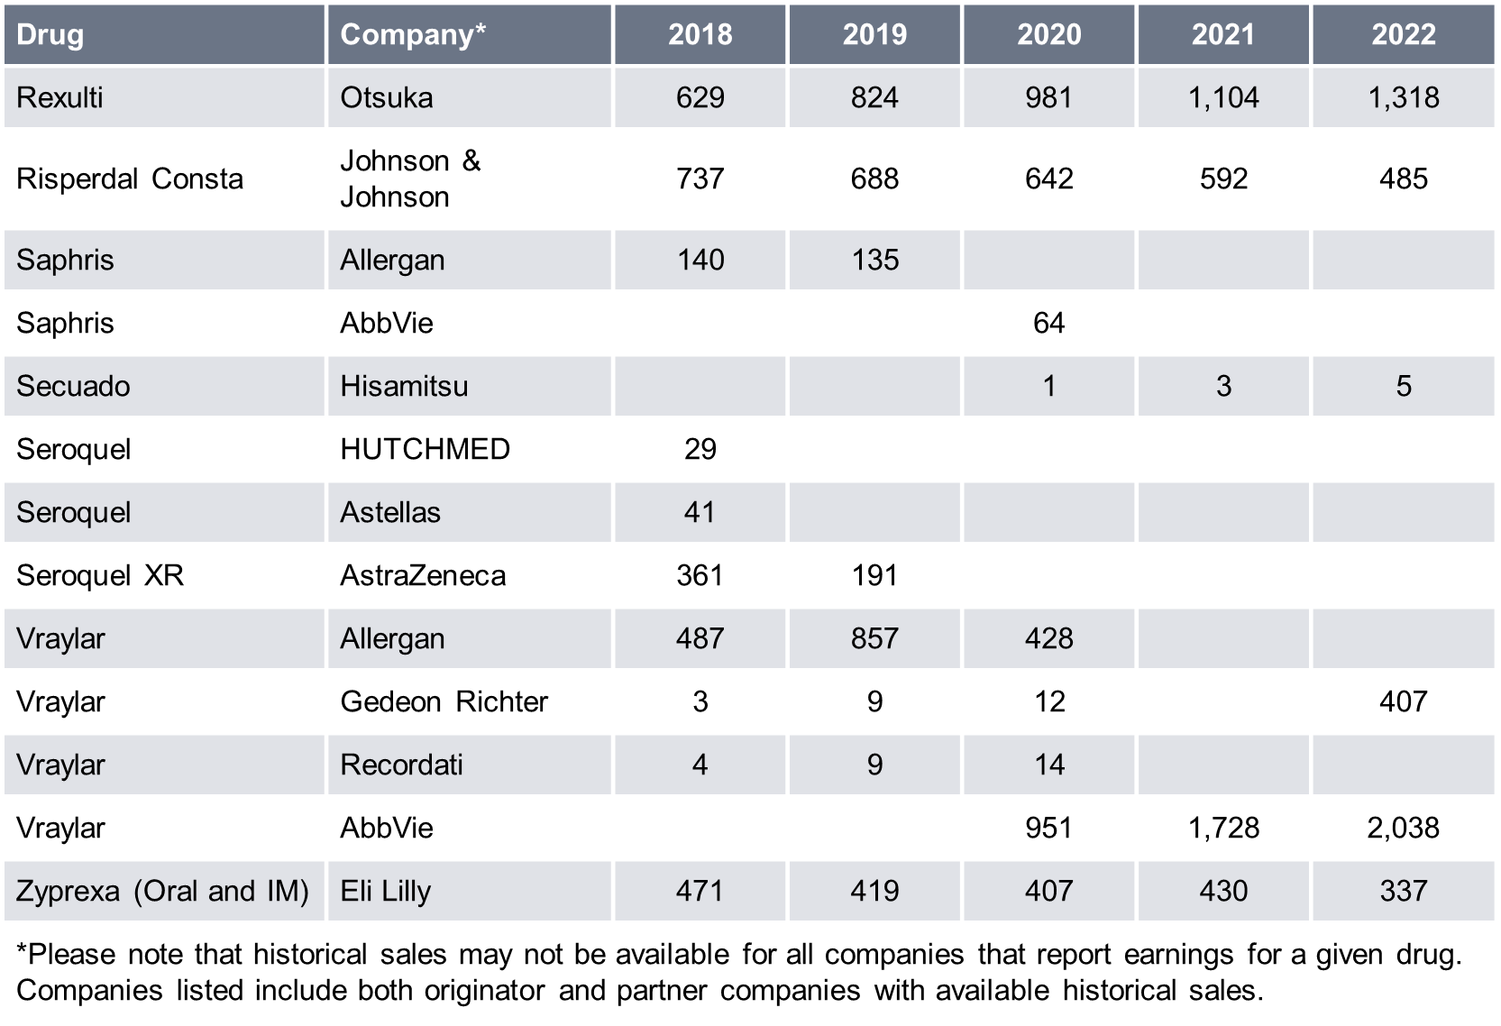
Consensus Forecasts
Historical
Global Sales
($m)
Please note: For disease-specific sales, please view our Patient-Based Forecast for Schizophrenia.
Source: Datamonitor Healthcare; Biomedtracker 15 January 2024

Slide 83
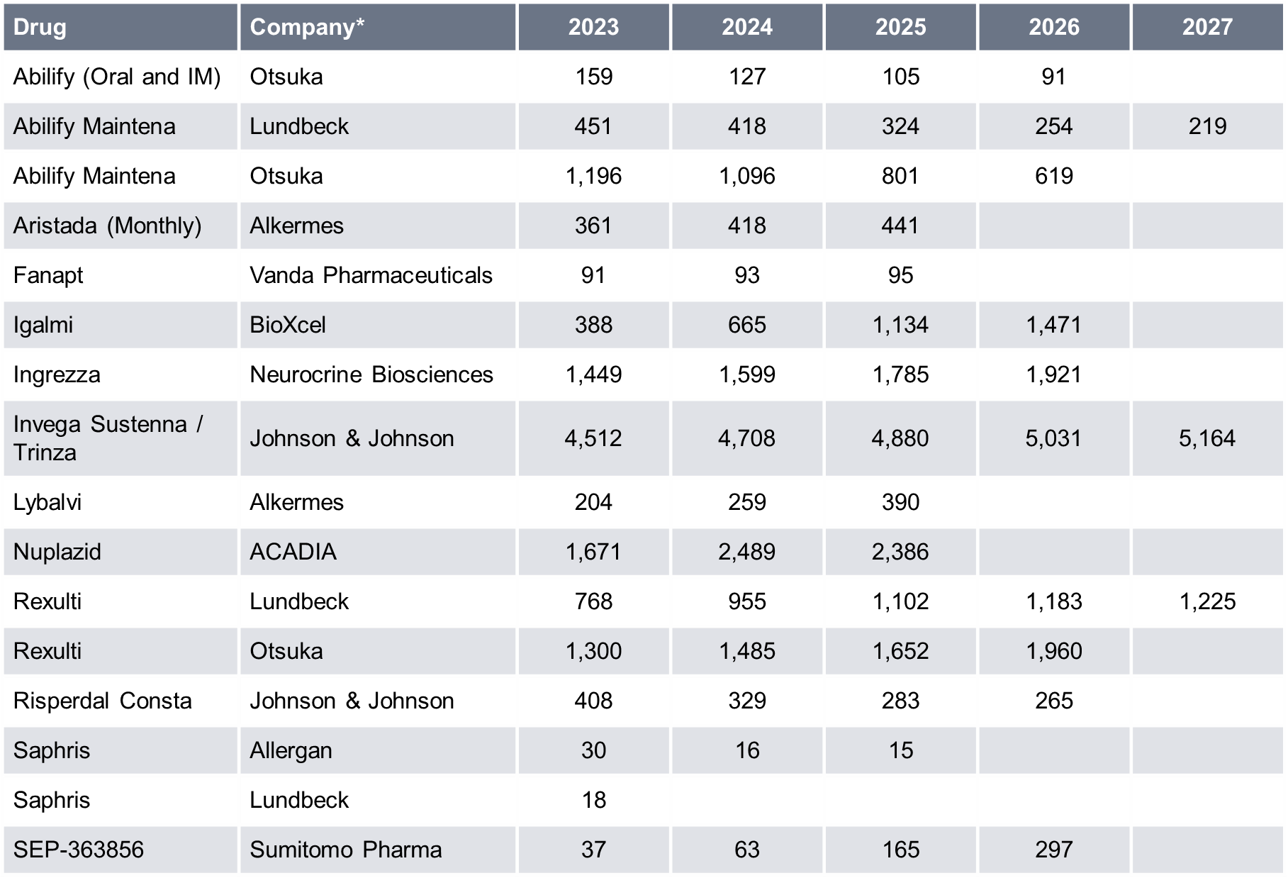
Consensus Forecasts
Forecasted
Global Sales
($m)
Forecasted
Global Sales
($m)
Source: Datamonitor Healthcare; Biomedtracker 15 January 2024

Slide 84
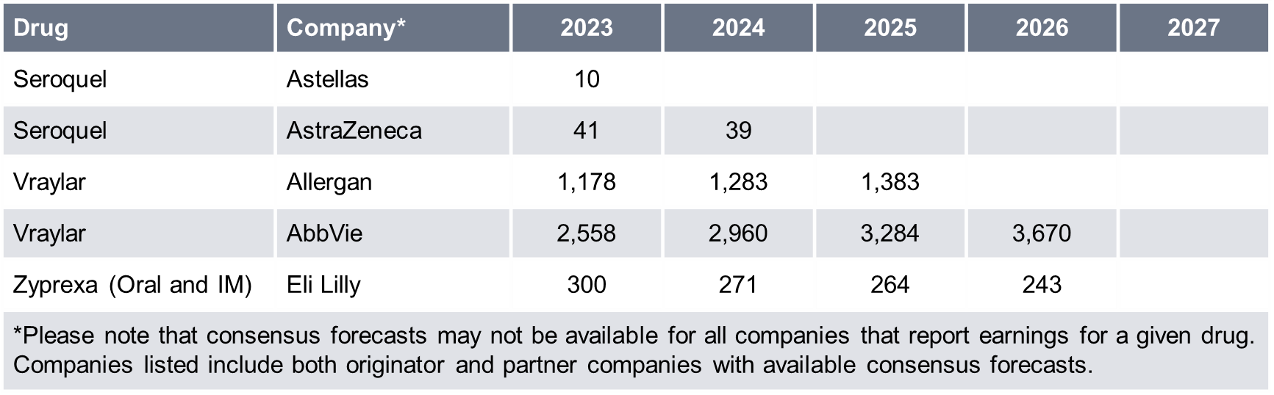
Consensus Forecasts
Forecasted
Global Sales
($m)
Please note: For disease-specific sales, please view our Patient-Based Forecast for Schizophrenia.
Source: Datamonitor Healthcare; Biomedtracker 15 January 2024

Slide 85
Recent Events and Analyst Opinion
This is a snapshot of high-impact events that have occurred in the last 18 months for drugs in the schizophrenia space in the curated Biomedtracker database. Analyst comments were provided by Pharma Intelligence’s global analyst team at the time of the event.
Brilaroxazine for Schizophrenia (October 30, 2023)
Event Type: | Trial Data - Top-Line Results
Trial Name: | Phase III - RECOVER
Lead Company: | Reviva Pharmaceuticals
Partner Companies: | N/A
Change to Likelihood of Approval: | 7%
Likelihood of Approval After Event: | 58% (7% above average)
Analyst Opinion
These are promising data for Reviva, with brilaroxazine meeting the primary endpoint and all secondary endpoints in the pivotal Phase III RECOVER study for adults with schizophrenia, while exhibiting a good tolerability profile. If approved, brilaroxazine will face competition from products on the market including various generics and Intra-Cellular’s Caplyta, as well as pipeline products such as Karuna’s KarXT, but, as these data support development going forward, we are increasing the LOA by 7%.
Brilaroxazine belongs to a class of third-generation antipsychotics called dopamine-serotonin system stabilizers. While targeting dopamine and serotonin receptor modulation is not a novel strategy in this indication (Abilify, Zyprexa, Risperdal, and Seroquel all target dopamine and serotonin receptors), Reviva aims for brilaroxazine to achieve a mix of modulation to drive strong efficacy while reducing the side effects associated with many marketed atypical antipsychotics.
In total, 412 patients with acute schizophrenia were enrolled in RECOVER, and brilaroxazine was administered at fixed doses of 15mg or 50mg once daily for 28 days. The 50mg dose achieved a statistically significant 10.1-point reduction on the Positive and Negative Syndrome Scale (PANSS) compared to placebo (-23.9 for brilaroxazine versus -13.8 for placebo) at week four, with a corresponding Cohen's d effect size of 0.6. Additionally, the 50mg dose met all the secondary endpoints at week four, including improvement on the PANSS negative symptoms subscale (2.0-point separation from placebo) and the PANSS positive symptoms subscale (2.8-point separation from placebo).
[continued on next slide]
Source: Biomedtracker 11 January 2024

Slide 86
Recent Events and Analyst Opinion
Analyst Opinion (continued)
The 15mg dose of brilaroxazine did not reach statistical significance on the primary endpoint but reached statistical significance on two key secondary endpoints.
In terms of safety and tolerability data, discontinuation rates in RECOVER were impressively low, which is an important outcome considering that discontinuation of antipsychotic medication is a serious problem when treating schizophrenia. The discontinuation rates in this trial were 22% for placebo, 19% for the 15mg arm, and 16% for the 50mg arm. Discontinuation rates due to side effects were 4% for placebo, 1% for the 15mg arm, and 0% for the 50mg arm. There was also no incidence of suicidal ideation and no significant change in body weight, blood glucose levels, lipid levels, or endocrine hormones as compared to placebo. Weight gain was slightly higher in the 50mg arm compared to placebo, with an increase of 5.9% compared to baseline versus a 2.9% increase for placebo. In the conference call, the investigator noted that enrolled patients received meals as part of the treatment regimen, which could have had an impact on weight considering that acutely ill schizophrenia patients are often malnourished and do not receive proper nutrition. We will pay particular attention to data regarding weight gain when results from the 52-week open-label extension trial are released in Q4 2024.
The RECOVER efficacy data are largely comparable to the prior Phase II study, although in the Phase II trial treatment with brilaroxazine led to statistically significant PANSS score improvements in both the 15mg and 50mg arms (but not the 30mg arm). In terms of safety comparisons, discontinuation rates in the Phase II trial were also lower for the treatment arms than for placebo; however, no increases in weight gain were observed versus placebo.
The PANSS results reported from RECOVER are in the range of what has historically been reported for atypical antipsychotics (at the upper end), and the safety profile thus far is stronger than the majority of atypical antipsychotics on the market. One drug that may take the edge in terms of tolerability is Intra-Cellular’s Caplyta, which has a very strong safety profile and does not cause weight gain or akathisia. Caplyta did, however, produce less impressive efficacy data in clinical trials compared to brilaroxazine, with reductions of 4.2–5.8 points on the PANSS scale compared to placebo. Of note, it is difficult to compare between trials, particularly as patients in the RECOVER study had higher baseline PANSS scores (corresponding to more severe illness at baseline) than in the studies assessing Caplyta.
[continued on next slide]
Source: Biomedtracker 11 January 2024

Slide 87
Recent Events and Analyst Opinion
Analyst Opinion (continued)
In terms of competition with other late-phase therapies in the schizophrenia pipeline, brilaroxazine indirectly competes with Karuna’s KarXT, Sunovion’s SEP-363856, and several others. KarXT and SEP-363856 are also being positioned as causing fewer side effects than marketed antipsychotics while maintaining strong efficacy. Both are more differentiated from marketed therapies than brilaroxazine is in terms of mechanism of action. Karuna’s Phase III studies demonstrated a PANSS reduction of 8.4–9.6 points, corresponding to a Cohen's d effect size of 0.6, comparable to the RECOVER trial, although these results were reported at week five as opposed to at week four. Data were also comparable to RECOVER regarding the PANSS positive and negative symptom subscales. KarXT is not associated with common problematic side effects of current treatments, including sedation (somnolence), weight gain, and extrapyramidal symptoms. The drug is ahead of brilaroxazine in developmental progress, with Karuna submitting an NDA to the FDA in September 2023.
Currently, brilaroxazine takes the edge over SEP-363856 in terms of efficacy. In the Phase II trial, SEP-363856 demonstrated a statistically significant 7.5-point reduction on the PANSS scale compared to placebo at four weeks. Although similar reductions were observed in the treatment arms in the Phase III trials, there was a strong placebo response which rendered the results statistically insignificant.
Reviva’s pivotal Phase III RECOVER-2 trial for acute schizophrenia is expected to be initiated in Q1 2024 and completed in early 2025. This trial is of similar design to RECOVER, with the same endpoints; however, it is six weeks long and includes a 30mg arm alongside the 50mg arm, instead of a 15mg arm. A longer trial will potentially give more chance for the treatment arm to separate from placebo as patients will pass through the acute exacerbation phase. Reviva plans to submit an NDA to the FDA in 2025.
Event detail in Biomedtracker: https://www.biomedtracker.com/EventDetail.cfm?EventID=498383
Source: Biomedtracker 11 January 2024

Slide 88
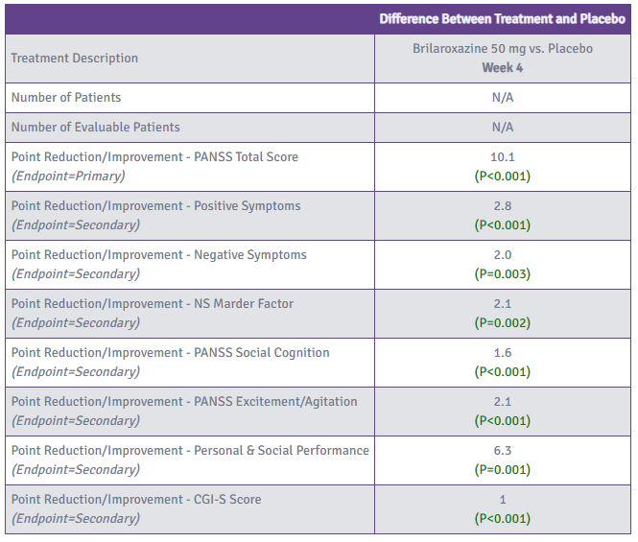
Recent Events and Analyst Opinion
Brilaroxazine for Schizophrenia (October 30, 2023): Phase III - RECOVER
Source: Biomedtracker 11 January 2024

Slide 89
Recent Events and Analyst Opinion
SEP-363856 for Schizophrenia (July 31, 2023)
Event Type: | Trial Data - Top-Line Results
Trial Name: | Phase III - DIAMOND 1, Phase III - DIAMOND 2
Lead Company: | Sumitomo Pharma
Partner Companies: | PsychoGenics
Change to Likelihood of Approval: | -2%
Likelihood of Approval After Event: | 52% (1% above average)
Analyst Opinion
Despite showing promising efficacy in its Phase II trial, SEP-363856’s failure in both pivotal Phase III schizophrenia trials will likely disrupt Sumitomo’s plans to submit an NDA for the drug in the remaining months of 2023. Based on these results, we are lowering the LOA by 2%.
SEP-363856’s novel mechanism of action, agonism at trace amine-associated receptor 1 (TAAR1), as well as Phase II results demonstrating a statistically significant reduction of 17.2 points on the PANSS scale compared to a 9.7-point score reduction in the placebo group at four weeks earned the drug a breakthrough therapy designation from the FDA in May 2019. Current results from DIAMOND 1 and DIAMOND 2 are markedly similar to these Phase II data: DIAMOND 1 showed decreases of 16.9 points and 19.6 points at 50mg/day and 75mg/day, respectively, and DIAMOND 2 had reductions of 16.4 points and 18.1 points in the 75mg/day and 100mg/day groups, respectively. The results for the upper dosage groups are just slightly lower than the recently released results for KarXT, another pipeline oral schizophrenia treatment, which demonstrated a 21.2-point reduction, with an 11.6-point decrease in the placebo group, at week 5 in the EMERGENT-2 study.
However, the placebo groups in these two SEP-363856 studies experienced surprisingly high PANSS score reductions, -19.3 points in DIAMOND 1 and -14.3 points in DIAMOND 2, rendering the treatment group results clinically insignificant. Intriguingly, this is not uncommon in clinical trials for patients with psychosis, as this group in particular is more likely to have an unusually high response to placebo treatments.
[continued on next slide]
Source: Biomedtracker 11 January 2024

Slide 90
Recent Events and Analyst Opinion
Analyst Opinion (continued)
Also notable is that DIAMOND 1 included adolescents aged 13 years and older as well as adults, while DIAMOND 2, where the placebo response was slightly less pronounced, was restricted to adults. Additionally, the COVID-19 pandemic may also have played a role in the placebo responses, something the FDA will likely consider when assessing the data.
Sumitomo has multiple other Phase III trials ongoing for SEP-363856, including a Phase III Japanese trial initiated in 2022 and an open-label extension study for DIAMOND 1 and 2. It will be interesting to see if subsequent studies, particularly the trial in Japan, report comparably high placebo effects. Given the numerical decreases in PANSS score in DIAMOND 1 and 2 and the positive Phase II data, Sumitomo is likely to continue pursuing an NDA for SEP-363856, especially if this large placebo response dwindles in other ongoing trials, although regulators may still wish to see another trial in light of these most recent failures.
Event detail in Biomedtracker: https://www.biomedtracker.com/EventDetail.cfm?EventID=488476
Source: Biomedtracker 11 January 2024

Slide 91
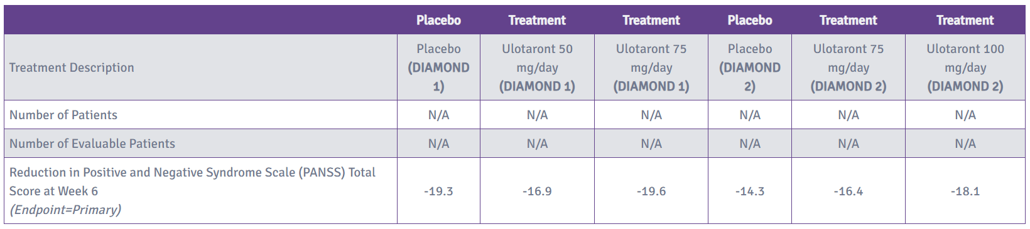
Recent Events and Analyst Opinion
SEP-363856 for Schizophrenia (July 31, 2023): Phase III - DIAMOND 1, Phase III - DIAMOND 2
Source: Biomedtracker 11 January 2024

Slide 92
Recent Events and Analyst Opinion
KarXT for Schizophrenia (March 20, 2023)
Event Type: | Trial Data - Top-Line Results
Trial Name: | Phase III - EMERGENT-3
Lead Company: | Karuna Therapeutics
Partner Companies: | PureTech Health / Zai Lab
Change to Likelihood of Approval: | 4%
Likelihood of Approval After Event: | 71% (20% above average)
Analyst Opinion
This is the third positive registrational trial in Karuna’s EMERGENT program, with KarXT meeting the primary endpoint, and a secondary endpoint, when assessed in schizophrenia patients with psychosis. In contrast to previous studies EMERGENT-1 and EMERGENT-2, KarXT missed the negative symptom endpoint; however, this should not impact its potential for approval in the broader schizophrenia indication. We are consequently increasing the LOA by a further 4%.
The design of this study was nearly identical to the design of EMERGENT-2. In all, 256 patients were randomized to receive either a flexible dose of KarXT or placebo two times a day for five weeks. A total of 79% of patients on KarXT, compared to 91% on placebo, opted to titrate to the highest dose level (125mg xanomeline/30mg trospium) on day eight.
The efficacy results from this trial were largely consistent with previous studies. Regarding the primary endpoint, EMERGENT-3 produced an 8.4-point reduction on the Positive and Negative Syndrome Scale (PANSS) total score for KarXT versus placebo at week five (p<0.0001). This is slightly lower than the 9.6-point reduction seen in EMERGENT-2 and the 11.6-point reduction observed in EMERGENT-1. The Cohen’s d effect sizes, however, were comparable between EMERGENT-2 and EMERGENT-3, at 0.61 and 0.60, respectively. These effect sizes are highly clinically meaningful and supportive of a change to the treatment paradigm. On the secondary endpoint, KarXT treatment led to a 3.5-point reduction in scores on the PANSS positive subscale compared to placebo at week five (p<0.0001).
This was higher than the 2.9-point reduction observed in EMERGENT-2 and the 3.2-point reduction observed in EMERGENT-1. Notably, KarXT showed a rapid onset of action, with statistically significant effects observed as early as week two, with a trend towards separation at week one.
[continued on next slide]
Source: Biomedtracker 11 January 2024

Slide 93
Recent Events and Analyst Opinion
Analyst Opinion (continued)
This is comparable to the previous studies, and an important differentiating factor for the drug since current therapies take much longer, often 3–4 weeks, to show clinical improvement.
Unfortunately, KarXT did not meet statistical significance regarding a reduction on the PANSS negative subscale at week five (p=0.12), but it did demonstrate a statistically significant reduction in PANSS negative subscale scores (and PANSS negative Marder factor subscale scores) compared to placebo at week four. The treatment arm showed a favorable trend in negative symptom reduction (even beyond week four), consistent with previous studies, and the endpoint miss at week five seems to have been due to variations in the placebo arm.
In terms of safety, the discontinuation rate for the treatment arm was higher than in EMERGENT-2 (37% versus 25%); however, discontinuation rates in the placebo arm were also higher (29% versus 21%). Discontinuations due to treatment-emergent adverse events (6% for KarXT and 5% for placebo) were comparable to EMERGENT-2 (7% for KarXT and 6% for placebo). These rates are consistent with trials for other atypical antipsychotics and should not have a negative impact on the drug’s potential.
A key potential competitor for KarXT is Cerevel’s Phase III asset emraclidine, which has a similar novel mode of action targeting the muscarinic acetylcholine receptor. KarXT is further ahead in development, however, and will likely have the first-to-market advantage. Little data have been released from emraclidine trials thus far, except for from a small Phase Ib study. Data from this Phase Ib study were comparable to those from KarXT trials, with reductions of 11.1, 11.9, and 12.7 points in PANSS total scores for the three doses tested. Of note, these scores were reported at week six, as opposed to week five in the EMERGENT studies.
Following the positive EMERGENT-3 readout, Karuna stated that it is on track to submit an NDA for KarXT in schizophrenia in mid-2023, with a potential launch in the second half of 2024, if approved. We also eagerly await the long-term efficacy and safety data from the EMERGENT-4 and EMERGENT-5 studies. The EMERGENT-4 trial is ongoing, while the EMERGENT-5 trial is currently enrolling. Beyond the EMERGENT studies, Karuna views KarXT to have potential as an adjunctive therapeutic for schizophrenia patients with inadequately controlled symptoms. This is being assessed in the Phase III ARISE trial. The drug is also being evaluated for the treatment of psychosis associated with Alzheimer’s disease dementia in the Phase III ADEPT-1, ADEPT-2, and ADEPT-3 trials.
Event detail in Biomedtracker: https://www.biomedtracker.com/EventDetail.cfm?EventID=473093
Source: Biomedtracker 11 January 2024

Slide 94
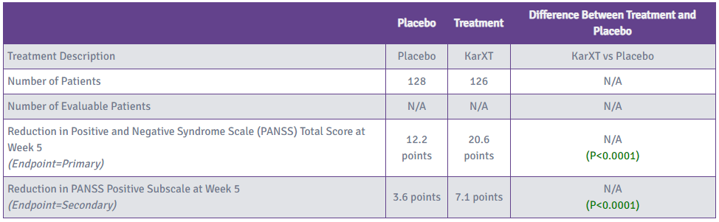
Recent Events and Analyst Opinion
KarXT for Schizophrenia (March 20, 2023): Phase III - EMERGENT-3
Source: Biomedtracker 11 January 2024

Slide 95
Recent Events and Analyst Opinion
MIN-101 (Minerva) for Schizophrenia (October 14, 2022)
Event Type: | Regulatory - Refuse to File Letter
Trial Name: | N/A
Lead Company: | Minerva Neurosciences
Partner Companies: | Mitsubishi Tanabe
Change to Likelihood of Approval: | -41%
Likelihood of Approval After Event: | 46% (5% below average)
Analyst Opinion
This refuse to file letter does not come as much of a shock considering prior warnings from the FDA, although investigators would have hoped that the deficit of approved drugs for negative symptoms would work in Minerva’s favor. The company intends to request a Type A meeting to discuss this with the FDA, but it is now more certain that further trials will be needed for the drug to progress. We are returning the drug to Phase III and also decreasing the LOA by a further 1%.
In two prior Type C meetings with the FDA, the regulatory body expressed dissatisfaction with the proposed data. Concerns involved the potential impact of MIN-101 on the efficacy and safety of antipsychotic drugs, the applicability of non-US patients in the Phase IIb study (conducted in Europe) to the US population, whether the subgroup analysis of the Phase III trial is sufficient evidence of efficacy, and the ability of clinicians to identify patients who might benefit from MIN-101. As the drug would likely be used as an adjunctive therapy initially while clinicians gain experience with the product, the lack of data regarding MIN-101’s interactions with other antipsychotics is of particular concern.
Event detail in Biomedtracker: https://www.biomedtracker.com/EventDetail.cfm?EventID=457199
Source: Biomedtracker 11 January 2024

Slide 96
Recent Events and Analyst Opinion
KarXT for Schizophrenia (August 8, 2022)
Event Type: | Trial Data - Top-Line Results
Trial Name: | Phase III - EMERGENT-2
Lead Company: | Karuna Therapeutics
Partner Companies: | PureTech Health / Zai Lab
Change to Likelihood of Approval: | 10%
Likelihood of Approval After Event: | 67% (16% above average)
Analyst Opinion
This is the first encouraging news from an anti-tau antibody in Alzheimer’s disease to Considering the positive efficacy and safety results from this pivotal Phase III trial (which follow the promising pivotal Phase II data release in 2019), as well as KarXT’s potential to serve the negative symptom domain, for which there are currently no approved treatments, we are increasing the drug's LOA in schizophrenia by 10%.
These new data are an exciting development for Karuna Therapeutics, with its novel drug KarXT (a formulation of xanomeline and trospium) meeting the primary endpoint in the EMERGENT-2 trial, which enrolled 252 adults with schizophrenia and symptoms of psychosis. Dosed twice daily, KarXT demonstrated a statistically significant 9.6-point reduction in Positive and Negative Syndrome Scale (PANSS) scores compared to placebo (p<0.0001) at week five. Statistically significant reductions in the secondary endpoints of PANSS-Positive and PANSS-Negative scores were also observed (-2.9 and -1.8 points, respectively). Patients treated with KarXT largely avoided the problematic side effects associated with current therapies, such as weight gain, sedation, and movement disorders. Rates of patient discontinuation and treatment-emergent adverse events (TEAEs) were similar between the treatment and placebo arms. Good tolerability was evident from the 81% of treated patients who opted to titrate to the highest dose level by the end of the study (xanomeline 125mg/trospium 30mg), compared to 90% on placebo.
These efficacy and safety data are consistent with those from the Phase II EMERGENT-1 trial, the company’s first registrational trial, which assessed acutely psychotic patients with schizophrenia. The efficacy differences between placebo and treatment were slightly higher in Phase II, with KarXT demonstrating a statistically significant 11.6-point mean reduction in total PANSS score compared to placebo (p<0.0001) at week five.
[continued on next slide]
Source: Biomedtracker 11 January 2024

Slide 97
Recent Events and Analyst Opinion
Analyst Opinion (continued)
The individual PANSS-Positive and PANSS-Negative scores followed a similar trend, with 3.2-point and 2.3-point reductions over placebo, respectively. Furthermore, 91% of KarXT-treated patients escalated to the highest dose, which was similar to the escalation rate with placebo.
The combination of xanomeline, a novel muscarinic agonist, with trospium, an approved (outside of schizophrenia) muscarinic antagonist, provides a differentiated mode of action compared to approved antipsychotics, which typically target D2 dopamine and 5HT-2A serotonin receptors. Xanomeline alone has been shown to reduce psychosis and improve cognition, but its advancement in trials has been limited by tolerability issues, a result of stimulation of muscarinic receptors in peripheral tissues. Trospium inhibits all five muscarinic receptor subtypes in peripheral tissues. Investigators believe that the drug combination has the potential to preferentially stimulate M1 and M4 muscarinic receptors in the brain without stimulating muscarinic receptors in peripheral tissues, to achieve meaningful therapeutic benefits in patients while avoiding cholinergic adverse events. The results so far have been supportive of this theory.
Its unique mode of action means KarXT does not directly compete with any approved or pipeline therapies and has the potential to become the first of its class. A main drawback is its twice-daily administration, which is more inconvenient than available antipsychotics with once-daily or longer dosing schedules. Sumitomo Dainippon's investigational drug SEP-363856, dosed once daily, will potentially be its biggest indirect competitor as a first-in-class trace amine-associated receptor 1 (TAAR1) agonist. The drug is being studied for schizophrenia and Parkinson's disease psychosis. In the Phase II study, SEP-363856 significantly reduced total PANSS scores by 7.5 points, PANSS-Positive scores by 1.6 points, and PANSS-Negative scores by 1.5 points compared to placebo. These differences are smaller than those observed with KarXT, albeit scores were recorded after four weeks rather than five. Safety findings were, however, positive compared to those from EMERGENT-2, with rates of TEAEs and discontinuation similar to placebo.
The FDA is willing to count the Phase II EMERGENT-1 trial as pivotal, so with these new Phase III results, Karuna has sufficient data to submit an NDA for KarXT as a treatment for psychosis in schizophrenia. The company plans to submit an NDA to the FDA in mid-2023, once further Phase III data have been gathered from long-term safety and tolerability trials, EMERGENT-4 and EMERGENT-5. The Phase III EMERGENT-3 trial, of similar design to EMERGENT-2, is also under way, with results expected in Q1 2023. Additionally, a fourth trial, ARISE, is evaluating the safety and efficacy of KarXT as an adjunctive treatment in adults who have an inadequate response to their current antipsychotic therapy, which is likely to be more reflective of how the drug would be used in the real world, if approved. KarXT is also in development for psychosis in Alzheimer’s disease.
Event detail in Biomedtracker: https://www.biomedtracker.com/EventDetail.cfm?EventID=449851
Source: Biomedtracker 11 January 2024

Slide 98
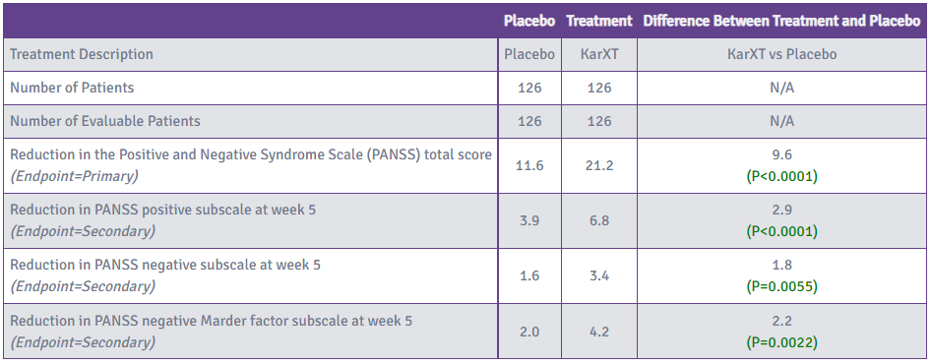
Recent Events and Analyst Opinion
KarXT for Schizophrenia (August 8, 2022): Phase III - EMERGENT-2
Source: Biomedtracker 11 January 2024

Slide 99
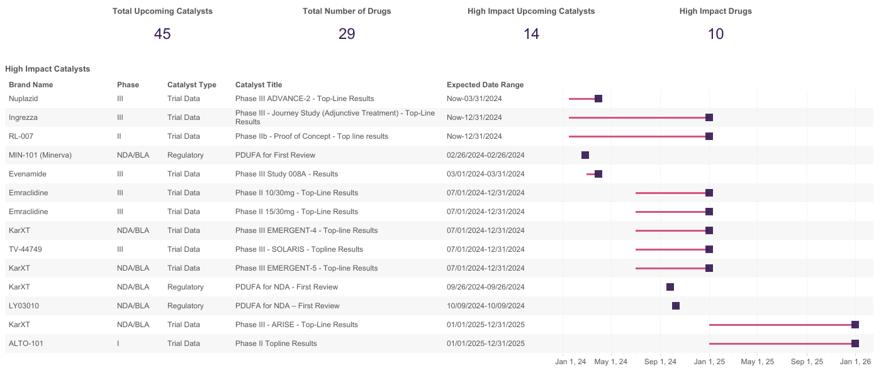
Key Upcoming Events
This is a snapshot of key upcoming events for drugs in the schizophrenia space in the curated Biomedtracker database. A number of high-impact upcoming events for schizophrenia drugs are expected during 2024, including Phase III trial data for KarXT and Nuplazid, and US approval decisions for KarXT and MIN-101. Preclinical, Investigator Initiated, and IND candidates are not included here.
To view more details on upcoming catalysts on Biomedtracker, click here.
Source: Biomedtracker 15 January 2024

Slide 100
Key Opinion Leader Insights
This is a snapshot of quotes from KOLs interviewed by our analysts. Full transcripts of interviews are available through a Biomedtracker subscription, or for single-copy purchase through the Report Store.
Physicians will prescribe generic drugs initially before moving on to branded medicines and/or polypharmacy for stable patients or those struggling with tolerability/efficacy
“We always start with monotherapy, it’s either/or, you don’t combine from the beginning, polypharmacy happens later in the patient’s treatment if they fail to respond adequately to one drug.” – US key opinion leader
“We use a lot of generics at first, insurance companies will push towards generics, and if patients are on Medicaid or any limited insurance coverage, or a state health insurance plan, they will start with generics. We don’t start with branded.” – US key opinion leader
“If they’re doing well on olanzapine without side effects, they continue olanzapine. If they start developing metabolic side effects, and weight gain, then they are switched to something else with a better metabolic profile, and we have options now, generics as well, things like ziprasidone, or aripiprazole, or more recently Latuda became generic, which is lurasidone.” – US key opinion leader
“I would say, barring individual circumstances, in the hospital I would use a fair amount of olanzapine because it acts quickly. Certainly, a fair amount of Risperdal and Abilify, particularly in people who I’m considering might be candidates for long-acting injectable. Those are going to be the workhorses. There’s going to be some Seroquel, and certainly some Latuda mixed in there, but those I’m sure would be my top three.” – US key opinion leader
“Stable phase patients are going to get a lot less of the olanzapine. So, in my stable phase patients there’s going to be a lot more Abilify, a lot more of the branded medicines as well like Vraylar, Caplyta. Actually, if I just back up and say my patient population that I treat specifically in the outpatient world is kind of bimodal, so 20% of my patients take clozapine as well.” – US key opinion leader
“Well, I prescribe nearly all available drugs in Germany for treating schizophrenia patients. That means that I use aripiprazole; clozapine; risperidone; paliperidone, which is quite associated with risperidone; olanzapine; haloperidol; cariprazine; amisulpride; quetiapine, but not primarily to treat positive symptoms, I use it more often in the context of depression, but very often in the context of bipolar depression. I use ziprasidone, but not very often, and I think that’s all.” – EU key opinion leader
Source: Datamonitor Healthcare

Slide 101
Key Opinion Leader Insights
Antipsychotics still fall short in various areas of schizophrenia treatment
“I do not know. I think that drugs are a long way off. So, I think they are not bad for positive symptoms, but they could do that better, and I think they could be easier for patients to take long term so that they are then better to keep people well, and I think that they do not have the benefits in these things that you are talking about, negative symptoms and cognitive impairment, and mood symptoms as well, and that is why what we see is chronic functional impairment in our patients. If we had something that improved function then that would be great. So, if I can have one answer, it is a drug that has a long-term beneficial effect on global function.” – EU key opinion leader
While patients may be slow to accept LAIs, KOLs would like to increase adoption
“Yes, I like long-acting injectables because I like to know that my patients have taken the drug, I think there is less likelihood of them missing doses obviously, and I know it is stocked. I think that therefore they are more effective, and help people to stay well. Some patients do not like them, the idea of having injections, and they are happy with tablets. The injections can seem somehow bigger, more of a treatment somehow, and patients do not like that, but I do.” – EU key opinion leader
“…They offer some tremendous advantages, and I think patients are reluctant to use them, and I think that doctors – and I do not put myself in this frame because I do like them, I do push them, but doctors are slower to use them, and slower to encourage patients to take them, and we should do because I think they make a definite difference to patient outcomes…” – EU key opinion leader
“…I think that there is a strong stigma about injectables, I think that also there is a reduced set of choices, many drugs have not been available as injectables, and I think that that conversation is just not had as often as it should be, you know, that simple conversation of would you rather take this long-acting form, I do not think we ask our patients that enough.” – EU key opinion leader
Source: Datamonitor Healthcare

Slide 102
Unmet Needs
Throughout the modern history of schizophrenia drug development, the majority of antipsychotics developed have been based on the schizophrenia dopamine hypothesis, with additional emphasis on serotonergic pathways. Although these agents have provided relief for acute and chronic schizophrenia patients alike, the etiology and pathophysiology of the disease are still poorly understood. The current repertoire of antipsychotics is reported to be effective in alleviating the positive symptoms associated with the disorder in a large portion of the clinical trial patient population, though this is not always the case in the real world, and effective treatments for other symptom domains are widely acknowledged as lacking. According to the literature and our proprietary primary research, the greatest unmet needs in the treatment of schizophrenia include the following.
Drugs that effectively treat the negative symptoms of schizophrenia
Currently, there is no standard treatment for negative symptoms, even though they are core to schizophrenia symptomatology. Negative symptoms may present throughout the disease course and contribute extensively to overall disease burden. Some examples of negative symptoms include alogia, flat affect, anhedonia, and avolition, and negative symptoms generally present in most schizophrenia patients at some point. Although increasing numbers of pipeline drugs are in development for the negative symptoms of schizophrenia, none are currently approved, and this aspect therefore remains as potentially the largest void in the disease area.
“Negative symptom studies are fraught with peril, they’re really, really hard to accomplish, because if you have patients who are negative enough, they don’t want to be in the trial.” – US key opinion leader
Improved options for treatment-resistant schizophrenia
Treatment-resistant schizophrenia is thought to occur in approximately 30% of all diagnosed individuals with schizophrenia, and this amounts to a large global population of schizophrenia patients who are unresponsive to most currently available therapies. Various health authorities recommend clozapine as an option for this patient segment, and while effective in mediating a response in patients, the drug is associated with several severe adverse effects and still remains ineffective for many patients.
Source: Datamonitor Healthcare; Skipta; Brisch et al., 2014; Fellner, 2017; Greene et al., 2018

Slide 103
Unmet Needs
Drugs with enhanced tolerability profiles
While second-generation atypical antipsychotics have partially improved upon the tolerability of first-generation typical antipsychotics, currently available antipsychotics still possess diverse side-effect profiles and are associated with burdensome motor, metabolic, hormonal, and cardiovascular adverse effects. Poor side-effect profiles of schizophrenia drugs lead to damaging consequences. Patients may respond to the burden of adverse effects and long-term monitoring of side effects by lowering their compliance or even discontinuing treatment. In turn, this negatively impacts treatment outcomes.
“Unmet needs in both groups [bipolar and schizophrenia] are medications with low metabolic risk, and in schizophrenia, lower risk of tardive dyskinesia.” – US physician
Treatments targeting the cognitive deficits associated with schizophrenia
Like negative symptoms, cognitive symptoms of schizophrenia contribute to the significant disability caused by the disease, with no currently marketed antipsychotics available for treating these deficits. Examples of cognitive symptoms include problems in executive function, attention, and working memory. Cognitive impairment from the disease is an especially important area as such troubles may persist while other symptoms have been alleviated and hinder patients’ reintegration into society. Few current pipeline programs are targeting this aspect of the disease.
“The most pressing unmet need is to further improve the cognitive deficits and negative symptoms. 60% of patients may show improvement in their negative symptoms, but only 30% in their cognitive deficits. So, improvement of cognitive deficits is an even a bigger unmet need than negative symptoms. We also have another major unmet need, and that is the treatment of treatment-refractory schizophrenia patients, or TRS, because we don’t have any drugs, except for clozapine, that are approved or have this indication.” – US key opinion leader
Source: Datamonitor Healthcare; Skipta; Brisch et al., 2014; Fellner, 2017; Greene et al., 2018

Slide 104
Unmet Needs
Drugs that address non-compliance
Despite the growing LAI antipsychotic market, there is still a widely perceived unmet need for therapy options to ameliorate compliance levels. The longer dosing schedules of LAI antipsychotics support higher compliance rates and lower discontinuation rates compared to oral drugs; however, LAIs have been underutilized in the clinical setting. Uptake has increased and is likely to do so further as physicians and patients become more familiar with their dosing regimens and schedules. There are disadvantages to LAIs, however, which explains why non-compliance is still regarded as an important unmet need. Some of these disadvantages include slower dose titrations, less flexibility of dose adjustment, the burden of administration in a healthcare setting, and a longer time to achieve steady state levels.
“Non-compliance can be debilitating. Non-compliance can increase risk of TD [tardive dyskinesia], relapse, rehospitalization, ER visits, time to restabilize…” – US physician
Source: Datamonitor Healthcare; Skipta; Brisch et al., 2014; Fellner, 2017; Greene et al., 2018

Slide 105
Bibliography
APA, 2013
APA, 2020
Brisch et al., 2014
Dryden-Edwards, 2018
Fellner, 2017
Gatt et al., 2015
Giegling et al., 2017
Greene et al., 2018
Leucht et al., 2012
NAMI, 2023
NHS, 2023
NICE, 2014
Patel et al., 2014
Pelayo-Terán et al., 2012
Radhakrishnan et al., 2017
Rolls et al., 2017
SIGN, 2013
Simeone et al., 2015
United Nations, 2019
WHO, 2022

Slide 106
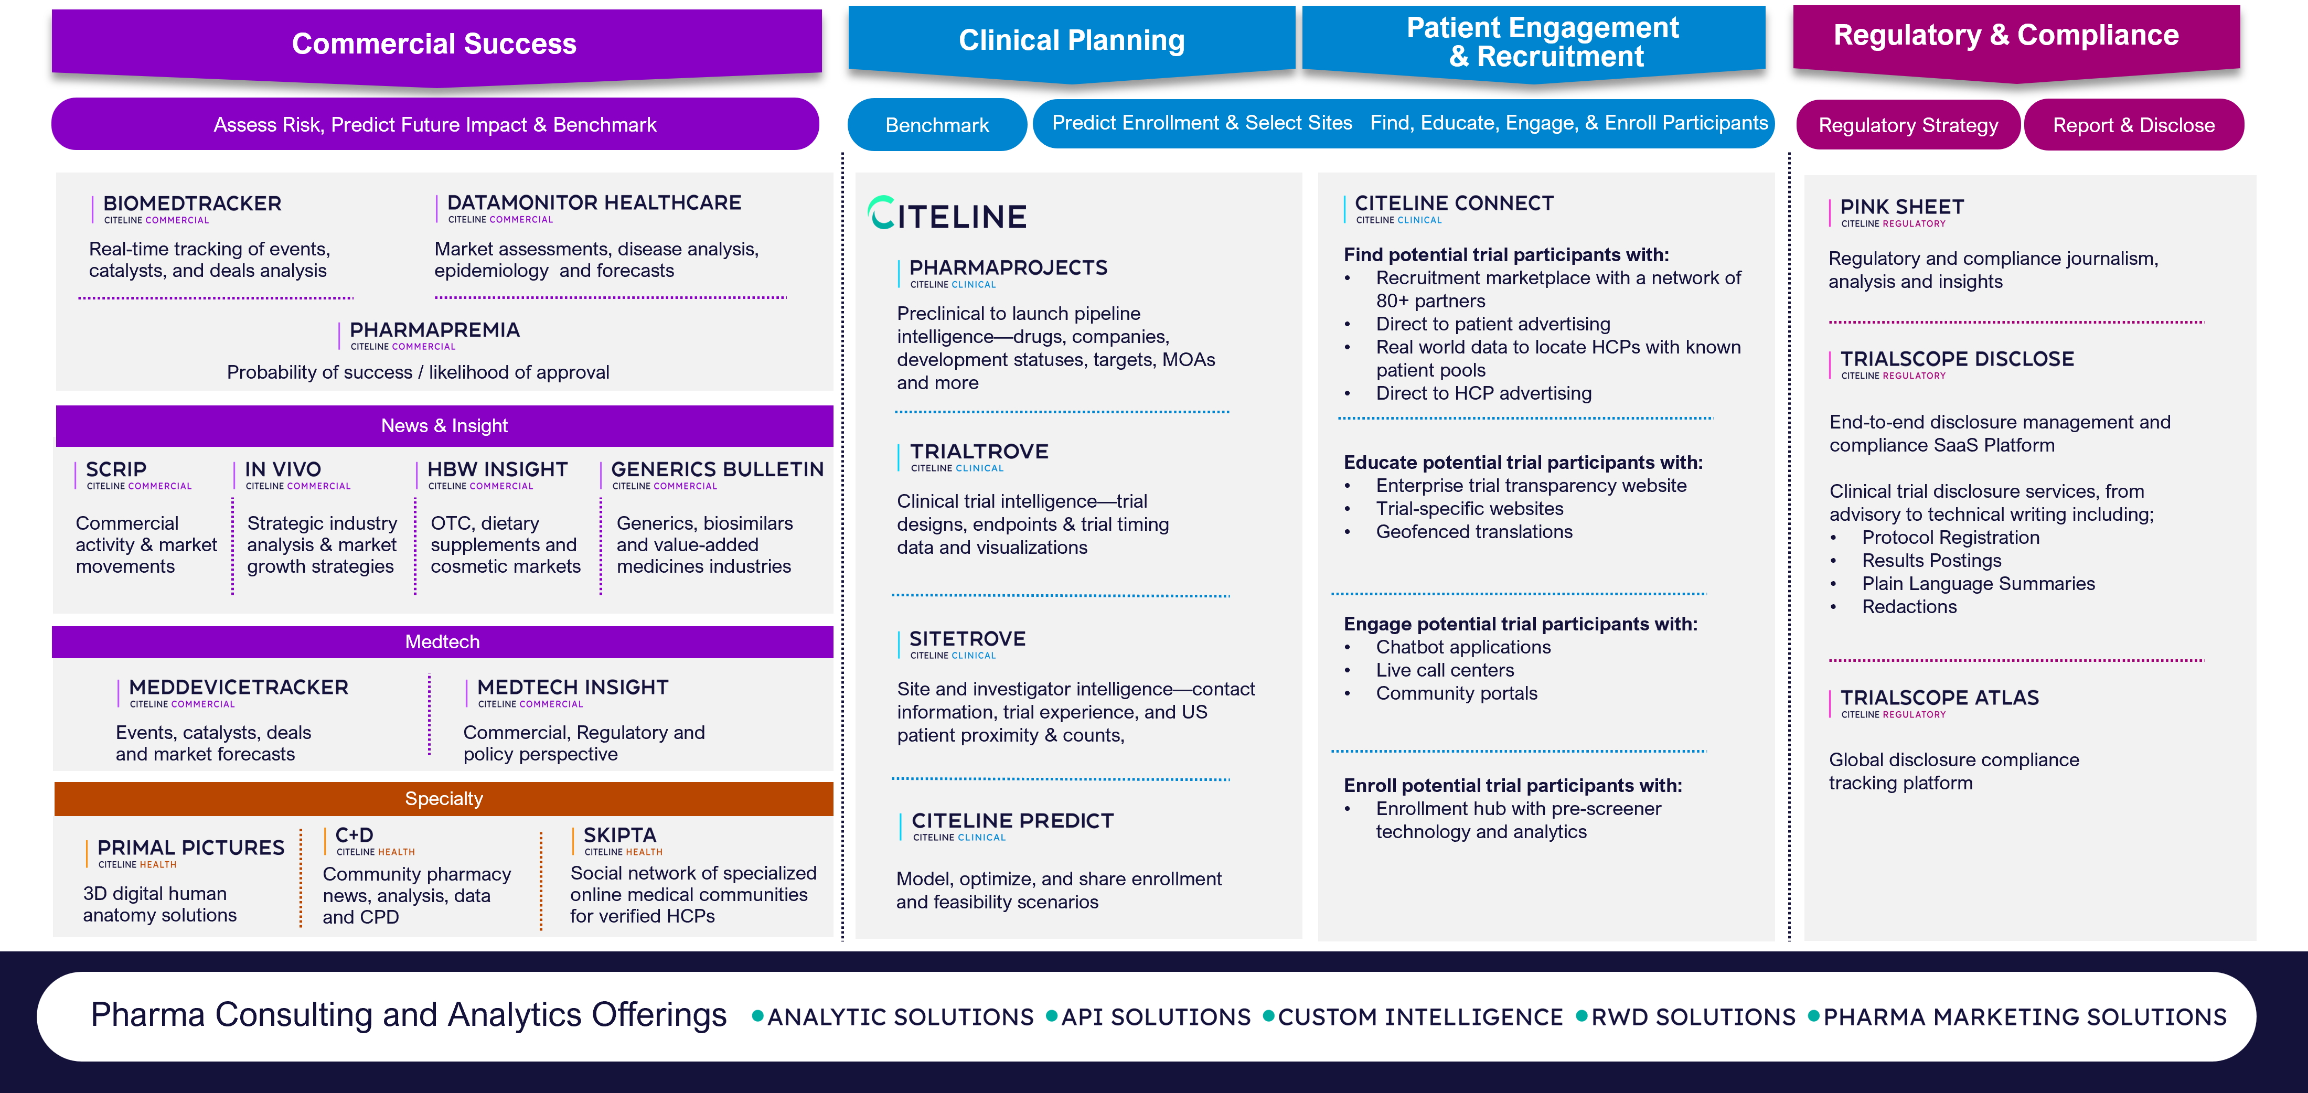
Citeline Portfolio

Slide 107
Appendix
Relying on Pharma Intelligence to deliver vital advantage when making critical R&D and commercial decisions, our customers come from over 3,000 of the world’s leading pharmaceutical companies, contract research organizations (CROs), and medical technology, biotechnology, and healthcare service providers, including top 10 global pharma companies.
From drug and device discovery and development to regulatory approval, and from product launch to lifecycle management, we provide the intelligence and insight to help our customers seize opportunities, mitigate risk, and make business-critical decisions, faster.
As the pharma and healthcare sector faces unparalleled upheaval, customers rely on our independent advice, enabling them to cut through the clutter and make sense of changing drug developments, as well as regulatory and competitive landscapes.
From early-phase and portfolio decisions to clinical R&D and commercial planning and analysis, our offering includes a suite of complementary subscription news, data, and analysis services, as well as expert analyst reports and consulting capabilities from the world’s leading pharma and healthcare R&D and business intelligence brands.
For more information, visit https://www.citeline.com/.

Slide 108
Disclaimer
Copyright © 2024 Pharma Intelligence
This report is published by Pharma Intelligence (the Publisher). This report contains information from reputable sources and although reasonable efforts have been made to publish accurate information, you assume sole responsibility for the selection, suitability and use of this report and acknowledge that the Publisher makes no warranties (either express or implied) as to, nor accepts liability for, the accuracy or fitness for a particular purpose of the information or advice contained herein. The Publisher wishes to make it clear that any views or opinions expressed in this report by individual authors or contributors are their personal views and opinions and do not necessarily reflect the views/opinions of the Publisher.

